Slide 1
MPRO Crunch Off October 2021
MPRO States: ND, SD, KS, NE, MO, CO, WY, MT

Slide 2
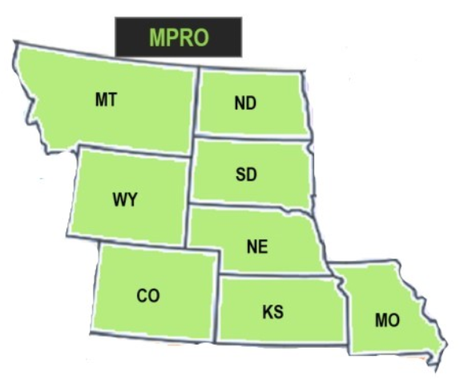
What & When is the Crunch Off?
To celebrate Farm to School Month (October), the Mountain Plains Region States hold a friendly competition to see which State can get the most “crunches” into a local apple, or other local produce, per capita.
OCTOBER 21, 2021
Crunch Off participants bite into a local produce together (virtually or in-person) to celebrate the wonderful fruits and veggies grown in the Mountain Plains Region.
community members
local food enthusiasts
students
teachers
farmers
parents

Slide 3
Why & How to Participate
Crunch Off events:
Encourage healthy eating
Support local agriculture
Celebrating Farm to School Month
Highlight community strength gained from farmer-school partnerships
To get more information, and get your team ready to crunch off versus other states in the region, contact:
Sarah Smith: sarah.e.smith@nebraska.gov
Marla Kurtenbach: marla.kurtenbach@nebraska.gov

