Slide 1
MyACT Workshop
Introduction to the MyACT system
with Iris Owens, Nebraska ACT Liaison
Notes:
Welcome to the MyACT Workshop for Nebraska State Testing. My name is Iris Owens and I am the ACT Liaison with the Nebraska Department of Education. There are a couple of housekeeping notes before we begin the presentation.
This workshop will be recorded and posted on the NDE NSCAS ACT webpage as well as this Power Point slideshow. Please provide your questions in the chat and we will answer them during the Question and Answer portion of this workshop. I want to thank you for taking time out of your very busy schedules to join me as I discuss the ins and outs of MyACT.

Slide 2
Ne
Notes:
MyACT was created to provide a place for students and parents to register for tests and easily access the ACT score reports. In the past ACT has had some difficulties with National scores and State scores being in separate accounts. This was not optimal for the test examinees, so MyACT was created. I want to be sure to provide you with information and resources to assist your students with creating accounts. As you can see in this screenshot, MyACT is a new system and replaces the previous national registration system.

Slide 3
Notes:
Information from ACT will be sent with your State test materials in the next few weeks, if you have not already received materials. I will cover the materials being sent later in this presentation and other important resources for your convenience.

Slide 4
Notes:
The steps to creating an account are fairly straightforward. Log into myact.org, select continue. If a student has registered for a National test in the previous system, but has not created an account in MyACT they will need to select the “I’m new!” button and create a new account. If they have registered in MyACT for a test or created an account, they will need to select the “I registered or tested before” button.

Slide 5
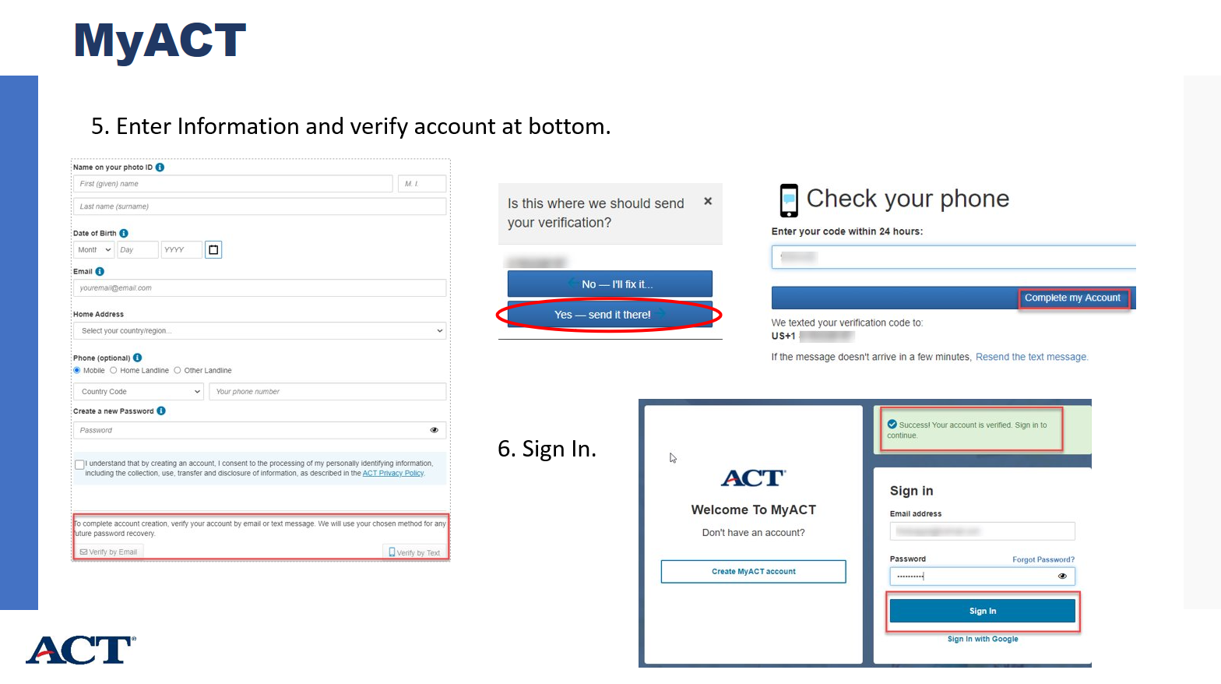
Notes:
When creating the account, either an email address or phone number will be needed for system verification. The questions other than the demographic questions in MyACT are optional. The general information will provide access to test scores and an opportunity to request any additional score reports at a cost. The questions cover things like student demographics, high school coursework, grades, and the interest inventory that can assist students to future college and career paths.

Slide 6
Notes:
Once the account is created, the student code on the student Non-Test Instructions will be entered in the “Enter Student Code” box. There are 4 sections to complete, only the Demographic information is required.

Slide 7
Notes:
I want to make note of the new Answer Document and the non-test information that is required. Please note, that blocks A, B, C, D, E, F, G are mandatory and block K is for the ACT High School code and can be completed if necessary.

Slide 8
Notes:
If you need to know if a student has completed the creation of an account, the Student Code Usage Status report may be helpful. This report is located in PA Next under Published reports in both school and district accounts.

Slide 9
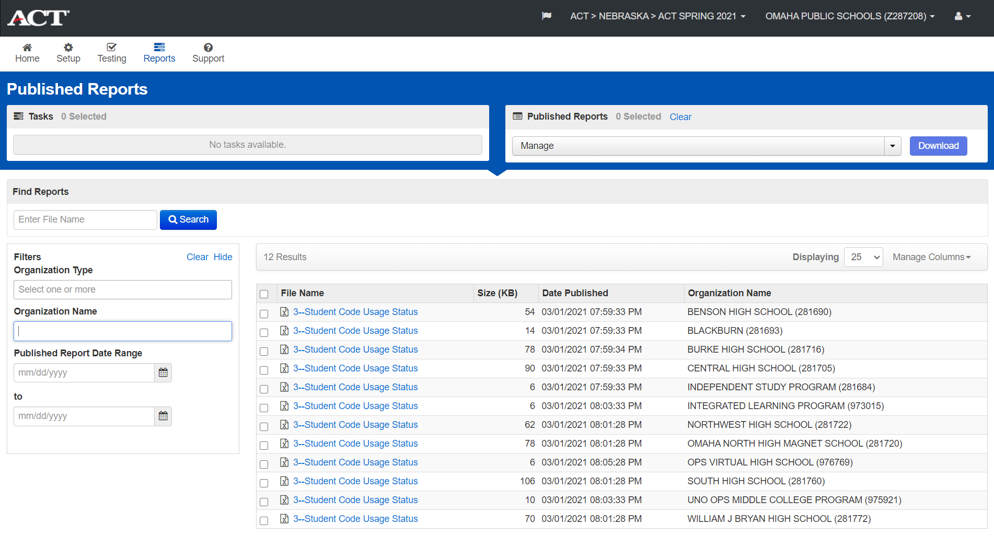
Notes:
I asked before the presentation if I could use the Omaha District account to show you what the screen should will look like on the PA Next system for this report. Thanks to OPS for being accommodating to help us all see where you can find these reports.
To download a report, just click on the title in blue for the school you are needing results. Student Code Usage reports are generated during the day and posted when available. This report is not dynamic and may not show the latest updates made by students until the next report is posted. If a student has entered their student code and selected at least one college choice, they will no longer appear on the report.

Slide 10
Notes:
The Student Code Usage Status report will include the following: Student name, student code, Has the student entered their student code, Y/N and Has the student entered their college choice Y/N. At least one college code will record the last question as a Yes.

Slide 11
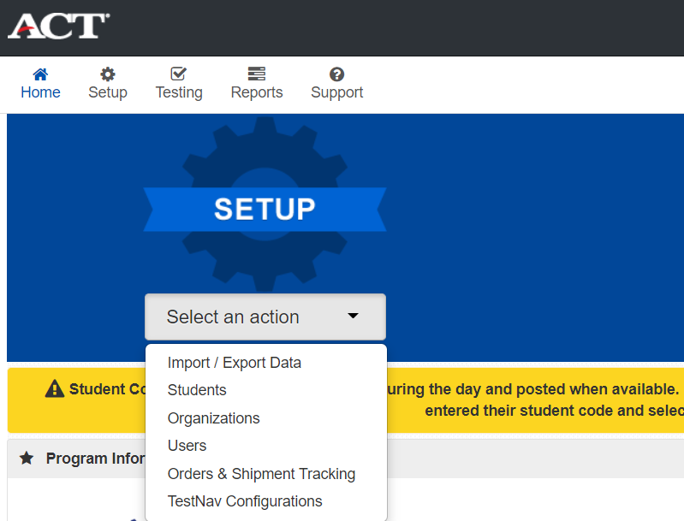
Notes:
If you need to find a student code, under SETUP, select Students, once you are on the Students screen you can find them in your list alphabetically or you can do a search in the Find Students bar. The 9 digit code is located to the left of the last name in your student list.

Slide 12
Notes:
If you have a large group of students, you can use the pdf on the ACT sponsored website called the MyACT Student Code Find and Merge. It has step by step instructions on how to create a file with the student codes and you will be able to print the Non-test Instructions for Students sheets for all students who may need them. This pdf includes the mail merge template link for your convenience.

Slide 13
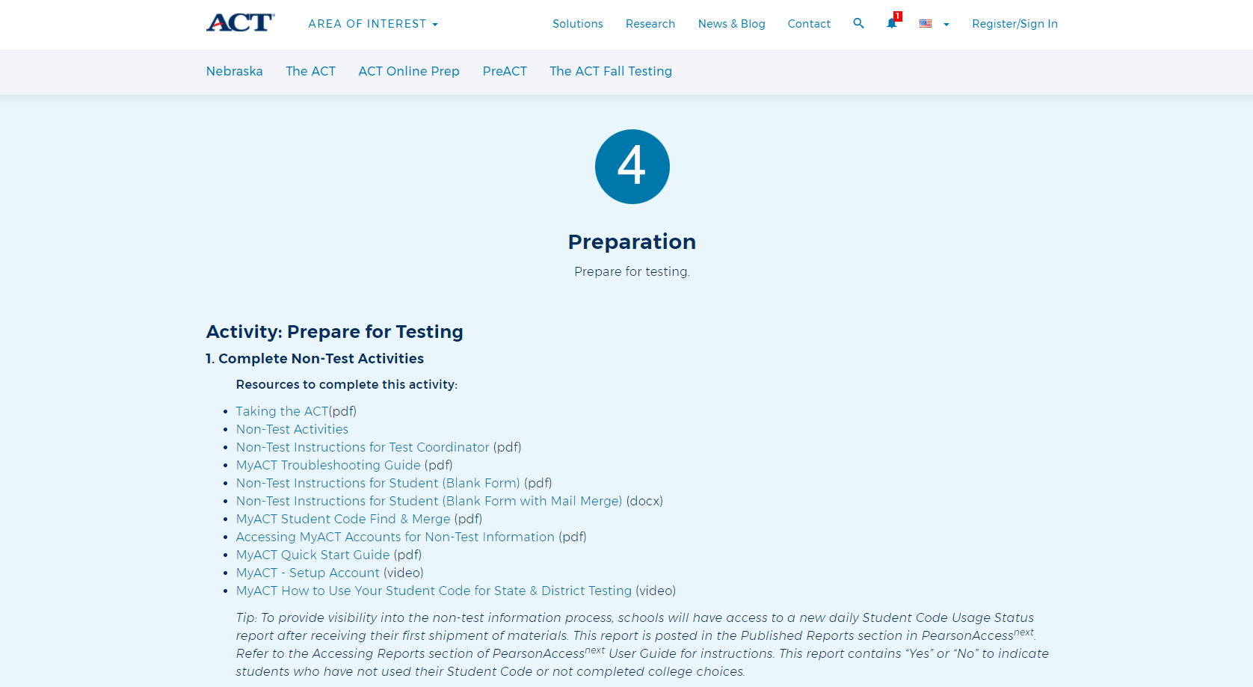
Notes:
When you visit the ACT sponsored website, you will see resources for you and your testing staff to prepare for the test and to assist with the non-test activities. Most of this information is for you and your staff. I do highly recommend the video “MyACT How to Use Your Student Code for State and District Testing. The link to this 5 minute video is a great overview on how to create an account and how to use the student code for the student’s state test.

Slide 14
Notes:
Several non-test information will be coming to your school in the next few weeks. Let’s take a look at what you will be receiving. Each student should be given a copy of the Taking the ACT Test booklet. This booklet covers the ACT, what is included in the non-test portion of the MyACT and great test day information. If you are curious to know what MyACT is asking your students, this little booklet covers all of that and much more.

Slide 15
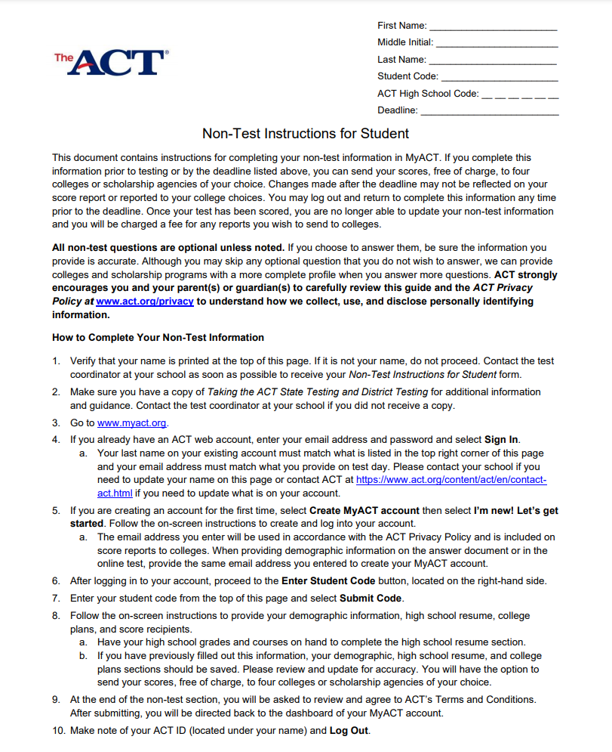
Notes:
Each student will be provided with a Non-Test Instructions for Student sheet. If the student was enrolled in your school’s student list in PA Next before the February 5 deadline, they will have a sheet with all of the information on the top right corner pre-populated. If you have students arriving after that date, you can locate a blank copy of this form at the ACT sponsored website. You or your staff will need to fill out the information as it is in the PearsonAccess Next system.

Slide 16
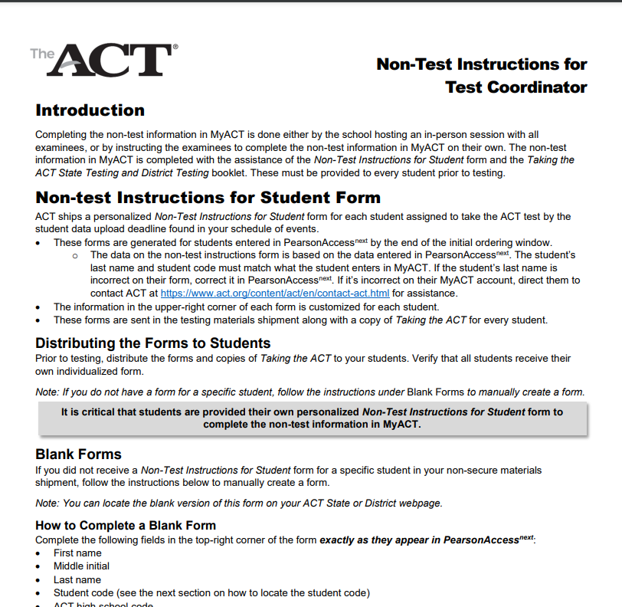
Notes:
Test Coordinators will also receive a 4 page instruction sheet for assisting students with the non-test information. There is a link on the ACT sponsored website with a link to the pdf for you to print out additional sheets for room supervisors or other staff. Please review this with your testing staff.

Slide 17
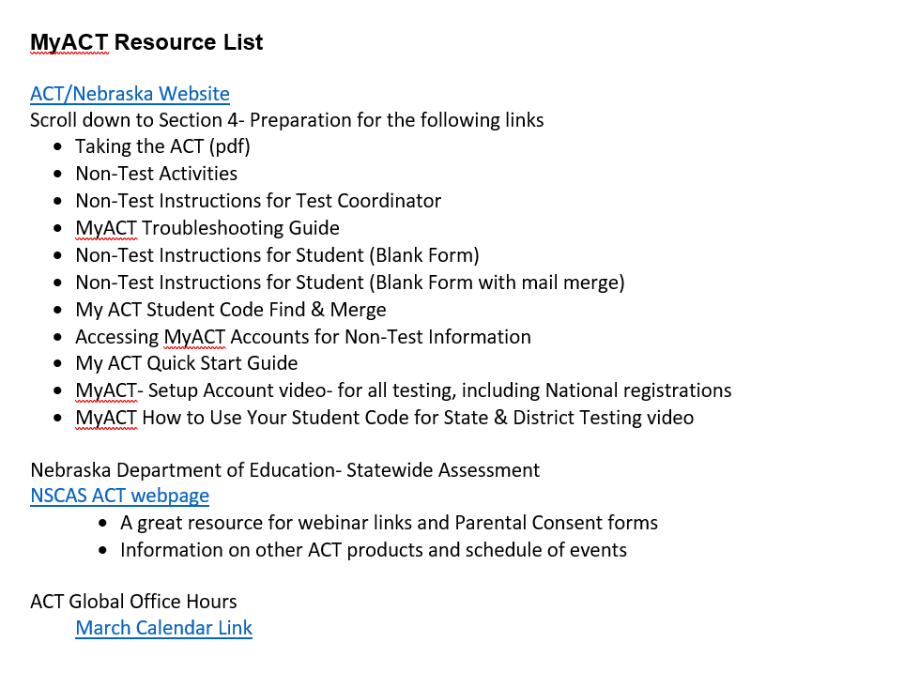

Slide 18
Contact Iris at iris.a.owens@act.org or call 531.207.9019 (new phone number)

