Slide 1
The Nebraska Student-Centered Assessment System (NSCAS) Innovation Overview and Timeline
February 2021

Slide 2
Level Setting
October of 2019 Announced Transition
Through-Year Adaptive (TYA) Assessment Model
Context Setting and Impetus of Change
NSCAS Innovations Presentation – YouTube Video, Time: 1:00:21
High Level Description of the Model & Timeline
NSCAS General Summative
ELA
Mathematics

Slide 3
Level Set
World Changed
Pandemic
Move to Remote Learning
Suspension of 2020 Assessments
Since March of 2020
NSCAS Innovation Update
Timeline and Evolution

Slide 4
NSCAS Innovation Update Agenda
Innovation overview
Timelines and results
2020-2021
2021-2022
This is the Way…Forward
Professional learning and Communications
Research updates

Slide 5
Presentation Goals
Provide high-level overview of TYA
Reestablish timeline transition
2020-21
2021-22
2022-23
Review plans for ongoing feedback and communication
Examine ongoing input methods and research needed to make the transition
Provide some reassurance!

Slide 6
High-Level Overview of through-year adaptive assessment model

Slide 7
The Evolution of NSCAS
NSCAS was established with the goal of creating a more student-centered assessment system
Since 2017 we have been engaged in an intentional process of evolution focused on making the system more relevant to teaching and learning
Feedback from Nebraska educators has been and will continue to be critical to this process

Slide 8
Educator feedback in action
Goals of NSCAS adaptive through-year assessment:
Provide more useful data throughout the year to guide instruction.
Reinforce assessment as an instructional tool.
Support the examination of learning in context.
Provide multiple opportunities to showcase student learning within the context of Nebraska’s College and Career Ready Standards.
Decrease overall testing time.
Utilize the strengths of NSCAS General Summative & MAP Growth.

Slide 9
AQuESTT Tenet Change
Student Achievement and Growth: A balanced assessment system that includes results from multiple sources is used to measure student growth and achievement of Nebraska’s college and career ready standards. A balanced assessment system is a necessary part of the instructional process to improve achievement and growth for each student.

Slide 10
Adaptive through-year model

Slide 11
Introducing . . .
NSCAS Growth
Our name for the NSCAS adaptive through-year assessment

Slide 12
Where we have been:
Fall
Winter
Spring
MAP Growth*
(RIT)
MAP Growth*
(RIT)
MAP Growth*
(RIT)
NSCAS General
(Summative Proficiency)
Formative instructional practice and professional learning
*District optional

Slide 13
Where we are headed:
Fall
Winter
Spring
NSCAS Growth ELA and Math
(RIT)
NSCAS Growth ELA and Math*
(RIT)
NSCAS Growth ELA and Math
(RIT)
(End of the Year Summative Proficiency)
Formative instructional practice and professional learning
*District optional

Slide 14
NSCAS Growth benefits
Leverages interim assessments to produce both growth and proficiency information
Aligned to Nebraska standards
Streamlines testing and increases coherence (same learning targets and testing protocols vs. separate interim/summative systems)
Adapts to efficiently and accurately measure student learning
Helps inform next steps/actions in learning
Measures growth within and across years
Tells a longitudinal story
Provides RIT scores, access to NWEA’s national norms
Avoids the administration of both an interim and a summative test in the spring (one test in spring vs. two)

Slide 15
The Pathway to NSCAS Growth

Slide 16
Spring 2021: A time of transition
NSCAS Phase I Pilot for ELA and mathematics
Transitional test that is neither the NSCAS General Summative nor NSCAS Growth (adaptive through-year assessment)
Will assist with the transition to NSCAS Growth (through-year adaptive summative assessment)
Will support research related to the impact of COVID
May help identify unfinished learning that may exist for each student
We are taking a different approach to science assessment
Students in grades 5 & 8 will take a field test for Nebraska’s College and Career Ready Standards for Science (NCCRS-S)
NSCAS Alternate is still available for ELA, math, science
Third-year cohort high school students will still take the NSCAS ACT or NSCAS Alternate

Slide 17
2020-2021Timeline
MAP Growth*
(Science, Reading, Language, Math)
Winter
MAP Growth*
(Science, Reading, Language, Math)
Spring
NSCAS Summative Field Test (Science)
NSCAS
Phase I Pilot
(ELA, Math)
MAP Growth* (Science, Reading, Language, Math)
Fall
*District optional

Slide 18
NSCAS Phase I Pilot Results
Scores not reported to public or families
Districts receive individual results (no aggregation)
Spreadsheet file
RIT Score (comparable to MAP Growth)
Estimated achievement level
Results will not be used for accountability classifications or designations
Results not comparable to preceding years; should be interpreted with caution and in context of other data sources
Districts should continue to rely on existing assessments such as MAP Growth to inform teaching and learning

Slide 19
2021-2022 Timeline Partially Operational
Fall
MAP Growth*
(Science, Reading, Language, Math)
Winter
MAP Growth*
(Science, Reading, Language, Math)
Spring
NSCAS Summative (Science)
NSCAS Growth
(ELA, Math)
MAP Growth* (Science, Reading, Language, Math)
NSCAS Growth Pilot
(ELA, Math)
*District optional

Slide 20
In summary
Fall 2021: MAP Growth
Normal administration
District Discretion
Winter 2021-22: NSCAS Growth Pilot (December-Mid-January)
TYA Pilot
MAP Growth District Discretion
Spring 2022 NSCAS Growth
Mandatory
MAP Growth District Discretion
Limitations on Growth and Full Implementation
Optional but…
Students will have more data for summative proficiency determination
Districts First Look at NSCAS Growth Data/Reports
Initial Experience with NSCAS Growth
Notes:
Summer 2022 Standard Setting to Cut Scores

Slide 21
Intended test results in 2021–2022
Winter 2021-22 NSCAS Growth pilot provides within-year growth on the RIT scale
Ability to provide immediate return of preliminary RIT scores (pending spring 2021 linking study results)
Standard setting for ELA and Mathematics
Proficiency score determined in summer 2022
Research will inform results that can be provided

Slide 22
2022-2023 Timeline Fully Operational
Fall
MAP Growth*
(Science)
Winter
MAP Growth*
(Science)
Spring
NSCAS Summative (Science)
NSCAS Growth
(ELA, Math)
MAP Growth* (Science)
NSCAS Growth
(ELA, Math)
NSCAS Growth
(ELA, Math)
*District optional

Slide 23
Retaining the best of MAP Growth
The new model will:
Take about the same amount of time per content
Measure student performance & growth irrespective of grade level, within and across years
Produce RIT information in fall, winter, & spring
Provide access to NWEA’s norms so growth can be considered in context of similar students nationally
Be adaptive, accounting for differences in scope & sequence (local control is retained)
Include access to the Learning Continuum or a similar, improved tool
Support student mobility (test scores & longitudinal history will follow students from one school or district to another)

Slide 24
Retaining & improving aspects of the NSCAS Summative
The new model will:
Measure student performance relative to grade-level expectations, adding criterion-referenced information to reports in fall, winter, & spring
Provide information based on Nebraska’s Achievement Level Descriptors (ALDs) to better support teachers in helping students reach & exceed standards-based learning targets
Potentially improve the Learning Continuum by transforming it into a tool rooted in Nebraska’s ALDs
Provide multiple chances for students to demonstrate proficiency (or beyond) vs. just one chance at year’s end
Nebraska educators will continue to have a strong voice in the assessment system.

Slide 25
How it will feel different from current state
No more need to administer two tests (or trade MAP Growth for NSCAS Summative) in the spring
Spring test is just one of three interim tests – about the same length as fall & winter tests, provided the student completed those tests
Processes will become standardized across fall, winter, & spring – e.g. accommodations, linguistic supports, security, retake policies, test windows, etc.

Slide 26
But Jeremy… what about the details?
Notes:
Right…we owe you answers to your questions. I understand this because that is what one of advisory groups emphasized just a couple of weeks ago.

Slide 27
Decision Making Philosophy
Prioritize Interim
Prioritize Growth
Prioritize Students
Prioritize Educators
Prioritize Ease of Use
Prioritize Continuous Improvement
Consider Summative
Consider Accountability
Consider Security
Consider Policy Makers
Consider Other Stakeholders
Consider Statutory Requirements

Slide 28
Moving Forward… NSCAS Growth Information
Monthly Advisory Meetings
Based around key areas (data/reporting, test management, psychometrics, etc.)
Followed by monthly updates for everyone (30-60 min. remote)
Recorded webinars posted on our webpage
Update NSCAS Frequently Asked Questions
Examples & Feedback Opportunities
Ongoing Educator Feedback

Slide 29
Nebraska Educator Opportunities
Assessment & Accountability Advisory (Biannual & Ad Hoc)
Assessment Thought Leaders (Ad Hoc)
Smaller group
Content Advisory Boards (Ad Hoc)
ELA & Mathematics
NE content experts
Annual Test Development
Content specific
Achievement Level Descriptors
Standards Review
Accessibility Review and Update (summer 2021)

Slide 30
Professional Learning & Communications

Slide 31
Communications Plan
2021-22 Communications (starting in July)
Core audiences:
Universal stakeholders (educators, parents, state board, general public)
Nebraska educators
District assessment coordinators
Goal: Educate on the transition to through-year assessment and support preparedness, positive perceptions, and commitment to participating in the 2021-22 pilot
Tactics:
NDE keynote at administrator days (target: educators)
Video focused on equity and through-year connection (target: universal audiences)
Video focused on educator involvement in shaping NSCAS and the evolution to through-year assessment (target: educators)
“Vignette” webinars tackling more specific or technical details (target: district assessment coordinators)

Slide 32
Professional Learning
2021-22
Core audiences:
Certified Facilitators
Plus-ones to join CF
Goal: to strengthen the capacity of all Nebraska educators, including the Certified Facilitators, through system-wide professional learning (grounded in Professional Learning and Academic Content Standards) to increase the role-based knowledge, skills, and explicit transfer-to-practice of all aspects of the Nebraska balanced assessment system.
Tactics:
Professional Learning Workshops: Assessment Literacy and Formative Assessment, Focusing on Growth, Interim Tools, and Writing with Evidence
CF Networking meetings
eNewsletter
Webinars

Slide 33
Ongoing Work

Slide 34
Research goals to support the transition to NSCAS Growth
Research study goals:
Establish a statistical link between MAP Growth and NSCAS scales
Running simulations and examining models

Slide 35
Content activities for transition to NSCAS Growth
Phase I Pilot in Spring 2021 to prepare for the transition
Alignment studies
MAP Growth Grades 3-8
Additional banks and MAP Growth Grades 1, 2, and HS
Range ALD review
Range ALD Tool

Slide 36
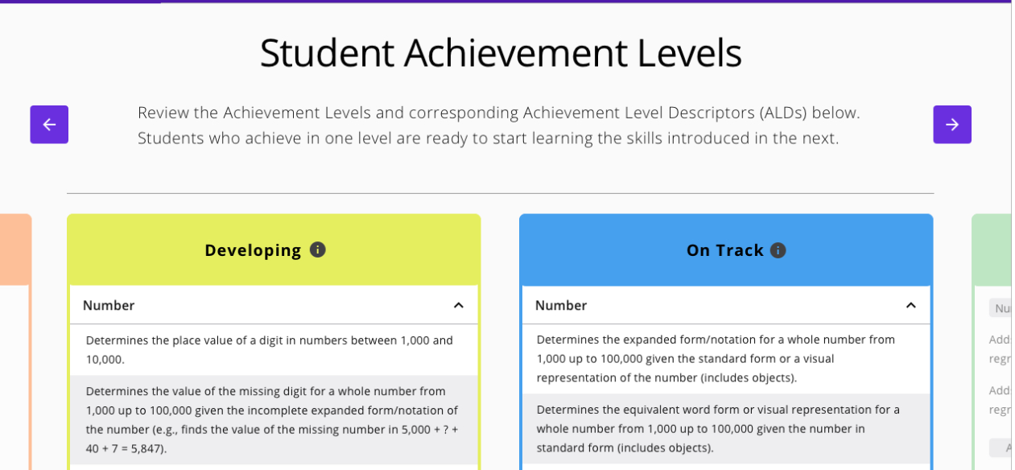
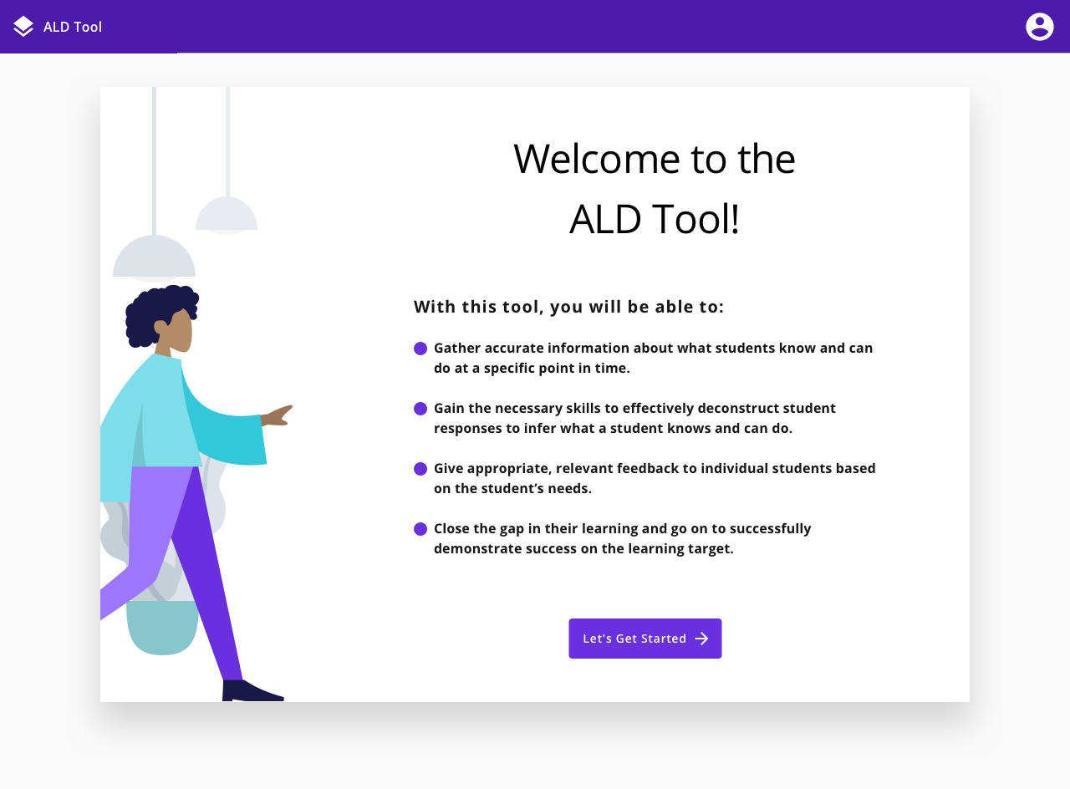
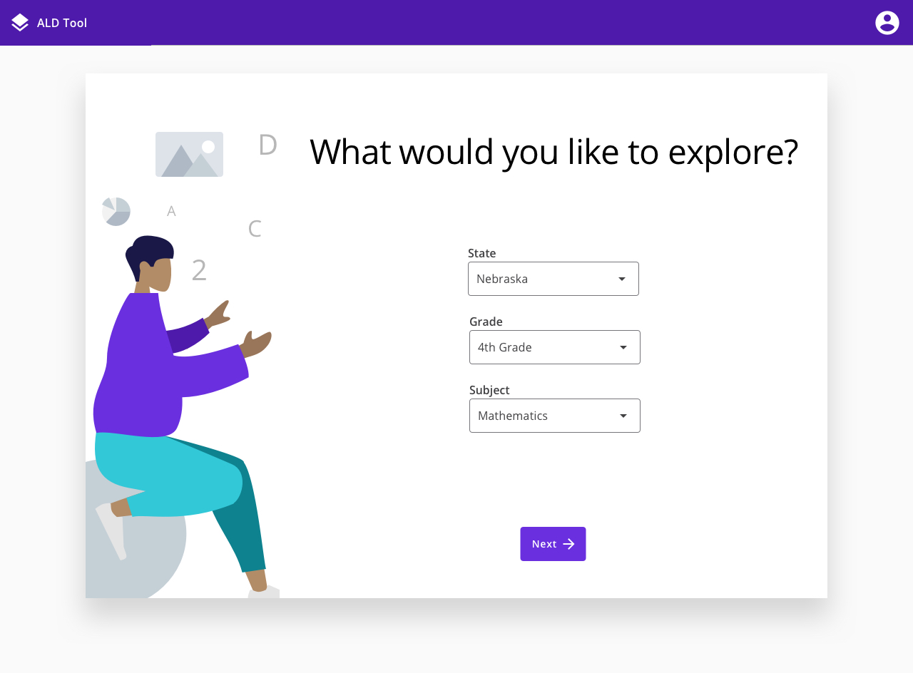
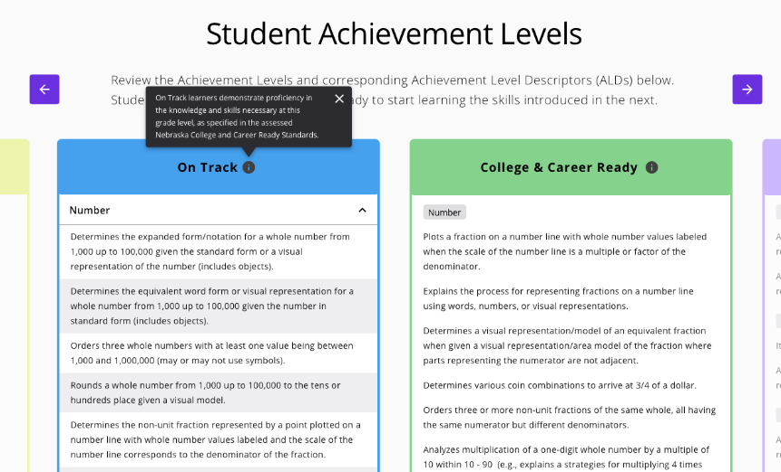
Nebraska research participation
TY instructional tool (ALD-based recommendations) and teacher insights

Slide 37
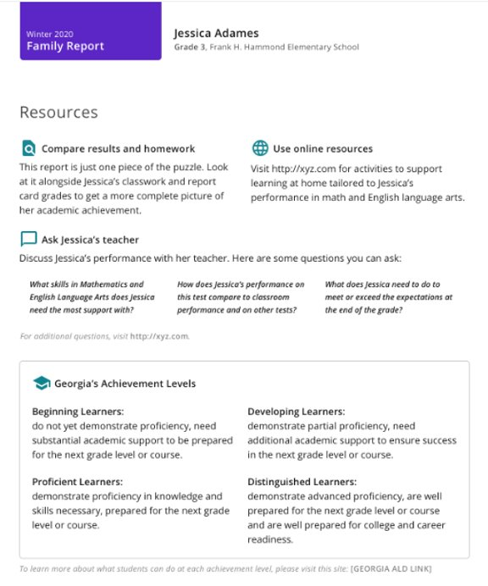
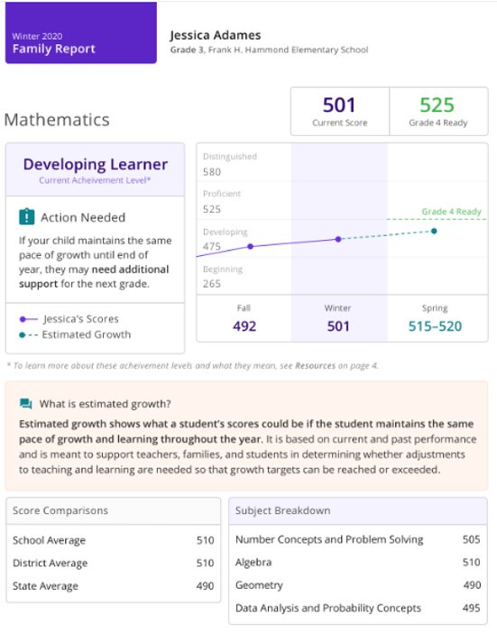
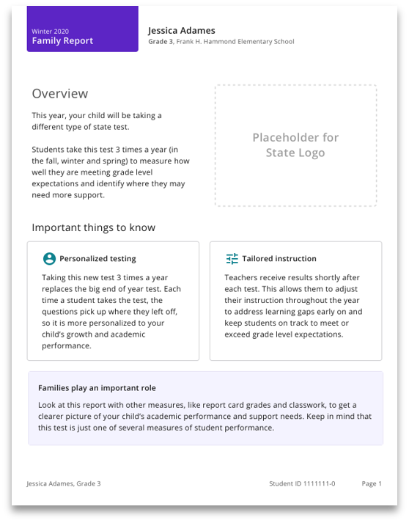
Nebraska research participation
WFF Grant Family Report

Slide 38
Closing message…
We hear your concerns…
…working on getting you answers.
We know you value MAP Growth…
…working to provide and improve on that data.
We acknowledge that you need resources…
…working on providing resources for you to share.
We value your input…
…keep asking questions and challenging us to do better.

Slide 39
Questions?
Thank you!

