Slide 1
EXPANDED LEARNING OPPORTUNITY
INNOVATION NETWORK
Engaging Community Partners
North Platte Public Schools Kids Klub

Slide 2
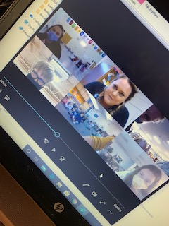
GETTING STARTED
PHOTO OR GRAPHIC
ENGAGING COMMUNITY PARTNERS
The first step to engaging community partners in your program is to put together an advisory team from your staff or school leaders. This will begin the process of vetting ideas and solidifying your “ask” when it’s time to approach community partners.
What do we want to do?
What is the community partner’s role?
What is the community partner’s commitment; time? Money?
What is the benefit for the community partner? Your program?
Does your partner have a “buy in” to the program already? i.e. parent, donor, etc.
Be clear how your program will support their involvement i.e. supervision/discipline will be solely your responsibility, your staff will assist with projects/clubs
Ask Your Students
Having a student advisory committee is also a great idea, kids are full of good ideas! What do THEY want to do at your after school program? We have zoom brainstorming sessions with our students and staff.

Slide 3
OUR BIG IDEA:
This year we decided to implement more club-based programming at each of our site locations. We knew that in order to be successful we had to address the biggest issue we would face this year and that was the social-emotional needs of our students. Brandy Buscher, our district Student Services Director approached me about hiring an SEL Coordinator and our idea began to come to life.

Slide 4
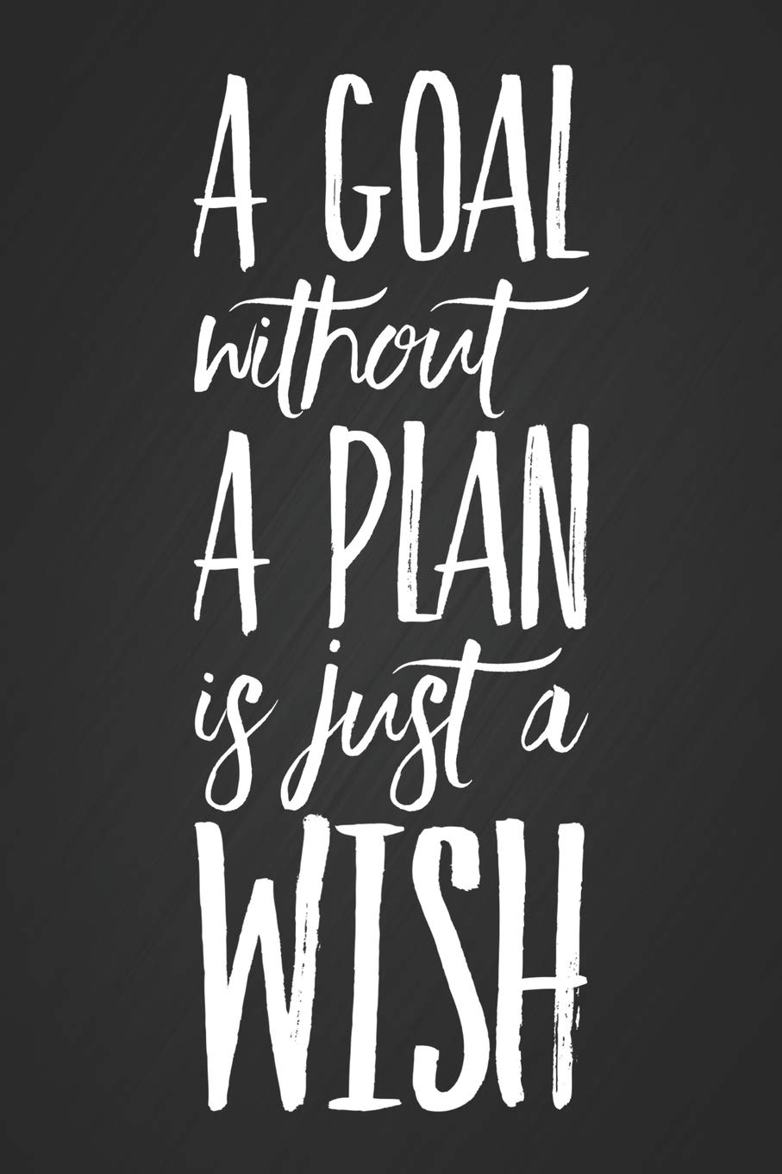
Our Ask…
Poto here
We had a local therapist, Angela Bear in mind for the SEL partnership so we contacted her & set up a meeting to present her with our ask.
In our meeting we outlined why SEL was so important to us this year and how we wanted to get it right for our students.
We presented Ms. Bear with our program schedule, budget, and curriculum and gave her a week to marinate on the idea and come back to us with an answer.

Slide 5
She Said...
Angela got back to us quickly and was onboard with our plan. She agreed to use the Sanford Harmony Curriculum and began creating her lesson plans immediately. We all wanted a quick start to this amazing new programming.
Photo here
YES!

Slide 6
FINE TUNING
To ensure the best practices were in place we decided to hire Angela as a NPPS Staff; this ensured we followed all district policies and procedures. This also allowed Angela to enter our buildings. Due to COVID-19 restrictions, only staff are allowed on-site.
Angela created a schedule to visit our sites once per week
Angela used Sanford Harmony as an activity guide for weekly lessons
Angela monitors each child’s answers, and notes any red flags or things of concern
Angela reports via email any child’s comments or drawings that cause concern
Brandy Buscher shares that information with our principals who work with Brandy to put the
proper supports in place for that child
If additional counseling is deemed necessary, we get parent permission and Angela comes in to visit one-on-one with that child during school hours
Payment for those services is never a barrier, we assist with that if need be using Medicaid, personal insurance or our Mental Health grant funds.
Angela has also offered to do SEL training for our staff

Slide 7
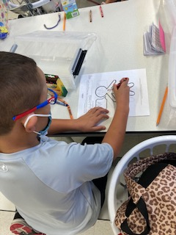
Using our SEL practices daily after school has been instrumental in the success of Kids Klub this year
Things I Wish My Teacher Knew* Journals *(inspired by Kyle Schwartz’s book; Things I Wish My Teacher Knew)
Open communication between our students and staff
Open communication between our day time and afterschool staff
Linking services to our students
Relieving financial strain on our families for these services
Promoting the overall well-being of our students
Photo here

Slide 8
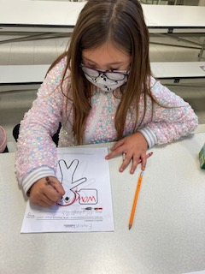
FUTURE PLANS
EXPANDING SEL TRAINING TO OUR STAFF
Due to the success of our partnership with Angela, and her ability to bond so quickly with our students and staff, we have decided to utilize Angela to assist us with some staff professional development.
This has been one of the most successful new partnerships we have ever put together and we cannot wait to see how it grows. We hope to inspire others to implement SEL into their after school time.

