Slide 1
Getting Back to School
Dr. Trudy Clark
Aly Martinez Wilkinson

Slide 2
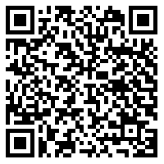
Session Resources
Google Doc
www.bit.ly/NDE_GBTS
Sign In
Resources from PPT
Notes:
www.bit.ly/NDE_GBTS
https://docs.google.com/document/d/1GqHyp2irPc-0ZhZodFzyyFhvBAGVWFWcq3ib7eNidGA/edit?usp=sharing

Slide 3
Redefining Growth
Schools cannot simply return to an instructional scope and sequence put on pause in the spring and continue at the same pace without students falling further behind.
Chase Nordengren, PhD
Research Scientist, NWEA

Slide 4
Launch Nebraska
Leadership & Planning
Conditions for Learning
Continuity of Learning
Partner Perspectives
Professional Learning & Resources
Notes:
www.launchne.com

Slide 5
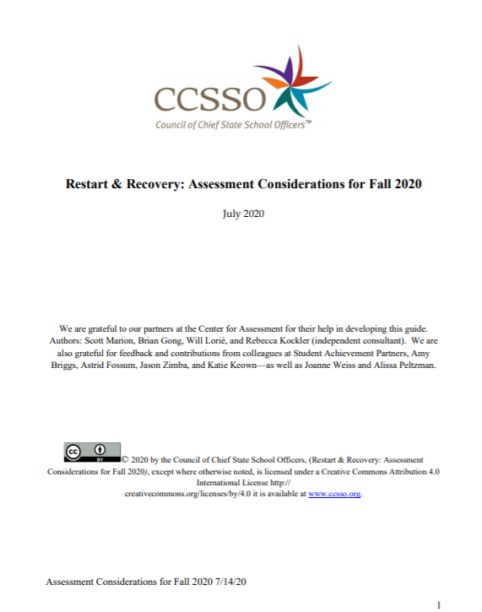
CCSSO
Restart & Recovery: Assessment Considerations for Fall 2020
Notes:
https://ccsso.org/sites/default/files/2020-07/Assessment%20Considerations%20for%20Fall%202020.pdf
https://ccsso.org/sites/default/files/2020-04/CCSSO%20COVID19%20Strategic%20Report%20final.pdf

Slide 6
NWEA
Kick-start fall planning: 4 principles for instructional leaders
Turning a New Page: Guiding Instruction and Using MAP Growth amid COVID-19 School Closures
Notes:
https://www.nwea.org/resource-library/welcome/kick-start-fall-planning-4-principles-for-instructional-leaders
https://www.nwea.org/resource-library/i/1258868-guiding-instruction-and-using-map-growth-amid-covid-19-school-closures/0?

Slide 7
Nebraska Professional Learning 2020–2021
Onsite and regional workshops
Impact
classroom
practices
Online learning and communities
Certified
Facilitators

Slide 8
NWEA Resources
Professional Learning Online
NWEA Connection
Teach.Learn.Grow
NWEAvideos
Notes:
Professional Learning Online
https://community.nwea.org/community/professional-development/
NWEA Connection
https://community.nwea.org/
Teach.Learn.Grow
https://www.nwea.org/blog/category/formative-assessment/
NWEAvideos
https://www.youtube.com/channel/UCmdB7jO3Yr2wV_qDmiXj3tQ

Slide 9
Dr. Trudy Clark trudy.clark@nebraska.gov
Aly Martinez Wilkinson aly.martinez.wilkinson@nwea.org
Notes:
Contact Information:
Dr. Trudy Clark, Assistant Director of Statewide Assessment – trudy.clark@nebraska.gov
Aly Martinez Wilkinson, NE Professional Learning Lead – aly.martinez.wilkinson@nwea.org

