Slide 1
Making Languages Our Business: World Language in Nebraska
Presented by Stephanie Call,
Education Specialist for World Language,
Nebraska Department of Education

Slide 2
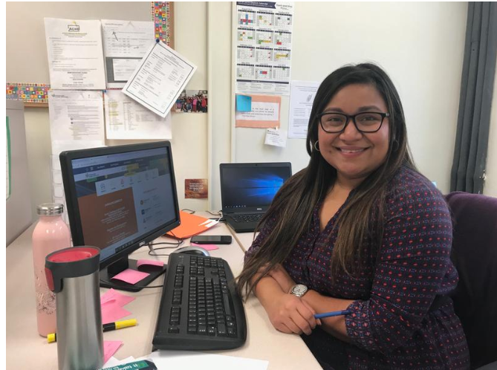
What career field is represented in this photograph?

Slide 3
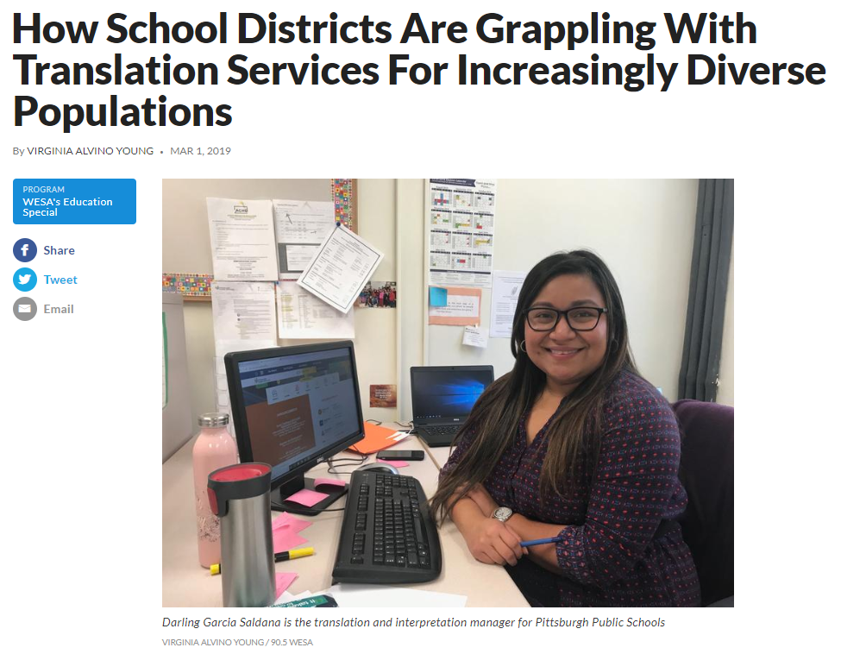
https://www.wesa.fm/post/how-school-districts-are-grappling-translation-services-increasingly-diverse-populations

Slide 4
What career field is represented in this photograph?

Slide 5
https://www.universityofcalifornia.edu/news/google-translates-doctors-orders-spanish-and-chinese-few-important-caveats

Slide 6
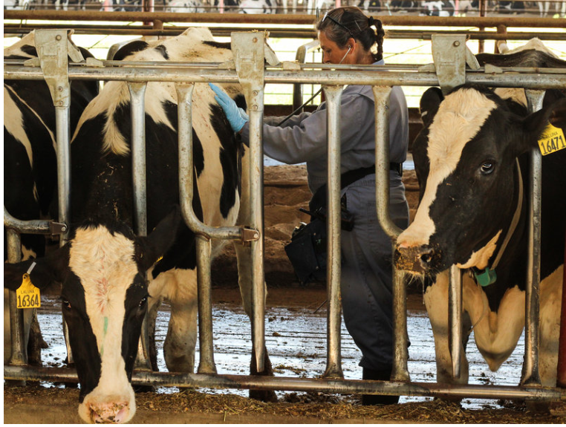
What career field is represented in this photograph?

Slide 7
https://www.npr.org/sections/thesalt/2018/07/26/529587702/with-spanish-classes-vet-schools-aim-to-break-down-barriers-with-farmworkers

Slide 9
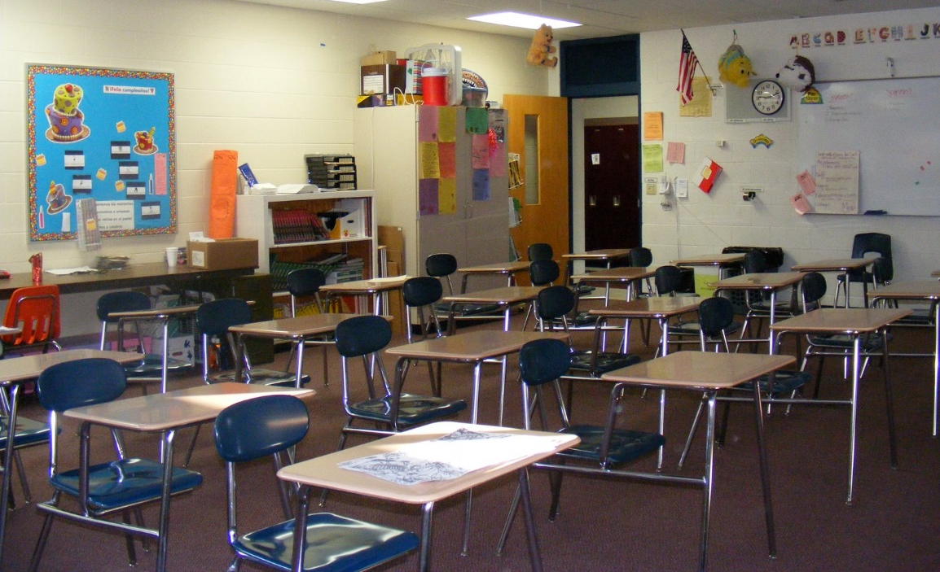
Stephanie Call
Education Specialist, World Language
Nebraska Department of Education
stephanie.call@nebraska.gov
Gaston Public Schools (Oregon)
School District of Albany (Wisconsin) * Big Foot Union High School (Wisconsin)
Burlington Area School District (Wisconsin)

Slide 10
Language Demand
What Business and Industry Need

Slide 11
NAE Data on Job Listings
New American Economy analyzed online job listings seeking bilingual skills from 2019-2015 for their 2017 report entitled Not Lost in Translation: The Growing Importance of Foreign Language Skills in the US Job Market.
The demand for bilingual workers is rising
The number of bilingual workers sought in 2010 had more than doubled by 2015
Employers are increasingly looking for workers who can speak Chinese, Spanish, and Arabic
Listings for Chinese-speaking workers tripled, while Spanish and Arabic increased by 150%
Some employers have particularly strong demand for bilingual workers
Topping the charts were Bank of America (33.9% of listings required language skills), H&R Block (24%) and Humana (23.3%)
There is a growing need for bilingual workers at both the low and higher-ends of the skills spectrum
Individuals without a bachelor's degree were eligible to apply for 60% of the jobs with the highest demand for language skills in 2015
Slide courtesy Howie Berman, ACTFL Executive Director, “Making Languages Our Business to Better Advocate for Language Education”, presented ACTFL 2019, Washington D.C.

Slide 12
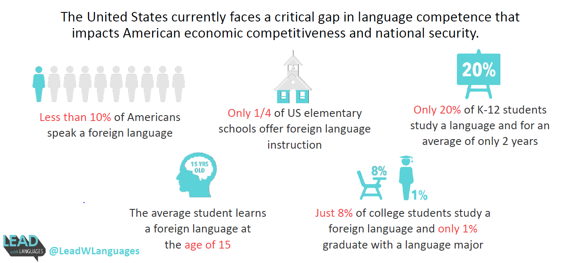
A Critical Language Skills Gap
Slide courtesy Howie Berman, ACTFL Executive Director, “Making Languages Our Business to Better Advocate for Language Education”, presented ACTFL 2019, Washington D.C.

Slide 13
An Urgent Need
Our 2019 report, based on a survey of 1,200 U.S. employers conducted by Ipsos Public Affairs, finds:
9 out of 10 U.S. employers rely on employees with language skills other than English
56% say demand for language skills will increase in the next 5 years
1 in 3 foreign language dependent U.S. employers report a language skills gap
1 in 4 U.S. employers lost business due to a lack of foreign language skills
Slide courtesy Howie Berman, ACTFL Executive Director, “Making Languages Our Business to Better Advocate for Language Education”, presented ACTFL 2019, Washington D.C.

Slide 14
What About Nebraska?

Slide 15
Jobs in Nebraska

Slide 16
January 20-23, 2020
Bilingual Jobs in Nebraska
Career Link: 23 results
Google: 27 results
Monster: 24 results
.Jobs: 535 results
Indeed: 687 results

Slide 17
The Essence of Language
Com•mu•ni•ca•ca•tion: the imparting or exchanging of information and news

Slide 18
Share out: Think of a baby you’ve known. How did their level of language use change from age 0-3?

Slide 19
Second Language Acquisition Primer
Second language acquisition is both similar and exponentially more dynamic than first language acquisition.

Slide 20
Input from family
0 months
Input from society
3 months
Limited output to family
9 months
Limited output to society
15 months
Structured input from school
3 years
Structured, limited output at school
4 years
Structured, more detailed output at school
6 years
Structured, complex output at school
9 years
Structured input from school
Year 1-2
Structured, limited output at school
Year 1-2
More detailed structured input at school Year 3-4
More detailed structured output at school Year 3-4
Complex, somewhat structured input at school
Year 4-5
Less structured, more detailed output at school
Year 4-5
Accessing previous knowledge of language acquisition
Comparing first and second language characteristics
Using higher thinking skills to question subtext, deeper meaning
Increasing meta-vocabulary

Slide 21
Oral Proficiency in the Workplace
Level of Proficiency | Language Function | Position/Profession
Distinguished | Ability to tailor language to specific audience, persuade, negotiate. | Foreign service
Superior | Discuss topics extensively, support opinions | University Language Professor, Financial Services Marketing Consultant, Lawyer, Court Interpreter
Advanced High | Narrate and describe in past, present, and future. Deal effectively with an unanticipated complication. | Physician, Military Linguist, Financial Advisor
Advanced Mid |  | Banking Representative, Medical Interpreter
Advanced Low |  | K-12 Language Teacher, Nurse, Social Worker
Intermediate High | Create simple conversations by asking and responding to basic questions. | Language learners following 6-8 years of dedicated language study in PK-12 or 4-6 semester college courses
Intermediate Mid
Intermediate Low |  | Language learners following 4-year high school sequence or 2-semester college sequence. Language learners who completed a PK-6 immersion program.

Slide 22
Time as Critical Component for Developing Language Performance
NOVICE INTERMEDIATE ADVANCED
Based on Figure 4. Time as a Critical Component for Developing Language performance published by the American Council of the Teaching of Foreign Languages , 2012.

Slide 23
Professional and Technical Language
Language that is characterized by career-based terminology

Slide 24
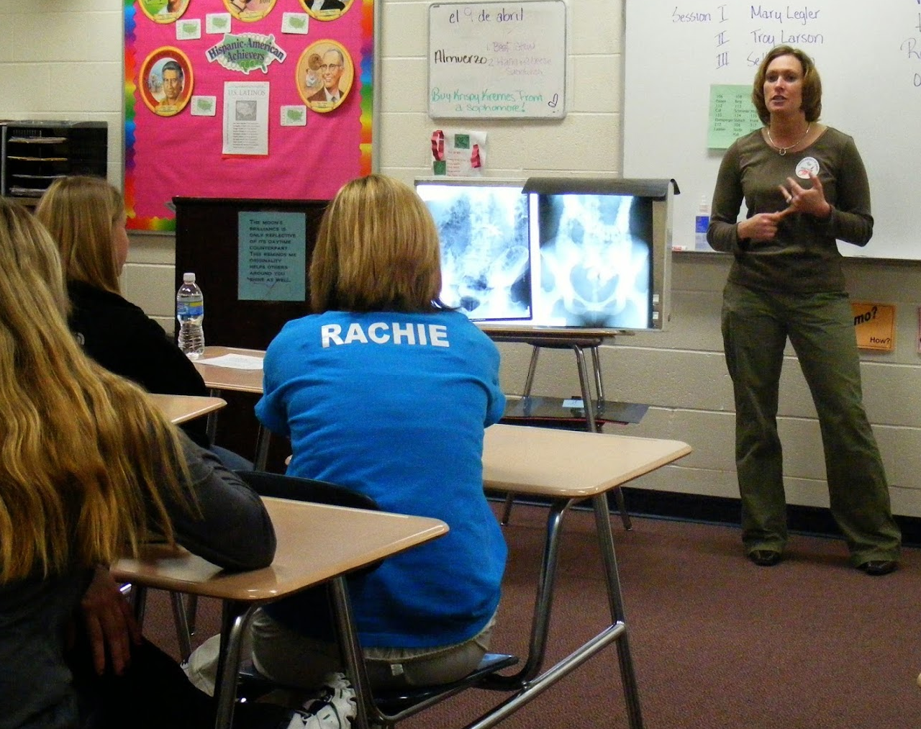
Professional and Technical Language in PK-16 Schools
Section One:
Dedicated courses
Section Two:
Integrated lessons in collaborative partnership of established classes
Section Three:
Integrated lessons in established classes

Slide 25
Section One: Professional and Technical Language Courses

Slide 26
Sample courses
…For Health Care/ Medical Professions
…For Public Safety Personnel / Emergency Responders
…For Business and the Professions
…For Tourism and Hospitality
…Agricultural Vocabulary
…For Educators
…For OSHA Trainers

Slide 27
Characteristics of Dedicated Professional and Technical Language Courses
Developed in collaboration with career expert and language expert
Focus on conversational use of language rather than grammar
Application of language to career and career to language
Dual credit option

Slide 28
Nebraska Post-Secondary Programs
Spanish for Health Care Professions Minor at Bryan College of Health Sciences.
Healthcare Sign Language Minor at Nebraska Methodist College
Spanish for Healthcare Professionals at Nebraska Methodist College
Spanish for Construction Management at Southeast Community College
Medical Spanish, Law Enforcement Spanish at Northeast Community College

Slide 29
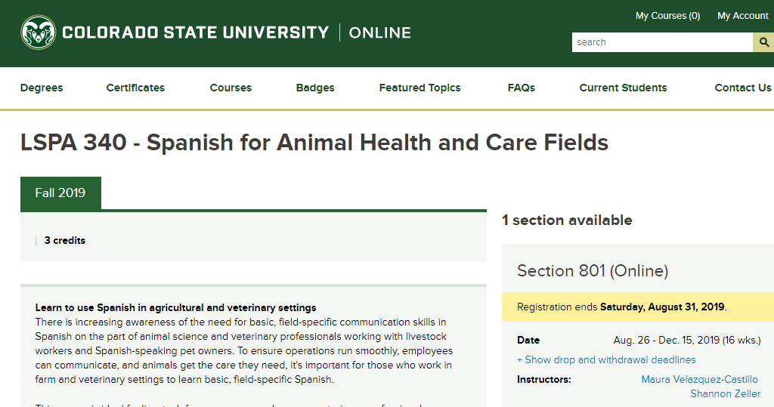
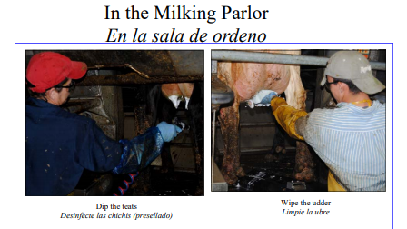
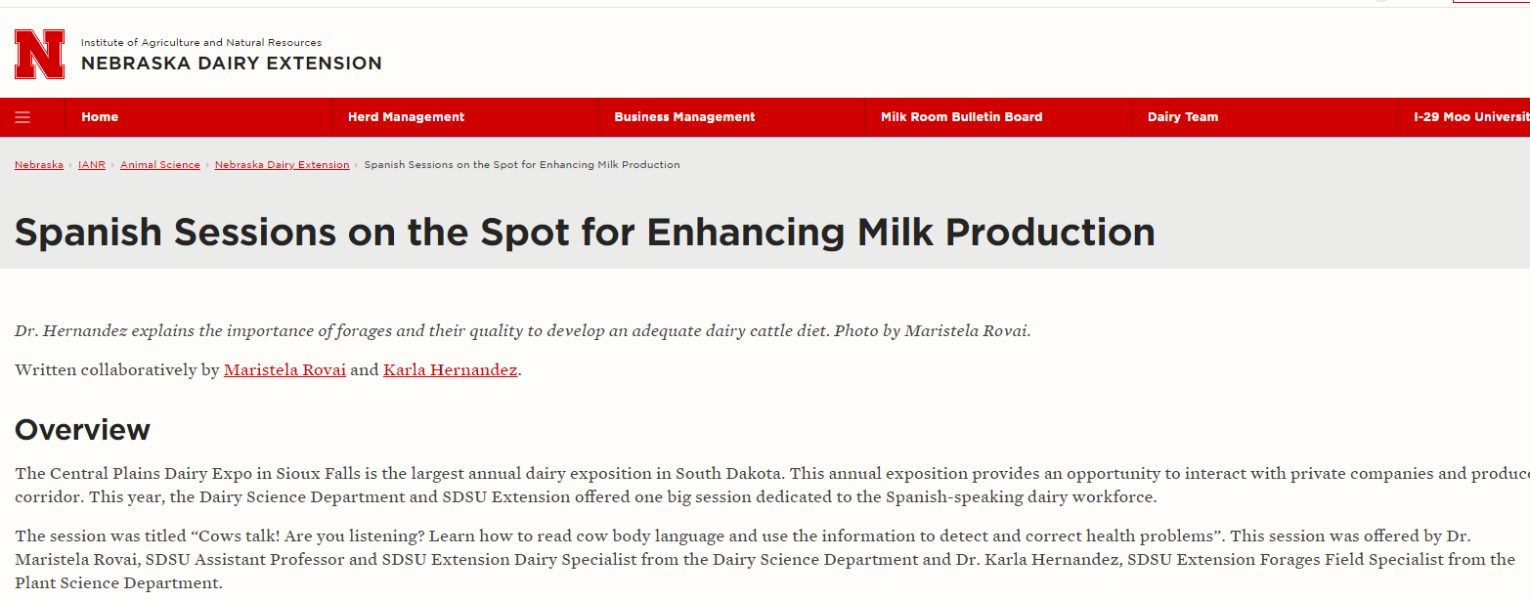

Slide 30
How to implement professional and technical language courses in my school?
Work with Post K-12 institution to establish criteria for instructor qualifications
Create agreement with Post K-12 institution

Slide 31
Section Two: Integrated lessons in collaborative partnership of established classes

Slide 32
Possible Collaborations
…French and Culinary Arts
…German and Automotive Technology
…Japanese and Landscaping
…Chinese and Marketing
…Latin and Health Science
…Arabic for Hospitality and Management
…Spanish and Cabinetry

Slide 33
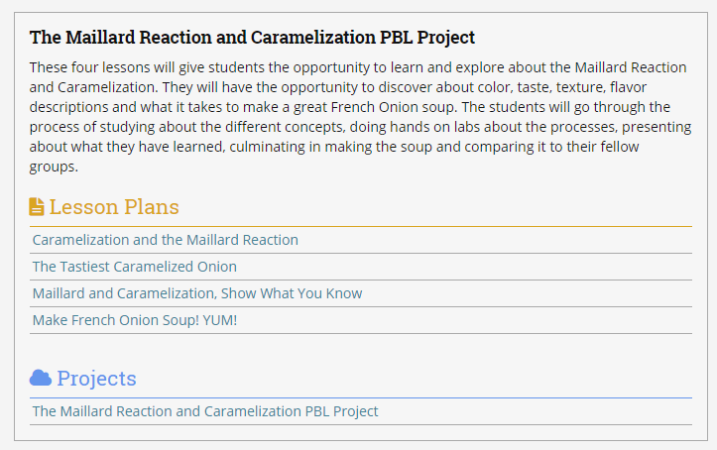
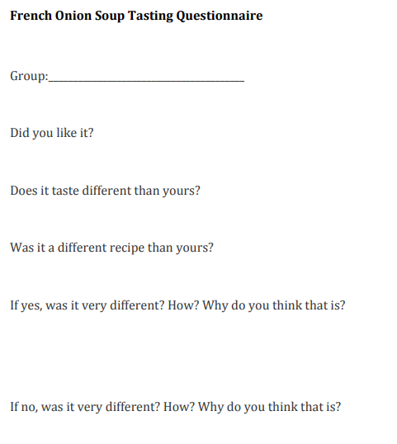
French:
Introduce commands.
Create or re-write recipe instructions.
Create follow-up survey in French.
Discuss French Onion Soup in French culture: la soupe à l’oignon.
Culinary Arts:
Present caramelization and the Maillard Reaction.
Experiments with caramelized onions.
Discuss chemistry behind caramelization.
Teach how to make French Onion Soup.
CTE Online: The Maillard Reaction and Caramelization PBL Project
Marmiton: Soupe à l’Oignon
Notes:
Developed in collaboration with career expert and language expert
Focus on conversational use of language rather than grammar
Application of language to career and career to language
Integrated unit of study approached in both career and language classroom

Slide 34
How to implement professional and technical language courses in my school?
Develop professional learning community with technical skills and language educators
Become familiar with curriculum of collaborating partner
Establish lesson plans that are appropriate to your needs:
Timing
Level of student
Resources
Shared projects or influenced work

Slide 35
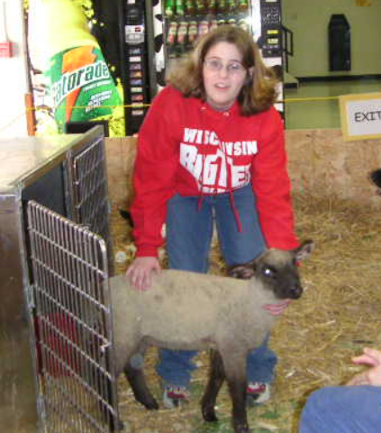
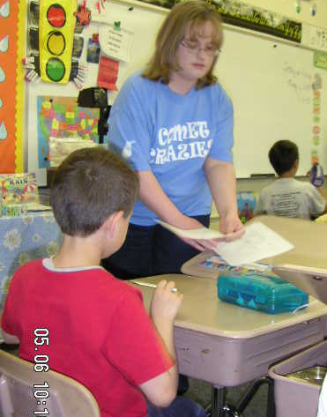
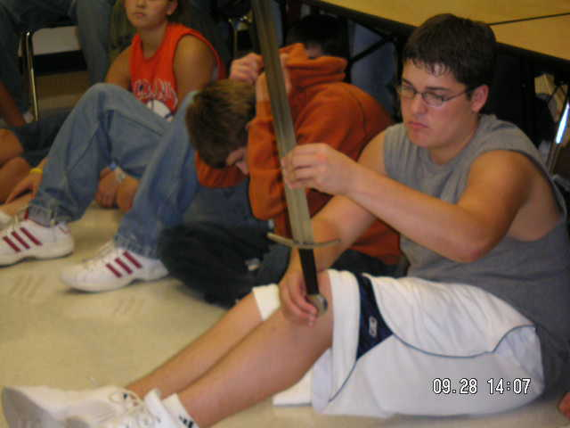
Section Three: Integrated lessons in established classes

Slide 36
Typical World Language Content
Greetings
School life
Family
Professions
Pastimes
Sports
Travel
Weather
Clothing
Bargaining
Hygiene
Food
Celebrations
Health
Medical Terms
Technology
House and Home
Environment
City Life
Money and Banking
Well-being and Nutrition
Workplace
Arts
Moves
Current events

Slide 37
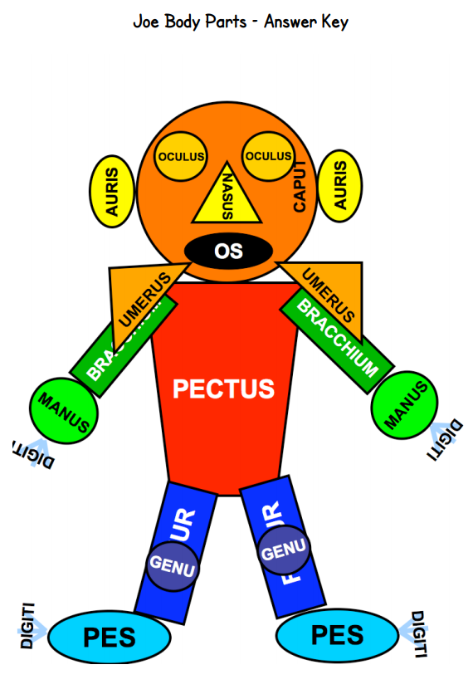
Cross-Curricular Connections: Health Science, Physical Education, Health
Objective: Increase student ability to identify body parts and related words using their Latin roots.
Sample:
PES pedicure, pedestrian
AURIS auditory, auricular
Latin Anatomy Lesson:
http://www.ascaniusyci.org/facebook/bodyparts-commands.pdf
Notes:
Developed individually or in collaboration with career expert and language expert
May or may not have a language focus
Application of language or culture to career and career to language or culture
Dual credit option

Slide 38
How to implement integrated cross-curricular lessons in my school?
Be creative.
Be attentive to opportunity.
Think global.
Seek input.
Look for resources.

