Slide 1
Families and Schools
Building Positive Relationships for Student Success

Slide 2
Objectives
Attendees will:
Be able to answer the question: Why is family engagement important?
Hear examples of family engagement initiatives from three Nebraska school administrators
Explore useful resources for growing awareness and facilitating conversations between school staff and families
Advise NDE on possible next steps for supporting schools/districts in the area of Family Engagement

Slide 3
Introductions
Kim Larson, kim.larson@nebraska.gov, NDE Family and Community Engagement
Jon Cerny, jcerny@esu2.org, Superintendent and Elementary Principal, Bancroft-Rosalie Public Schools
Margaret Sandoz, msandoz@esu1.org, Superintendent and Elementary Principal, Niobrara Public Schools
Tammy Schaefer, tschaefer@crosscounty.esu7.org,
Principal, Cross County Elementary, Cross County Community Schools

Slide 4
Why is family engagement important?
Research supports that when families are engaged and involved in schools, increased student learning results.
Student’s grades go up.
They attend school more regularly.
They are more likely to enroll in higher-level programs.
They are more likely to graduate and go on to college.
They are more excited and positive about school and learning.
They have fewer discipline issues inside and outside class.

Slide 5
Why is family engagement important?
Requirements in ESSA
http://www.esc16.net/upload/page/0463/docs/Stafford%201%20Over%20view%20of%20Parental%20Involvement%20Under%20ESEA%2005262016.pdf
Identified in AQuESTT
https://aquestt.com/tenets/
NE State Board of Education Strategic Vision and Direction
https://nebraskaeducationvision.com/goals-and-outcomes/positive-partnerships-relationships-success/
Emphasis in current initiatives across NDE programs (required or best practice)
Research regarding its connection to student engagement and student success in school
Notes:
ESSA
AQuESTT
Positive Partnerships, Relationships, and Success
Attendance and Participation
Family Engagement
Community and Support Services
NE State Board of Education
2016-17 Strategic Vision and Direction
Outcome Statement: Increase student, family, and community engagement to enhance educational experiences and opportunities.
NDE will build connections amongst stakeholders to take action in support of success for all learners.
Connector: NDE Helps bridge the divide between learning, earning, and living, connecting with schools, families, business’, and communities by supporting other agencies and organizations in active engagement and relationships building amongst individuals, parents and families

Slide 6
Where do I begin?
Examine core beliefs about family engagement in your school. The essential core beliefs include:
All families have dreams for their children and want the best for them.
All families have the capacity to support their children’s learning.
Families and school staff are equal partners.
The responsibility for cultivating and sustaining partnerships among school, home, and community rests primarily with school staff, especially teachers.

Slide 7
Next steps…
Create building-level teams to focus on engaging family and community partners to help improve student success (include family members as part of the team).
Provide ongoing professional development for both school staff and families.
With your team, write an annual family engagement plan that is embedded in your continuous improvement plan.
Reflect on your family and community engagement events and program, at least annually, to understand what was implemented well and where improvements are needed.
Be part of regular conversations with school leaders to discuss partnership challenges and best practices.

Slide 8
Hear from Nebraska Administrators
Jon Cerny, Superintendent and Elementary Principal
Bancroft-Rosalie Public Schools
Margaret Sandoz, Superintendent and Elementary Principal
Niobrara Public Schools
Tammy Schaefer, Elementary Principal
Cross County Community Schools

Slide 9
Bancroft-Rosalie Family Engagement
Meetings/Events
Computer Check-out Night
Parent Advisory Committee- Title VIII
MTSS at Kindergarten Round-up
Parent/Grandparent Breakfasts
Virtual Learning Days
College-Career Readiness/Personal Learning Plans

Slide 10
Bancroft-Rosalie Teachers as Advisors Professional Development Plan
All advisors should know and understand:
How to read a student transcript
School graduation requirements, including required courses and options
Specific course requirements for each of the graduation pathways
Course offerings as outlined in the course description book
How to design a four-year Personal Learning Plan
Difference between college-preparatory, honors, and Dual Credit courses
Opportunities students have to earn post-secondary credit while in high school: Dual Credit, On-Line, Pathways 2 Tomorrow, Fridays at Northeast.
Post-secondary opportunities and entrance requirements for area community colleges, colleges, and universities

Slide 11
Bancroft-Rosalie Teachers as Advisors Professional Development Plan
All advisors should know and understand (continued):
Military opportunities and post-secondary training opportunities
Job Shadowing and school-sanctioned work opportunities that enable students to connect on-the-job experiences to their school work
State scholarship opportunities including the Buffett Scholarship
How students can access career information
Basic information about each of their advisees, including ethnic background, socio-economic status, grades, test results, school attendance, and previous disciplinary actions
How to conduct a successful advisement session
2017-2018 DIBELS Parent Report

Slide 12
Sample Parent Report From Dibels Next (Text Only)
2017-2018 Parent Report from DIBELS Next (Former), easyCBM NCTM Math​
Class: First Grade, District: Bancroft-Rosalie Community Schools​
Grade: First Grade, School: Bankcroft-Rosalie School​
​
Nonsense Word Fluency - Whole Words Read (NWF-WWR)​
NWF-WWR measures basic phonics and blending skills. Your student's score is at or above the goal. They are on track in sound blending. End Score: 32(Met Goal) National percentile: 74th​
Beginning score 0, below goal​
Middle score 22, above goal​
Ending score 32 above goal​
​
DIBELS Oral Reading Fluency – Accuracy (DORF)​
DORF accuracy is the percent of words the students reads correctly. Your student’s score is at or above the goal. They are on track in reading accuracy. End score: 99 (Met Goal) National percentile:85th​
Middle score 90, above goal​
End score 99, above goal​
​
DIBELS Oral Reading Fluency – Words Correct (DORF)​
DORF measures the ability to read accurately and automatically. Your students score is at or above the goal. They are on track in reading fluency. End score: 87 (Met goal) National Percentile: 79th​
Middle score 35, above goal​
End score 87 above goal​
​
DIBELS Oral Reading Fluency – Retell (RTF)​
RTF measures reading comprehension on DORF. Students tell back what they read. Your student’s score is at or above the goal. They are on track in reading comprehension. End score: 48 (Met goal) National Percentile: 97th​
End score 48, above goal.​

Slide 13
Bancroft-Rosalie Public Schools Family Engagement
Technology
Remind 101
Parent Access to Powerschool / Canvas / Education Apps (IXL, XtraMath)
Shared School Calendars
Website News Articles- Staff assigned due dates
Parent Surveys

Slide 14
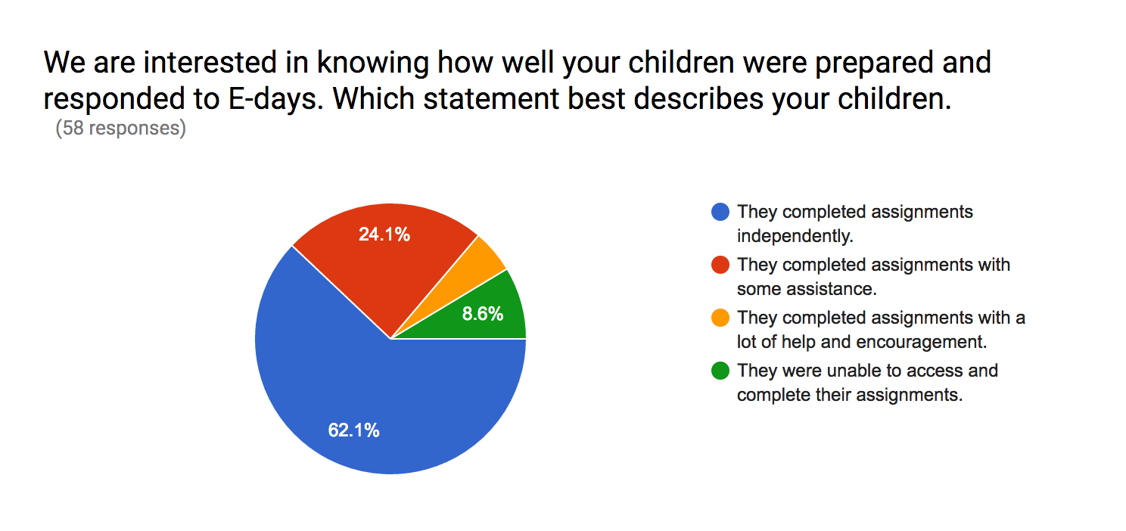
Bancroft-Rosalie Public Schools Family Engagement

Slide 15
Bancroft-Rosalie Public Schools Family Engagement
School Nurse
Free Admission for students to school activities
Mental Health Services provided at school
21st Century Community Learning Center Program
Jumpstart Summer School
Full Day Preschool- 3 and 4 year olds
Scholarships for Dual Credit students

Slide 16
Niobrara Public Schools Family Engagement
School nurse on-site daily
Free admission to school activities
Summer school to address summer slide
Full-day PreK for 3 and 4 year olds
A+ Scholarship for college credit classes (or High Ability Funding used to support those who don’t qualify for the scholarship)

Slide 17
Niobrara Public Schools Family Engagement
School Facebook page coordinated by their parent group- Niobrara School Supporters
Niobrara Public School
Indian Education Parent Committee to ensure tribes and Native American parents can engage in conversations on topics important to them
Meets at least quarterly
Open house/Family Literacy night each semester

Slide 18
Niobrara Public Schools Family Engagement
Midwest and Plains Equity Assistance Center (MAP Center)
As a federally funded organization, funded by the US Dept. of Education and sanctioned under the 1964 Civil Rights Act, we offer free technical assistance surrounding issues of equity to local public school districts and state education agencies across our 13-state region.
greatlakesequity.org
Twitter @greatlakesEAC
Facebook @greatlakesequity

Slide 19
Cross County Community Schools
Family Communication
See Saw
Remind App
Daily notebooks
Weekly files
Positive cards sent home

Slide 20
Cross County Community Schools
Engagement
Community/Family Committee
Family Surveys
Back to school open House
Punch card for families

Slide 21
Cross County Community Schools
Students sing National Anthem at football and
basketball games- families get in free
Cougar Academy- recognize students for NSCAS scores
Family activities per quarter/semester
Dr. Seuss Night
Science Night
Family Game night
Fitness Night
One Book One School
Facilitated IEP’s

Slide 22
Cross County Community Schools
Give Back to the Community activities
Community Coffees
Weekly/Monthly Newsletters
Social Media
Twitter/Facebook
Publicize the great things occurring in the district

Slide 23
Resources to Explore

Slide 24
US Department of Education
Dual Capacity Framework
https://www.ed.gov/parent-and-family-engagement

Slide 25
Nebraska Department of Education
https://www.education.ne.gov/FAMILY/

Slide 26
National Parent Teacher Association
National Standards for Family-School Partnerships, 2008
https://www.pta.org/home/run-your-pta/National-Standards-for-Family-School-Partnerships
PTA National Standards for Family-School Partnerships: An Implementation Guide
https://www.pta.org/docs/default-source/files/runyourpta/national-standards/national_standards_implementation_guide.pdf
Standard 1: Welcoming All Families into the School Community
Standard 2: Communicating Effectively
Standard 3: Supporting Student Success
Standard 4: Speaking up for Every Child
Standard 5: Sharing Power
Standard 6: Collaborating with the Community

Slide 27
Kansas Technical Assistance System Network
Engaging all Families series
10 modules, each 17 minutes long
https://ksdetasn.org/kpirc/engaging-all-families-series
Resource Library
https://ksdetasn.org/search/resources

Slide 28
Colorado Department of Education
These research briefs were developed by CDE and the State Advisory Council for Parent Involvement in Education (SACPIE) to provide information and implications for practice to school leaders as they establish family and community engagement partnerships focused on student achievement.
Creating Opportunity Conditions to Partner with Families in Student Learning
https://www.cde.state.co.us/uip/researchbrief_opportunityconditions
Improving Student Learning with Family and Community Engagement
http://www.cde.state.co.us/uip/researchbrief_studentoutcomes

Slide 29
Attendance Works
A national initiative aimed at advancing student success by reducing chronic absence
Hedy Chang, Director, Attendance Works
http://www.attendanceworks.org/about-us/our-team/hedy-chang/
“Chronic absenteeism is a sign that families have lost faith and hope that schools can deliver a better future for children…It is a sign that something is amiss.”
Online learning modules to reduce chronic absence
http://www.attendanceworks.org/resources/teaching-attendance-curriculum/
Bringing Attendance Home: Engaging Parents in Preventing Chronic Absence
This toolkit is filled with ideas, activities and materials you can use to spark conversations with parents.
http://www.attendanceworks.org/resources/toolkits/bringing-attendance-home/

Slide 30
Teacher Book Study
Powerful Partnerships: A Teacher’s Guide to Engaging Families for Student Success
Karen Mapp, Ilene Carver and Jessica Lander
Scholastic, 2017
Book Study Guide
https://www.scholastic.com/teachers/blog-posts/meghan-everette/17-18/A-Book-Study-Guide-for-Powerful-Partnerships/

Slide 31
Let us know your suggestions regarding how NDE can support your efforts in the area of family/community engagement.

Slide 32
Thank You
Please leave your recommendations for NDE’s next steps.

