Slide 1
Regional SAE Workshop
STATE IMPLEMENTATION EDITION

Slide 2
How to Use the Slides and Facilitator Guide
The slide notes contain three sections where applicable:
Preparation for this slide: Contains any physical setup, visuals to create, or materials to distribute in order to support the content.
Facilitator notes: Contains bulleted instructions for teaching the content, including click animations noted by the () icon.
Other notes: Contains reference to outside resources including source content or additional readings.
Technical Note:
Some slides within the PowerPoint have been intentionally hidden, This is typically because the slide is for facilitator reference only or to ensure proper formatting of the facilitator guide.
Hiding slides leaves them in the appropriate sequence but omits them from audience view when the file is opened in “slide show” view.
Slides that correspond to pages in the Participant Guide will be represented with this icon as well as the related page number(s).
Slides that can be adapted for use at or below the state-level are designated with this grassroots icon.
Participant Guide, page XX.

Slide 3
Materials and Other Preparation
The following materials and tear sheets are needed for this workshop. Numbers in parenthesis refer to the slide(s) where the item is used.
Other Materials Needed
Tear Sheets to Create
Speakers for Video sound
Markers, divided among groups
Participant Guide, one per participant
Sticky notes, several pads per group
“SAE for All” Guide Teacher’s Version, one per participant
Binders with tabbed SAE for All Guides (one copy of each)
Three blank tear sheets (see slide 11)
SAE Barriers, set of two (see slide 24)

Slide 4
Who are you?
Where are you from?
Notes:
Facilitator notes:
Once all participants are settled and have completed the pre-survey, invite them to introduce themselves to the group by answering the four questions on the slide.
Be the first to introduce yourself to model what this looks like.
Explain that your role is to equip this group of teachers with the knowledge and resources to lead an effective implementation of the National Council for Agricultural Education’s “SAE for All” model.
Share that this time together is meant to challenge assumptions, think critically, and create working plans to use beyond this workshop.
Insist that participants ask questions and hold you accountable to meeting their needs in this train-the-trainer format.

Slide 5
Workshop Objectives
Setting the Stage – the need and philosophy
Understanding the “SAE for All” Model
Foundational SAE Component
Notes:
Facilitator notes:
Set context around goals for workshop and why we are here.
Explain that up until now we’ve been demonstrating the need for a new model. Now we will dive into the new model.
Assure participants that SAE for All does not mean a bunch more work for teachers – it is a new framework for how we approach what we do.

Slide 6
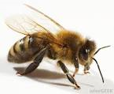
precessional effects
bee’s purpose?
pollination
nectar
processional
effects
Notes:
This slide is designed to introduce the concept of processional effects
Ask the audience why bees go to flowers. Gather several answers and then come to consensus on the bees purpose.
The other answers, most likely pollination, is considered a processional effects
There are both positive and negative positive effects that occur for any primary purpose.
Pollination would be a positive effect.
If there were a disease that attacked flowers that was spread by moving pollen from a diseased flower t a healthy flower this would be a negative effect.

Slide 7
precessional effects
bee’s purpose?
nectar
SAE?
SAE’s Purpose?
Notes:
Facilitate a discussion:
What if the Bee represents SAE? If so, then what do most Ag teachers see as SAE’s purpose? (See the next hidden slide for possible answers.)
Facilitate a discussion about the positive and negative (processional effects/byproducts) of each suggested purpose.

Slide 8
SAE Outcome | Example Positive Effects | Example Negative Effects
Awards and Recognition | Student is motivated by competitive nature of an award or prize. Student sees clear examples of what highly successful projects look like. | Student is limited to projects that align neatly to award areas. Student puts emphasis on attainment of a plaque rather than attainment of skills. Some students get all the recognition and could turn other students off.
Legacy SAE | Student has a head start courtesy of groundwork laid by others. Student has access to mentors who are/have been intimately involved in project. | Student misses the opportunity to develop introductory skills because of head start. Psychological ownership on the part of mentors may result in the student not having ownership themselves. Student might not work hard to improve project.
Record Keeping | Student has a well-documented project. Student develops a skill transferable to a number of contexts. | Student puts emphasis on record keeping over technical skills. Student prioritizes profit over learning.
Application of Learned Skills | Student acquires technical skills relevant to the project. | Student develops skills through a project that may not align with intended career path.
Notes:
These are potential SAE outcomes and positive/negative processional effects.

Slide 9
The Ag Ed Mission
“Agricultural education prepares students for successful careers and a lifetime of informed choices in the global agriculture, food, fiber, and natural resources systems.”
Notes:
Facilitator notes:
Ask participants what is Ag Ed’s purpose which leads them to defining the ag ed mission.
Click to bring up the mission (directly from the National Council for Agricultural Education’s website).
If this is the purpose of ag ed why would the focus of SAE not be the same?
Bring out the fifth poster with career prep focused and ask participants to provide positive and negative processional effects on the new poster
Have participants voice these as the facilitator writes them on the poster.
Make note that there should be greater positive effects than the previous four posters

Slide 10
Awards and Recognition
Record Keeping
CAREER PREPARATION
WORK-BASED LEARNING EXPERIENCE
Legacy SAE
Application of Learned Skills
Notes:
Facilitator notes:
This slide is a wrap up of the processional effects and can show that moving to a career prep focus SAE can still provide the positive outcomes of the other four posters
Explain that the work-based learning experience is the starting point in a student’s journey. The end destination is the student being prepared to enter his or her career.
 Click to connect the starting and ending points as you explain that SAE is the mechanism that moves them from Point A to Point
Explain that, along the way, various processional effects transpire.
 Click again reveal four subsequent outcomes of SAE, describing them as they are revealed.
Reiterate that the intended destination hasn’t changed. The journey has just become a bit more scenic.

Slide 11
DISCUSSION
What are we currently doing in the Ag Ed program that is career preparation focused?
Notes:
Preparation for this slide:
Post three unlabeled, blank tear sheets next to one another. You will label them later in the activity.
Facilitator notes:
Ask participants to consider the question on the screen in light of the mission statement they just read.
Capture responses on one of the tear sheets accordingly (these tear sheets are still unlabeled):
Responses related to FFA/leadership development on Poster A
Responses related to classroom instruction/knowledge and skills on Poster B
Responses related to experiential/work-based learning on Poster C
Pose the following questions for discussion: What does the ideal work-based learning program look like?
What are the outcomes that we want from classroom instruction and SAE?

Slide 12
DISCUSSION
What could ideally be done to focus an Ag Ed program even further on career preparation?
Notes:
Facilitator notes:
Pose the question on this slide to the participants. Change the color of the marker to record this input
Once you have generated a substantial list for each poster (leadership, classroom instruction, work-based learning) label each poster and move the FFA/leadership development poster out of sight.
Explain that the focus for this workshop will be on the remaining two elements of the three-component model.
Capture responses on the same tear sheets used for the previous discussion question, but this time in a different color ink.

Slide 13
Who is credited as the father of SAE?
A. Henry Groseclose
B. C.H. Lane
C. Rufus W. Stimson
Participant Guide, page 1.
Notes:
Preparation for this slide:
The intent for these five quiz questions is not to see what participants know/don’t. The questions exist to set context for the path that brought SAE to modern day. For this reason, don’t dwell on the questions/answers.
Facilitator notes:
Explain that while it hasn’t always been called SAE, the concept of project-based learning in agricultural education has been around for more than 100 years.
Share that participants will “show what they know” by testing their knowledge individually.
 Click to reveal the first question and give participants 15 seconds to determine the correct answer and circle it on page 1 in their Participant Guide.
 Click again to reveal the correct answer.
Correct Answer: Rufus W. Stimson
 Click again to display next slide and give context.

Slide 14
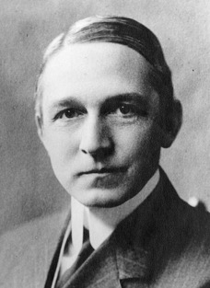
Rufus Stimson: Father of SAE
1908 Rufus Stimson appointed the first director of the new Smith Agricultural School in Northampton, Massachusetts
Agricultural education consisted mainly of lecture, recitation, and labor on a school farm
Stimson believed that students spent more time observing others work than they did working themselves
Stimson introduced a new method at Smith, the “project method” where students applied classroom knowledge on their home farm operations
Notes:
Facilitator notes:
Share the following context set. Make sure learners understand that student projects are the roots of agricultural education.
In 1908, Rufus Stimson was appointed the first director of the new Smith Agricultural School in Northampton, Massachusetts.
Agricultural education, at this time, consisted mainly of lecture, recitation, and labor on a school farm.
Stimson believed that students spent more time observing others work than they did working themselves.
Seeking a more ideal learning environment, Stimson introduced a new method at Smith, the “project method” where students applied classroom knowledge on their home farm operations.
Other notes:
Citation: Moore, G. E. (1988). The Forgotten Leader In Agricultural Education: Rufus W. Stimson. Journal of Agricultural Education, 29(3), pp. 50-58. Retrieved from http://www.jae-online.org/attachments/article/855/Moore,%20G_Vol29_3_50-58.pdf.

Slide 15
Which factor did not drive the development of SAE?
A. Roughly one-third of the U.S. population lived on farms.
B. The average per capita income was $3,200 per year.
C. Farmers and farm laborers comprised 31% of the labor force.
Participant Guide, page 1.
Notes:
Facilitator notes:
 Click to reveal the correct answer.
Correct Answer: The average per capita income was $3,200 per year.
Other notes:
Citation: R. Stimson. (1920). Vocational Agricultural Education By Home Projects The MacMillan Company, New York.

Slide 16
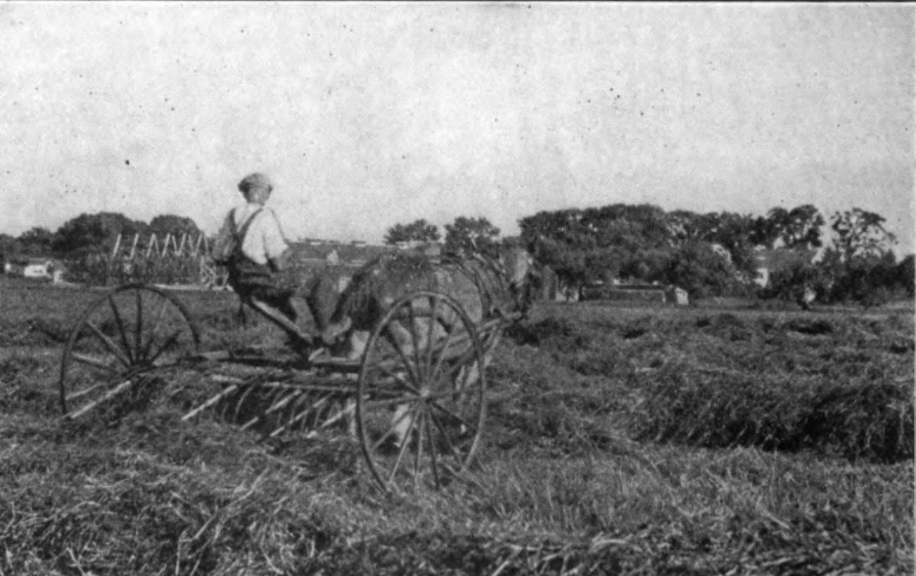
The Need for Applied Learning
34% of the U.S. population lived on farms
Farmers and farm laborers constituted 31% of the U.S. labor force
These two factors demanded a skilled workforce
Notes:
Facilitator notes:
Share the following context. Emphasize that the nature of the job market necessitated skilled workers.
34% of the U.S. population lived on farms.
Farmers and farm laborers constituted 31% of the U.S. labor force.
Other notes:
Citation: R. Stimson. (1920). Vocational Agricultural Education By Home Projects The MacMillan Company, New York.

Slide 17
Smith Agricultural School accepted female students for study. True or False?
A. True
B. False
Participant Guide, page 1.
Notes:
Facilitator notes:
 Click to reveal the correct answer.
Correct Answer: True

Slide 18
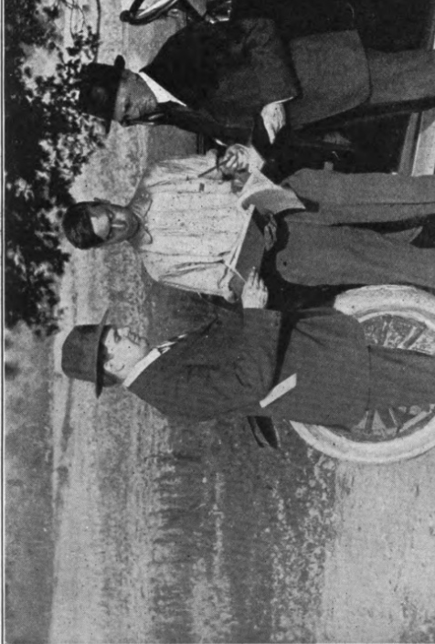
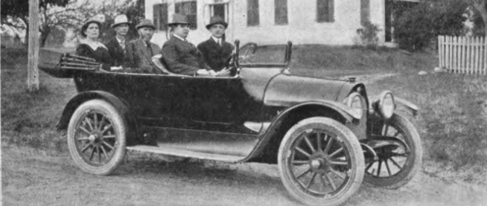
Requirements for Study
The deciding factor in acceptance into the Smith School of Agriculture was not gender but rather “serious intent” to pursue a career in agriculture.
Advisory committees were assembled to guide students in projects.
Notes:
Facilitator notes:
Share the following context. Emphasize that the Smith School wanted students who would apply their knowledge to their career.
The deciding factor in acceptance was not gender but rather “serious intent” to pursue a career in agriculture.
Advisory committees were assembled to help guide students as they developed their project. Of note, Rufus Stimpson was a huge proponent of advisory committees and required at least one female to be a part of each committee.

Slide 19
Three types of project existed at Smith Agricultural School. Which type was required?
A. Production projects
B. Improvement projects
C. Trial projects
Participant Guide, page 1.
Notes:
Facilitator notes:
 Click to reveal the correct answer.
Correct Answer: Production projects

Slide 20
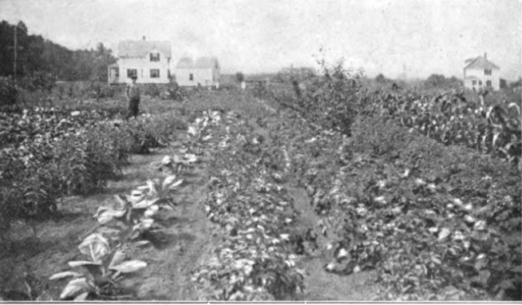
Emphasis on Agricultural Production
While every student was “encouraged” to have Improvement and Trial projects, only Production projects were “required”
Notes:
Facilitator notes:
Share the following context.
While every student was “encouraged” to have Improvement and Trial projects, only Production projects were “required.”

Slide 21
Project work accounted for what percent of each day’s instruction?
A. 12%
B. 30%
C. More than 50%
Participant Guide, page 1.
Notes:
Facilitator notes:
 Click to reveal the correct answer.
Correct Answer: More than 50%

Slide 22
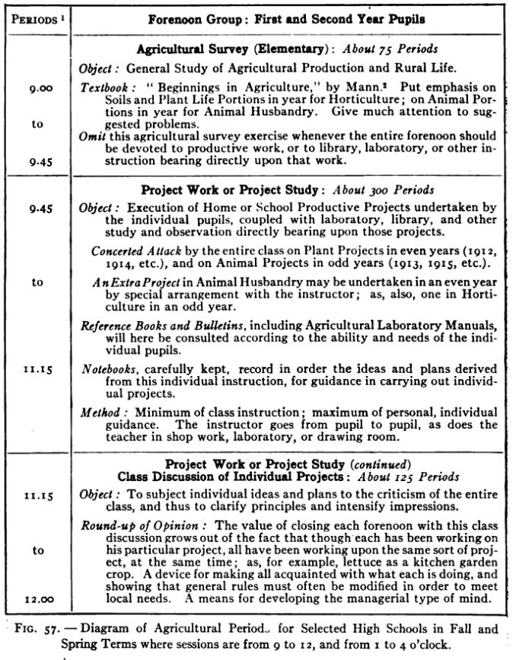
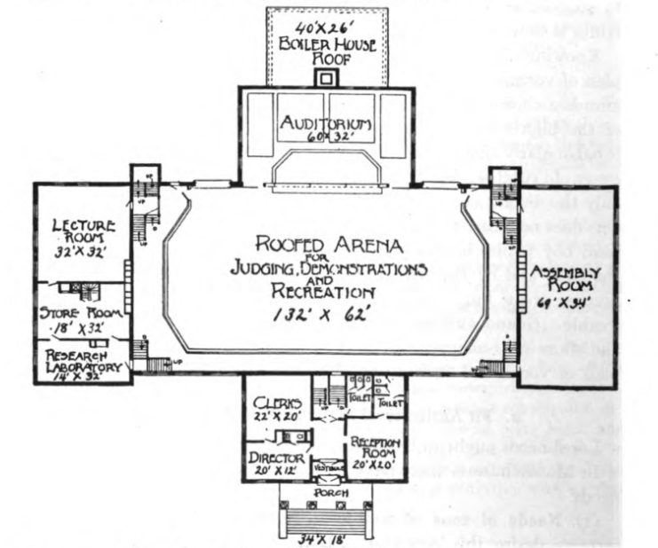
Supporting Project-Based Learning
More than half of each day’s instruction was spent working on projects.
Facilities at the school were designed to support project work and students were supervised accordingly.
Notes:
Facilitator notes:
Share the following context.
Project work accounted for more than half of each day’s instruction.
The facilities at Smith Agricultural School were designed to support project work and students were supervised accordingly.

Slide 23
DISCUSSION
How is Stimson’s “Project Method” similar to today’s Supervised Agricultural Experience?
Notes:
Preparation for this slide:
Based on your knowledge of the group and the limited time you’ve spent with them, forecast the level of moderation this conversation will require of you as the facilitator.
The discussion should create consensus for an optimistic, future-focused approach to SAE but should not exceed 10 minutes.
Facilitator notes:
Invite participants to discuss the question on this slide as a large group.
Guide the discussion to the realization that the goals remain the same, but context has changed, therefore delivery must change. Potential guiding questions could include:
How has the demand for skilled labor changed relative to the number of U.S. workers involved in agriculture? (The percentage of labor force in agriculture has decreased while the demand for skilled workers has increased.)
Stimson’s method was based engaging every student through projects on their home operations. How does SAE engage every student today? (Fewer students have home operations so many students maintain placement SAEs.)
Emphasize that we, as agricultural education professionals, are not leaving our roots nor abandoning what we value, we are coming full circle to where we started.
The current educational system and Perkins V are focused on project-based education/work-based learning.
Discuss the difference between today’s culture and today’s educational climate.

Slide 24
Step 1. THINK
What barriers might inhibit meaningful educational and career-readying experiences through SAE?
Step 2. PAIR
Step 3. SHARE
Notes:
Preparation for this slide:
Create two tear sheets. Label one “Teacher Barriers” and the other “Student Barriers” with ample space beneath each label.
Divide the “Student Barriers” poster into two columns: “No SAE” and the other “Limited Value,” explaining that this indicates an SAE with limited value for student’s career goals, with ample space beneath each label.
Be prepared to save these posters. You’ll refer back to them later in the workshop.
Facilitator notes:
Introduce the two posters. Explain that one represents barriers faced by teachers and the other faced by students.
Explain that student barriers may look different for a student who lacks an SAE versus a student who has an SAE with limited career preparation value (i.e. feeding their dog).
Draw participants’ attention to the question on the screen and ask them to accomplish the following ( click to reveal instructions):
First, ask them to think independently about how they’d answer the question for the two students represented by the posters. Ask them to jot down three to five ideas for each poster.
Second, ask them to turn to their immediate neighbors and share their thoughts in pairs or trios.
Finally, divide the pairs by having one go to each poster. Have each large group work together to make a single list on each poster. Have each large group share with the rest of the participants.
Bring closure to this exercise by emphasizing that these barriers represent the current state of SAE and signify the need for a new approach, they do not necessarily indicate the future state of SAE.
Ask participants to consider the potential a new approach might offer by posing this question: “If we were to rethink our approach to SAE in a way that students maintained high-quality projects, how would their learning experience be richer?”
Ask: “How would agriculture teachers benefit from their students having quality SAEs?”

Slide 25
Let’s hit
PAUSE.
We’ve discussed:
The present state of SAE
Purpose of SAE
SAE History
SAE Barriers
Where do you think SAE for All should go from here?
Notes:
Facilitator notes:
Pause and allow the participants to reflect on the content in this session. Consider asking the following questions to gauge where participants are in their understanding of the content and their confidence in executing the model within their local program:
What from this section can I clarify?
Based on the information in this section, how confident are you in your ability to implement this model in your program? (Consider asking participants to indicate their confidence using a hand-gesture scale of 1-5 fingers where five fingers indicates high confidence.)
Ask those who indicated a three or below what they would need to gain confidence.

Slide 26
Spring
Fall
2010
2011
2011
Council initiates SAE renewal
National Ag Ed Summit – SAE held in Orlando
NCAE and AERO SAE committees formed
Fall
Spring
2015
2015
SAE resource development starts
Council approves SAE philosophy and guiding principles
Fall
Fall
Summer
Fall
2016
2017
2018
2018
SAE Summit held in Omaha
SAE for All guides released for students and teachers
Independent Learning Guides released
Council approves
Plaid Agency marketing plan
Fall
Spring/Summer
Winter
2019
2019
2019
SAE for All Implementation
Regional Train-the-Trainer events held
Marketing plan initiates
Notes:
Facilitator notes:
Briefly set context that this has been a multi-year process with various stakeholders to develop and test the model and now we are ready to roll it out nationally and ensure it is successful.
Note: Facilitators are not meant to walk through the timeline on screen- it is just meant to be a visual to display how long the project has been going on.
Draw attention that there have been opportunities in the past decade for input and participation of all members of Team Ag Ed

Slide 27
Supervised Agricultural Experience is…
A student-led, instructor-supervised, work-based learning experience
that results in measurable outcomes
within a pre-defined, agreed upon set of Agriculture, Food, and Natural Resources (AFNR) Technical Standards and Career Ready Practices
aligned to a career plan of study.
Participant Guide, page 2.
Notes:
Facilitator notes:
Share that you’ll be presenting a renewed definition for SAE.
Ask participants to raise a thumbs up when they feel as though the definition is adequate.
The definition on this slide is intentionally broken into four parts.  Click to reveal each component.
After the fourth and final component is revealed, allow learners to copy the complete definition into their Participant Guide on page 2.
Emphasize that this renewed definition moves beyond the basics to ensure alignment to AFNR standards and career focus.
Explain that this definition can provide opportunity for students with career goals outside of AFNR when content outcomes align with both agricultural careers and the student’s career goals.
Share that each element of this definition is broken down in greater detail in both the student and teacher versions of the ”SAE for All” guide (page 2 in both versions).
Other notes:
Both versions of the “SAE for All” guides can be found on the National Council for Agricultural Education website at https://thecouncil.ffa.org/sae/.

Slide 28
ISAAC:
He took “Introduction to Ag” the first semester of his Freshmen year. Then, he took electives for the next two semesters. He’s enrolled in “Environmental Science” for his Sophomore spring semester.
EMMA:
TORI:
She wasn’t enrolled in your program until the fall of her Senior year when she decided to take “Ag Welding” to earn dual credit.
She’s a graduating Senior who has taken agricultural education classes every semester of her high school career.
Notes:
Preparation for this slide:
Foundational SAEs will be a mindset shift for most experienced teachers. Before diving into the technical content, spend a few minutes demonstrating the need for a new approach.
Facilitator notes:
By a show of hands, identify who in the room is a current or former agriculture teacher.
For those that aren’t, ask them to imagine themselves in the role.
Ask participants to raise their hand if they have taught/met/or heard of students like Tori who take four years of agricultural education courses.
Ask participants to raise their hand if they have taught/met/or heard of students like Isaac who come in and out of the program multiple times throughout their high school career.
Ask participants to raise their hand if they have taught/met/or heard of students like Emma who take only one course in the program.
 Click to focus participants’ attention on Isaac and Emma and away from Tori.
Ask what challenges exist in reinforcing SAE among students such as them. For example:
Students like Isaac may lack continuity in their project and their record keeping. When they re-enter the program, they may be starting at square one again.
Students like Emma may see one-off ag classes as a means to graduation. While she has a number of other things on her plate (potentially a part-time job) and limited time, she may comfortable doing the bare minimum.
Explain that a new classification of SAE — Foundational SAEs — alleviate some, if not all, of those challenges by enabling students to engage in SAE from the moment they enroll in agricultural education.

Slide 29
View this video in a larger online lesson when you visit thecouncil.ffa.org.
Click on SAE and launch the Learning Guides Online Course.
Notes:
Facilitator notes:
Before playing the video, acknowledge that the term “Foundational SAEs” may be a new term to veteran professionals.
Emphasize that it’s a new term to students as well, so the National Council for Agricultural Education has produced this video to explain the term to students.
Reassure the group that while they may not be the intended audience, the video does a nice job explaining the concept.
Following the video, reassure participants that you’re about to dissect the five elements of a Foundational SAE one-at-a-time.
Other notes:
This video is from the “Learning Guides Online Course” found on the National Council for Agricultural Education website at https://thecouncil.ffa.org/sae/.

Slide 30
Notes:
Facilitator notes:
Introduce the “SAE Student Roadmap” model
Explain that the new SAE for All model starts with the students entering the agricultural education program.

Slide 31
SAE Student Roadmap
Awareness
Grades 6-9
Intermediate
Grades 9-11
Advanced
Grades 11-12
Foundational
Notes:
Facilitator notes:
Click to bring up the word “Foundational”
Explain that the Foundational SAE is designed to extend throughout the student’s entire time in Ag Ed. It is NOT just a one-time project or event.
Click to bring up the three levels.
Explain that as a student progresses through Ag Ed that they should “level up” with their Foundational SAE. Describe that the three levels allow for students to enter Ag Ed at the Middle or High School level.

Slide 32
SAE Student Roadmap
Awareness
Grades 6-9
Intermediate
Grades 9-11
Advanced
Grades 11-12
Career Exploration and Planning
Employability Skills for College and Career Readiness
Foundational
Personal Financial Management and Planning
Workplace Safety
Agricultural Literacy
The agricultural literacy component of a Foundational SAE may be transitioned to one or more Immersion SAEs. All Foundational SAE components and Level 1 Immersion SAEs are intended to be graded.
Notes:
Facilitator notes:
Click to move the word “Foundational” to the side.
Explain that everything that we will add in the green Foundational arrow is a component of a Foundational SAE.
Emphasize that what we are about to add are not “choices” of different types of Foundational SAEs, but rather all contribute to a complete Foundational SAE. (Nothing on the screen is “optional”.)
Emphasize that everything in the Foundational green arrow is intended to be graded (in every class), which ensures that this is truly an SAE for All students.
Ask teachers if they currently give a class grade for SAE, and if so, what percent?
Ask how much class time they give to SAE and how that is used (usually record books). Based on the percent grade, we should allow ourselves time in class to spend on SAE. For example, a 20% grade is one day each week; a 10% is one day every other week.
What if we were to expand how we use class time for SAEs to includes other artifacts beyond a traditional record book?
Click to bring up the blank bars.
Explain that there are five parts. Re-emphasize that all are necessary for a Foundational SAE.
Click to bring up each component of a Foundational SAE.
Provide a bit of commentary for each part to draw attention to each component individually.
Emphasize the need of each component for every student. “Doesn’t every student deserve to spend time individually planning for their career?” etc.
Click to bring up the small Ag Literacy text.
Explain how Ag Literacy can “fade away” for students who may add an Immersion SAE. Mention that you’ll talk about that later as well.

Slide 33
Awareness
Grades 6-9
Intermediate
Grades 9-11
Advanced
Grades 11-12
Career Exploration and Planning
Foundational
Employability Skills for College and Career Readiness
Personal Financial Management and Planning
Workplace Safety
Agricultural Literacy
The agricultural literacy component of a Foundational SAE may be transitioned to one or more Immersion SAEs. All Foundational SAE components and Level 1 Immersion SAEs are intended to be graded.
Conceptual example of how Foundational SAE components may be delivered.
Notes:
Facilitator notes:
After the Career Exploration and Planning box expands, explain that we are going to provide a conceptual example of what students may experience within the Career Exploration and Planning component of a Foundational SAE at the three levels.
Click to move to the top.

Slide 34
Awareness
Grades 6-9
Intermediate
Grades 9-11
Advanced
Grades 11-12
Career Exploration and Planning
Complete Career Interest Inventory (ex. AgExplorer.com)
Career Pathway Goals
Start 4-year Career Plan
Academic
Immersion SAE Research/Plan
Career Readiness Skills/Leadership
Revisit Career Goals
Update Career Plan
Pursue Shadowing Opportunities
Develop Immersion SAE Plan
Explore post-secondary options and terminology
Specific post-secondary research and planning based on Career Goals
Financial aid research
Revisit Career Goals
Update Career Plan
Application to post-secondary
Application for financial aid
Identify and contact support at post-secondary level
Foundational
Employability Skills for College and Career Readiness
Personal Financial Management and Planning
Workplace Safety
Agricultural Literacy
The agricultural literacy component of a Foundational SAE may be transitioned to one or more Immersion SAEs. All Foundational SAE components and Level 1 Immersion SAEs are intended to be graded.
Conceptual example of how Foundational SAE components may be delivered.
Notes:
Facilitator notes:
Click to show the Awareness examples.
Describe the value of a student who would experience these types of activities.
Draw particular attention to the Career Plan and the value it gives to the rest of the student experience.
Click to show the Intermediate examples.
Describe how the experiences listed here would help to “level up” students, individualizing and personalizing it for students.
Click to show the Advanced.
Continue the conversation.
Discuss that we “could” expand each of the other Foundational components (workplace safety, etc), but that participants will do that and also find examples in the SAE for All guide materials.
Click to “close” the example.

Slide 35
SAE Student Roadmap
Awareness
Grades 6-9
Intermediate
Grades 9-11
Advanced
Grades 11-12
Career Exploration and Planning
Employability Skills for College and Career Readiness
Foundational
Personal Financial Management and Planning
Workplace Safety
Agricultural Literacy
The agricultural literacy component of a Foundational SAE may be transitioned to one or more Immersion SAEs. All Foundational SAE components and Level 1 Immersion SAEs are intended to be graded.
Notes:
Facilitator notes:
Click to the next slide.

Slide 36
Class
SAE
FFA
Notes:
Facilitator notes:
Click to add the arrow.
Emphasize that the Foundational SAE “lives” in the sliver between the Class and SAE component of the Ag Ed Model.
Discuss that these things are “okay” to do in the classroom.
Click to move back.

Slide 37
SAE Student Roadmap
Awareness
Grades 6-9
Intermediate
Grades 9-11
Advanced
Grades 11-12
Career Exploration and Planning
Employability Skills for College and Career Readiness
Foundational
Personal Financial Management and Planning
Workplace Safety
Agricultural Literacy
The agricultural literacy component of a Foundational SAE may be transitioned to one or more Immersion SAEs. All Foundational SAE components and Level 1 Immersion SAEs are intended to be graded.
Notes:
Facilitator notes:
Explain that we’ll now add Immersion SAE.
Click to advance.

Slide 38
Awareness
Grades 6-9
Intermediate
Grades 9-11
Advanced
Grades 11-12
Career Exploration and Planning
Employability Skills for College and Career Readiness
Foundational
Personal Financial Management and Planning
Workplace Safety
Agricultural Literacy
The agricultural literacy component of a Foundational SAE may be transitioned to one or more Immersion SAEs. All Foundational SAE components and Level 1 Immersion SAEs are intended to be graded.
Five Immersion SAE categories span three levels of motivation.
Every enrolled agricultural education student shall have a Foundational SAE. As part of this SAE, students will maintain intensive Career Exploration and Planning, Personal Financial Management and Planning and Workplace Safety components throughout their high school career. Students will also start an Agricultural Literacy project that may transform into one or more Immersion SAEs.
Graded
Recognition
Career-Ready
Placement / Internship
Ownership / Entrepreneurship
Research: Experimental, Analysis or Invention
School-Based Enterprise
Service Learning
Notes:
Facilitator notes:
Click to slide up the Foundational SAE.
Click to add the arrows.
Reemphasize that what we are going to add is in addition to students maintaining a Foundational SAE.
Click to add the Immersion box.
Everything added in this box is considered an Immersion SAE.
Click once to add all five Immersion SAE categories.
Provide a brief explanation of each, reminding participants that they will have a “deep dive” of each Immersion SAE at a later time.
Explain that Immersion SAEs are designed to be “RESUME WORTHY” experiences.
Immersion SAEs directly align to Perkins V’s definition of Work-Based Learning Experiences. (Good info for state staff, in particular.)
Click once to add the three levels of Immersion SAEs.
Discuss that teachers should have graded expectations when they have an Immersion SAE.
The reason the Ag Literacy component “fades away” is because we are now also requiring graded artifacts for an Immersion SAE, which replaces the Ag Literacy grade.
Discuss how we hope “stair step” student from extrinsic motivation (graded expectations) to more intrinsic motivation (recognition through FFA and career readiness, or being passionate about their future career).

Slide 39
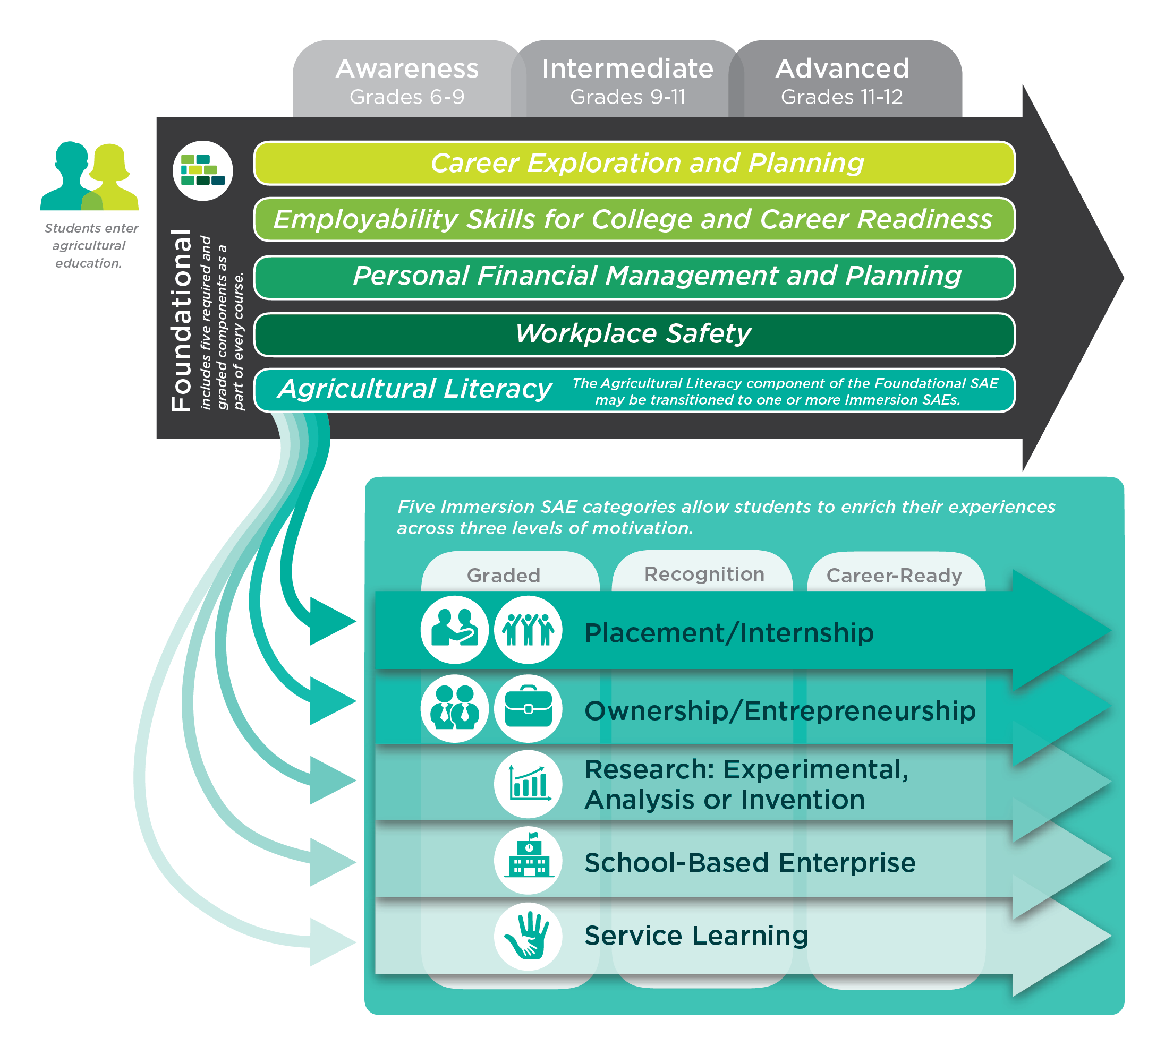
Notes:
Facilitator notes:
Explain this is how the SAE for All Roadmap appears in the SAE guides.

Slide 40
Five Elements of Foundational SAEs
1. Career Exploration and Planning
2. Employability Skills for College and Career Readiness
3. Personal Financial Management and Planning
4. Workplace Safety
5. Agricultural Literacy
Participant Guide, page 2.
Notes:
Facilitator notes:
Remind participants that Foundational SAEs consist of five required and graded elements
Direct participants to pages 10-11 in the “SAE for All” Teacher Guide and allow time for them to read about each of the five elements.
Offer clarity as needed.
Other notes:
Access the “SAE for All” Teacher Guide at https://thecouncil.ffa.org/sae-resources/.

Slide 41
Mapping Learning Outcomes
“Students will summarize their individual results of a career interest inventory in a five-minute presentation.”
Career Exploration and Planning
Awareness: Grades 6-9
Participant Guide, page 3.
Notes:
Preparation for this slide:
Create a tear sheet that associates each of the five elements of Foundational SAE with a number between one and five as shown at the bottom of page 2 in the Participant Guide. Label the poster “Map Legend” and display it prominently in view of all participants.
Facilitator notes:
Emphasize that the elements of Foundational SAE are meant to be measurable and graded components of every agricultural course.
Explain that you’re about to share a series of eight sample learning objectives that agricultural education instructors can use in their classroom.
Clarify that each objective can be mapped back to one of the five elements.
Using the poster you’ve created as a “Legend,” instruct participants to use their fingers to silently correspond each objective to one of the five elements.
 Click to reveal the first objective.
Invite silent answers using fingers
 Click again to reveal the answer. Process through any disagreement.
Instruct participants to capture the correct answers on page 3 in their Participant Guide.
Ask for verbal guesses as to which grade level (awareness, intermediate, advanced) the activity would correspond.
 Click a third time to reveal the correct level.

Slide 42
Mapping Learning Outcomes
“Students will collect and compare a personal, peer and mentor rating of their level of responsibility.”
Employability Skills for College and Career Readiness
Intermediate: Grades 9-11
Participant Guide, page 3.
Notes:
Facilitator notes:
 Click to reveal the next objective.
Invite silent answers using fingers
 Click again to reveal the answer. Process through any disagreement.
Instruct participants to capture the correct answers on page 3 in their Participant Guide.
Ask for verbal guesses as to which grade level (awareness, intermediate, advanced) the activity would correspond.
 Click a third time to reveal the correct level.

Slide 43
Mapping Learning Outcomes
“Students will analyze current trends in AFNR systems and predict their impact on local, state, national, and global levels in a two-page essay.”
Agricultural Literacy
Intermediate: Grades 9-11
Participant Guide, page 3.
Notes:
Facilitator notes:
 Click to reveal the next objective.
Invite silent answers using fingers
 Click again to reveal the answer. Process through any disagreement.
Instruct participants to capture the correct answers on page 3 in their Participant Guide.
Ask for verbal guesses as to which grade level (awareness, intermediate, advanced) the activity would correspond.
 Click a third time to reveal the correct level.

Slide 44
Mapping Learning Outcomes
“Using a financial management tool, students will generate a balance sheet, income statement and statement of cash flow.”
Personal Financial Management and Planning
Intermediate: Grades 9-11
Participant Guide, page 3.
Notes:
Facilitator notes:
 Click to reveal the next objective.
Invite silent answers using fingers
 Click again to reveal the answer. Process through any disagreement.
Instruct participants to capture the correct answers on page 3 in their Participant Guide.
Ask for verbal guesses as to which grade level (awareness, intermediate, advanced) the activity would correspond.
 Click a third time to reveal the correct level.

Slide 45
Mapping Learning Outcomes
“Students will create a slideshow that features images found online of ten instances of workers adhering to personal protective equipment requirements and ten instances of workers not adhering to PPE requirements.”
Workplace Safety
Intermediate: Grades 9-11
Participant Guide, page 3.
Notes:
Facilitator notes:
 Click to reveal the next objective.
Invite silent answers using fingers
 Click again to reveal the answer. Process through any disagreement.
Instruct participants to capture the correct answers on page 3 in their Participant Guide.
Ask for verbal guesses as to which grade level (awareness, intermediate, advanced) the activity would correspond.
 Click a third time to reveal the correct level.

Slide 46
Mapping Learning Outcomes
“Students will differentiate three talents and strengths of a classmate and translate them to a workplace context.”
Employability Skills for College and Career Readiness
Advanced: 11-12
Participant Guide, page 3.
Notes:
Facilitator notes:
 Click to reveal the next objective.
Invite silent answers using fingers
 Click again to reveal the answer. Process through any disagreement.
Instruct participants to capture the correct answers on page 3 in their Participant Guide.
Ask for verbal guesses as to which grade level (awareness, intermediate, advanced) the activity would correspond.
 Click a third time to reveal the correct level.

Slide 47
Mapping Learning Outcomes
“Students will summarize one peer-reviewed research article about a historical public policy that affected AFNR systems.”
Agricultural Literacy
Advanced: 11-12
Participant Guide, page 3.
Notes:
Facilitator notes:
 Click to reveal the next objective.
Invite silent answers using fingers
 Click again to reveal the answer. Process through any disagreement.
Instruct participants to capture the correct answers on page 3 in their Participant Guide.
Ask for verbal guesses as to which grade level (awareness, intermediate, advanced) the activity would correspond.
 Click a third time to reveal the correct level.

Slide 48
Mapping Learning Outcomes
“Students will conduct a four-minute interview with a professional from the AFNR pathway of their choosing.”
Career Exploration and Planning
Awareness: 6-9
Participant Guide, page 3.
Notes:
Facilitator notes:
Facilitator notes:
 Click to reveal the next objective.
Invite silent answers using fingers
 Click again to reveal the answer. Process through any disagreement.
Instruct participants to capture the correct answers on page 3 in their Participant Guide.
Ask for verbal guesses as to which grade level (awareness, intermediate, advanced) the activity would correspond.
 Click a third time to reveal the correct level.
Instruct learners to again use their fingers to indicate a number between one and five. This time, the number indicates their level of confidence in incorporating the five elements of Foundational SAE into classroom activities.
Establish that ”one” represents very low confidence and “five” represents very high confidence.
Ask those who indicated a three or below what they would need to gain confidence.
Explain that these eight learning objectives were created using an Appendix resource of the version of the “SAE for All” Teacher Guide.
If time permits, encourage learners to review that resource which begins on page 31.

Slide 49
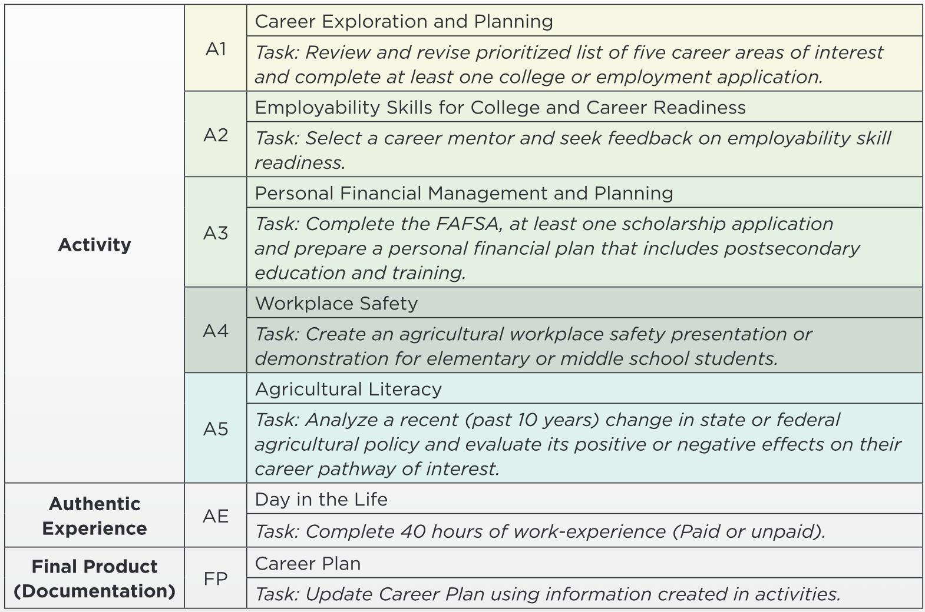
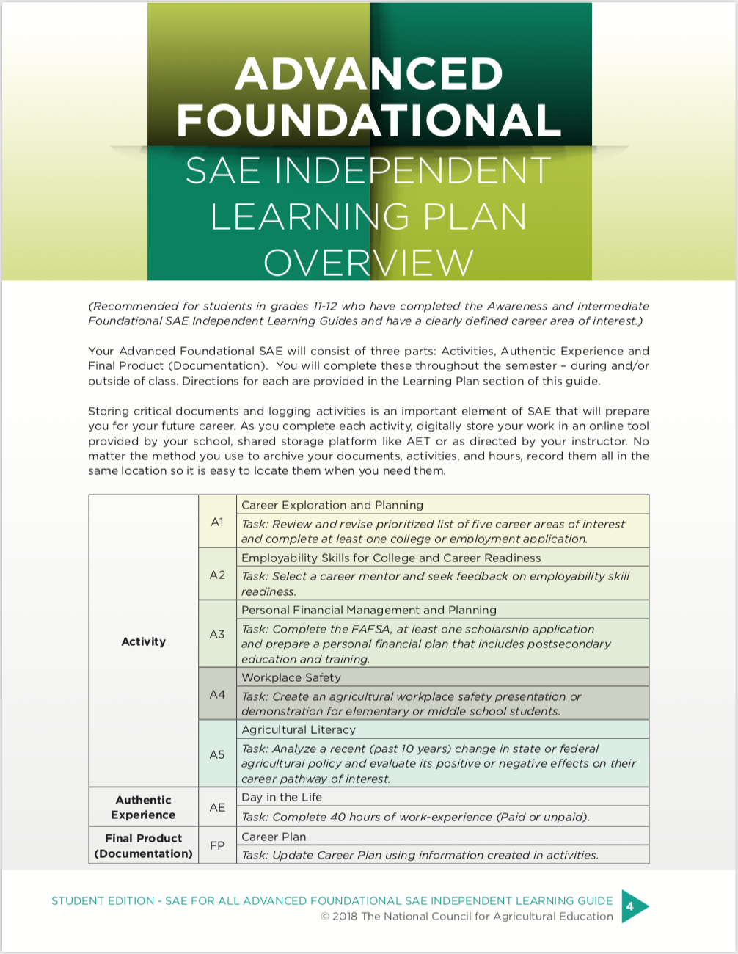
Notes:
Preparation for this slide:
Familiarize yourself with the National Council for Agricultural Education website, particularly the “SAE Resources” page (http://thecouncil.ffa.org/sae-resources/) and locate the Individualized Learning Guides.
Facilitator notes:
Explain that the “SAE for All” guide isn’t the only place to find learning activities that support Foundational SAE.
The National Council for Ag Education website features a series of Individual Learning Guides as student resources.
 Click to trigger an animation that zooms on the activity table.
Share that each guide contains activities, authentic experiences and documentation guidelines. Grading rubrics and activity pages are also provided.
Explain that different versions of the guide exist for various grade levels from grades six through twelve.

Slide 50
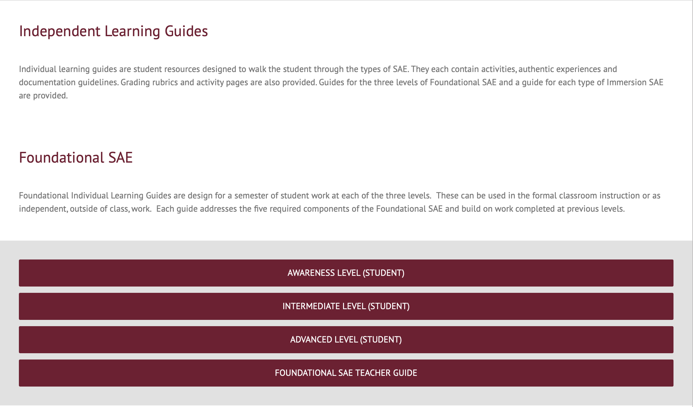
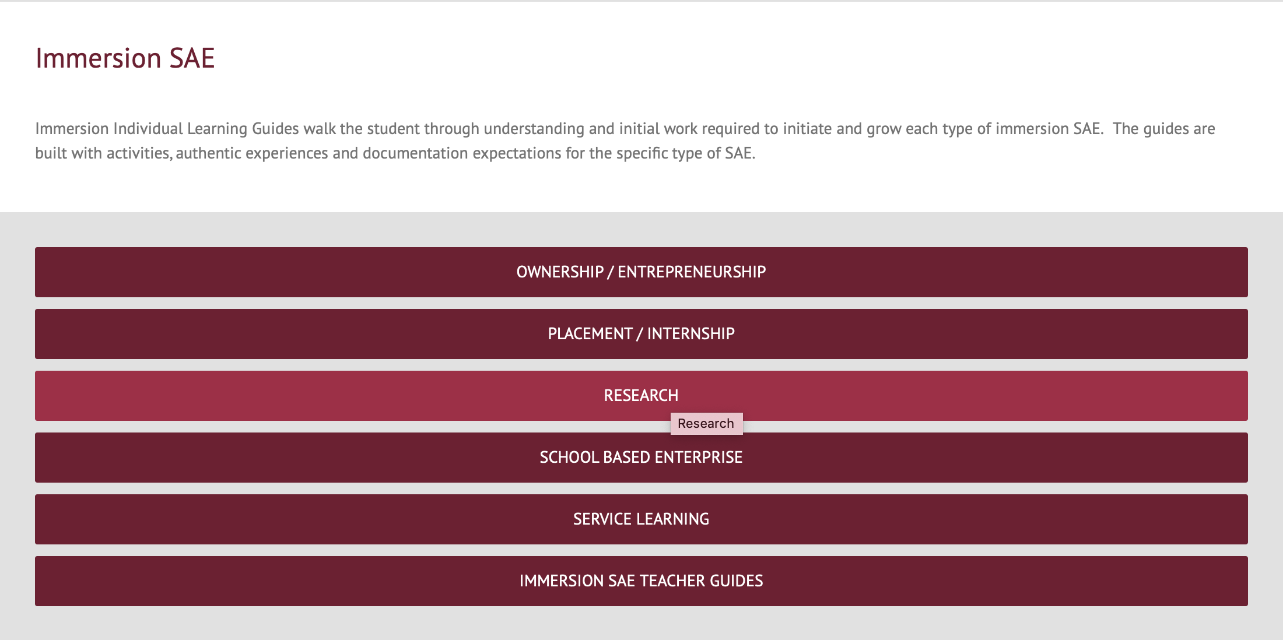
SAE Resources
http://thecouncil.ffa.org/sae-resources/
Notes:
Facilitator notes:
Acknowledge that we don’t have time to dive deep into the guide here, but encourage participants to explore them on their own.
 Click on the link to show participants where the Individual Learning Guides can be found on the Council website (requires WiFi).

Slide 51
ISAAC:
He took “Introduction to Ag” the first semester of his Freshmen year. Then, he took electives for the next two semesters. He’s enrolled in “Environmental Science” for his Sophomore spring semester.
AWARENESS
EMMA:
TORI:
She wasn’t enrolled in your program until the fall of her Senior year when she decided to take “Ag Welding” to earn dual credit.
She’s a graduating Senior who has taken agricultural education classes every semester of her high school career.
INTERMEDIATE
ADVANCED
Notes:
Facilitator notes:
Tell participants that even delivering foundational SAE’s can be differentiated. This allows us to meet students where they are. No matter where they are at in their Ag Ed journey, we can tailor foundational SAEs to meet their needs.
Revisit Tori, Isaac, and Emma to introduce the different levels of Foundational SAEs.
Awareness: Grades 6-9
 Click to trigger label by Isaac
Intermediate: Grades 9-11
 Click to trigger label by Emma
Advanced: Grades 11-12
 Click to trigger label by Tori

Slide 52
Let’s hit
PAUSE.
What from this section can I clarify?
Based on the information in this section, how confident are you in your ability to implement this model in your program?
Notes:
Facilitator notes:
Pause and allow the participants to reflect on the content in this session. Consider asking the following questions to gauge where participants are in their understanding of the content and their confidence in executing the model within their local program:
What from this section can I clarify?
Based on the information in this section, how confident are you in your ability to implement this model in your program? (Consider asking participants to indicate their confidence using a hand-gesture scale of 1-5 fingers where five fingers indicates high confidence.)
Ask those who indicated a three or below what they would need to gain confidence.

Slide 53
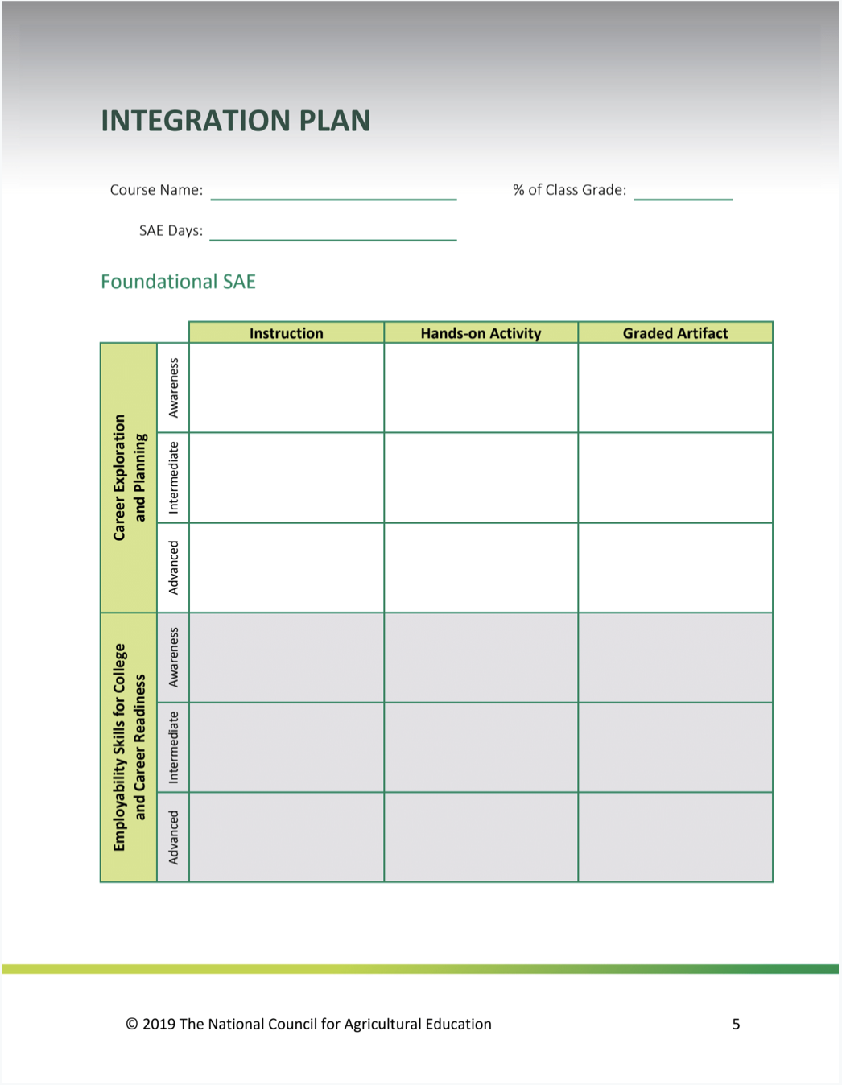
Integration Plan: Foundational SAE
Instruction |  |  | What will you teach?
Hands-on Activity |  |  | How do you plan to teach it?
Graded Artifact |  |  | How will you know students understand it?
Participant Guide, page 4-5.
Notes:
Facilitator notes:
Acknowledge that participants are the key ingredient to a successful roll-out of the “SAE for All” model in their states.
Emphasize that while they may not be local teachers, they will need to help local teachers adopt these principles into their total agricultural education program.
Explain that you’re about to share a plan to integrate the model successfully. Stress the importance of understanding how to use this resource in order to effectively assist teachers at the local level.
Direct learners’ attention to the SAE Integration Plan on page 5-6 in their Participant Guide.
Explain that the Integration Guide will be a take-home tool to guide their implementation of the new SAE model.
Draw attention to the five elements of Foundational SAE in the left-most column.
Remind participants that a Foundational SAE contains all five components, therefore all five components should be infused into each course taught.
Emphasize that for each element, participants will build out the remaining columns:
Instruction: What will you teach students regarding this element?
Hands-on Activity: What will be your instructional method?
Graded Artifact: What will you use to verify that learning occurred?
Highlight that there are different levels for Awareness, Intermediate, and Advanced and they should think of examples for each.
Suggest that state staff can pair up or work in small groups with people who are currently classroom teachers.
Offer clarity and give the group ample time to work, making yourself available for questions.
If time allows, seek one or more volunteers to share their integration plan with the group.

Slide 54
Foundational SAE in Action Foundational SAE Portfolio
Four year menu activities in Foundational SAE
Primarily in Career Exploration & Planning
Students select which activities they complete each year and accumulate points for each.
Minimum requirement of 10 points / semester
Contains worksheets and resources for each activity
Brandon Jacobitz
Adams Central High School
Hastings NE
https://app.box.com/file/502395283703
Video explanation by Brandon
https://www.dropbox.com/s/y8iy0fhmo140wjn/Adams%20Central%20Foundational.mp4?dl=0

Slide 55
Foundational SAE in Action SAE Activity Guide
Example of a Google document created by Kurt VanDeWalle in Nebraska.
Activity designed to guide the student through the activities identified in the integration plan.
Shared Google doc that the student fills out as they progress through the semester.
https://ffa.box.com/s/7d7n21kej9h1p3dmmv70ip0mcjzinjrd

Slide 56
Student Testimonies for Foundational SAE
I believe the biggest impact that the foundational SAE can have is helping students develop career goals. Before I participated in the foundational SAE activities, I had never really thought of the specific goals that I had for my future, or what steps I needed to take to reach them. The activities I completed helped me realize what I wanted to do after high school and what measures I would have to take to reach my goals.
My foundational and immersion SAE experiences have helped me develop career goals, skills, and given me real-world knowledge because they are my own. By letting me do something that is uniquely my own it has allowed me to grow in my own way. By doing this I have learned and developed the skills that I will need when I am truly on my own in my career.

Slide 57
Let’s prepare to
POWER DOWN
for the day.
Let’s revisit the barriers and cross off barriers that have been addressed by the Foundational SAE.
Straight line is largely addressed.
Squiggly line is partially addressed.
Notes:
Preparation for this slide:
Confer with your host site coordinator regarding any housekeeping items.
Make any housekeeping announcements on behalf of the host site.

Slide 58
Sponsored as as special project of the National FFA Foundation by

