Slide 1
National Assessment of Educational Progress
NDE Logo by Nebraska Department of Education is licensed under CC-BY 4.0
Rhonda True
Interim Nebraska NAEP Coordinator

Slide 2
Questions Answered
What is NAEP?
At what level are results reported?
Do schools have to participate in NAEP?
Why are some schools chosen more than others?
How can DACs support NAEP?

Slide 3
What is NAEP?
The National Assessment of Educational Progress (NAEP) is the largest nationally representative and continuing assessment of what America's students know and can do in various subject areas.
(Taken from The Nation’s Report Card.)
Notes:
Large- Nationally, almost 50,000 students in grades 4 and 8 will be involved in NAEP this year.
Nationally representative – a sample of students are chosen. Not every student takes NAEP. LOTS of money is involved. Psychometrically sound. NAEP is very picky about how data is collected and submitted.
The Nation’s Report Card is a website where NAEP results are reported.

Slide 4
What is NAEP?
The Nation’s Report Card is a resource—a national wakeup call—because it offers a window into the state of our education system and what our children are learning. The results provide educators, policymakers, elected officials, and parents across the country with invaluable information regarding how our children are doing compared to other children in participating large urban districts, other states, and the nation. (Taken from The Nation’s Report Card.)
Notes:
I believe that NAEP is a bell that helps us keep our focus on education, motivates policy makers and elected officials to commit financial backing to provide a quality education.

Slide 5
How are scores reported?
NOT at the school level
NOT at the student level
NOT tied to accountability
Nation’s Report Card- aggregate data
Nation’s Report Card- subgroup data
Nation’s Report Card- contextual data
Notes:
Student identities are kept strictly confidential.
Contextual data comes from the questionnaires students answer. The survey asks about their home, their classroom and their experiences.

Slide 6
Is participation required?

Slide 7
Is Participation Required?
The United States Department of Education requires all states who receive Title 1 funding to participate in NAEP in reading and math every two years at fourth and eighth grades.
2019, 2021, 2023, 2025
Notes:
During odd numbered years, participation is required. This year all state’s will get their 2019 NAEP data back probably around end of October or November.
No NAEP testing for districts this year 2020. (This test is given in the spring of that year.)

Slide 8
Is Participation Required?
Included in the NDE district application request for Title 1 funding is an assurance that the district applying will participate in NAEP.
Notes:
How is participation enforced?

Slide 9
International Studies - Optional
TALIS
Teaching and Learning International Survey
ICILS
International Computer and Information Literacy Study
TIMSS
Trends in International Mathematics and Science Study
PIRLS
Progress in International Reading Literacy Study
IELS
International Early Learning Study
PISA
Program for International Student Assessment
Notes:
International studies compare the US with other countries. Results are not reported at the state level. Here are just a few of the international studies. Participation is optional.

Slide 10
My role…
To facilitate the process by being a communicator and a resource and to make this the best experience possible for the schools that are in the sample.

Slide 11
Why are some schools chosen more than others?

Slide 12
Stratified Random Sampling
free and reduced lunch
urban
rural
special education
Representative
ELL status
gender
race/ethnicity
"Nebraska State Fair: World record tractor parade" by Visit Grand Island is licensed under CC BY 2.0
Notes:
The sample group is representative of the state if the study yields state-level results, representative of the nation if the study yields national or international results. Schools who have more students in a given subgroup may be chosen more often so that the number of schools tested remains manageable.

Slide 13
Achievement Levels Differ
NSCAS
x
NAEP
Do not compare
CCR Benchmark
On Track
Developing
Advanced
Proficient
Basic
Do not compare
Do not compare
Notes:
See https://www.educationdive.com/news/report-says-naeps-proficiency-term-is-misleading/514842/ The Basic level is still on grade level. NAEP calls these achievement levels “aspirational.” Proficient is the “aspired” level at which they would hope all 4th and 8th graders will perform.

Slide 14
How can DACs support NAEP?

Slide 15
How can DACs help?
Where NAEP is concerned, be positive!
Remind principals and school coordinators to complete the tasks required.
During even numbered years, when NAEP is optional, communicate to schools that participation is not required.

Slide 16
NAEP Website
Notes:
This is the Statewide Assessment landing page. You can access the NAEP pages from here.

Slide 17
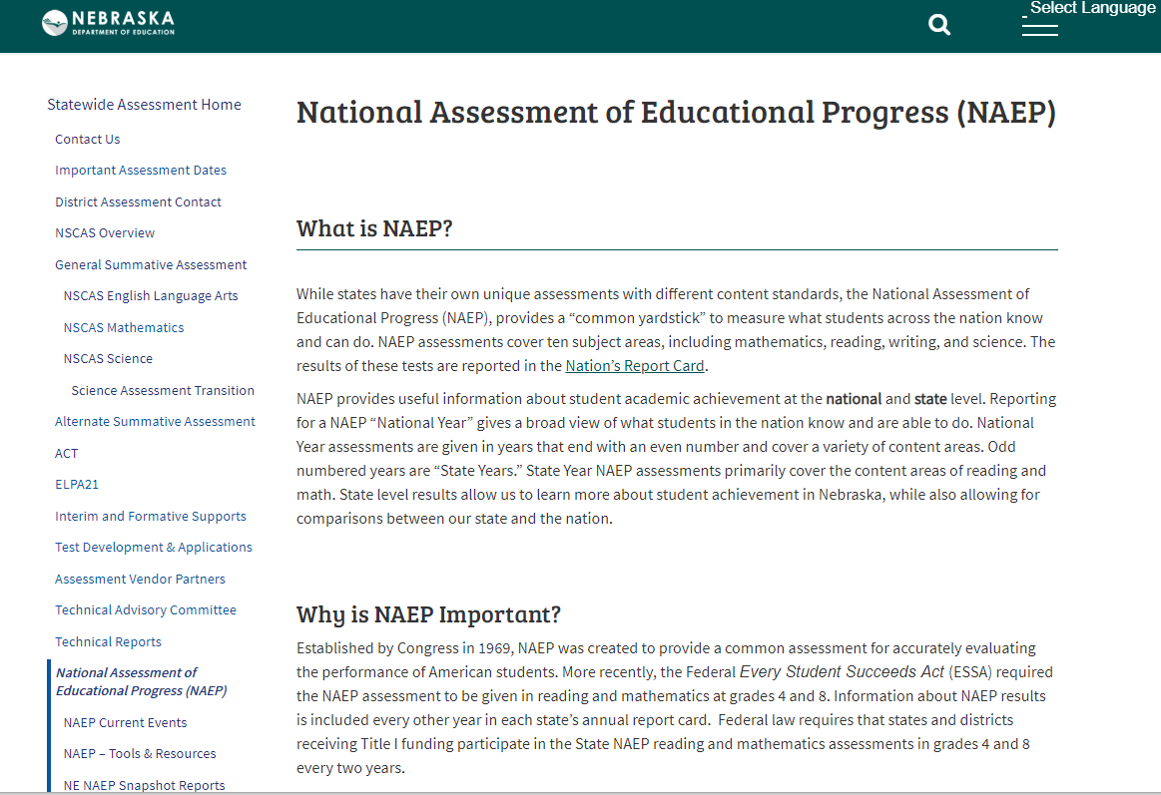
Notes:
NAEP Landing page

Slide 18
Rhonda True rhonda.true@nebraska.gov (402) 471-2959
Notes:
My contact information

