Slide 1
SOLUTION-BASED RESOURCES for children living in poverty
Notes:
Wouldn’t this be nice? A key on the keyboard that would help us be successful with each and every child!
Hi I’m John Parsons, and we will be discussing Resources, and Solutions – some general, some individualized – for working with children in Poverty.
Some of OUR solutions may not be what you automatically think is/are the answer.
PROVIDE INTRODUCTION FOR MR P HERE --- Get a Demographic layout of Audience – show of hands for Omaha, Lincoln, mid, western?
That’s what we’re here to explore this afternoon. Let’s begin the discussion.

Slide 2
A 2020 – 20/20 View
Notes:
Cute, right? Get the double entendre? Feel free to use this in the coming months, it’s an obvious and easy way to prepare for next year.
You/We are in a spot where WE can determine the course and direction of the future – but we need a VIEW that is 1) truly futuristic, not “I’m just getting by”
AND, I’ll suggest we need a view that is 2) Holistic by design, encompassing what we know about children – and sometimes what we don’t exactly know
MTSS provides a vehicle thru which YOU can accomplish those goals, and such a MODEL is needed when working with kids in poverty.

Slide 3
Begin … with the end in mind
Notes:
Last 3 years I’ve worked along side a retired Omaha CPA whose mission became “ to defeat poverty in Omaha” - (ok to smile)
Like everyone, I smiled too. “Out of curiosity”, I asked, “how do you intend to do that?” He had an idea, and we added on.
We began OB with a business principle, from Steven Covey, “Begin w/ the End in Mind” – then built a 10-year plan around the GOAL
So, in your school or district, what is the end game? How do you measure Success? If so, what does a success look like?
Turn to your neighbor and answer that Q for YOUR school

Slide 4
TRICK QUESTION?
Notes:
When you answered, did you … BEGIN WITH THE END IN MIND?
How many thought the 1st day? The 1st month? This semester? Or an entire school year?
Intentionally not defined so you could begin to contemplate your own parameters as teacher, counselor, Admin
BUT … I’d like to push us out as far as practicable for you --- help me with “usual” “end” dates? 1 school year? Several?
Caveat: I think I understand why schools go ONE year at a time, but is this the ‘best’ way to plan?
**Does anyone use a model that allows for multi-year planning? Have someone/anyone share if they do (??)

Slide 5
Success: What does it look like?
Notes:
Shoot some measurements out to me: (Guessing they’ll be middle class things like test scores, grades, etc.)
What about lower performing schools or districts – do you/they possess the same measurements?
At OSS, our average reading level for HIGH SCHOOL-AGED Students was 7th grade, 3rd month
My success measurements did not look like those at Creighton Prep, Millard North or Westside
Take a minute and talk to your neighbor about “success” at your school – compare similarities & note any differences

Slide 6
Where Do You Want to Get to? Where Do You Need to Get to?
Notes:
Back to the “end” question, and/or the Success question – what does it look like for ALL your students?
Will ONE solution fit all? Duh, clearly one solution “could” fit all, if you didn’t wish to consider influence of other factors.
Proposing something you might know, intellectually and intuitively, we NEED multiple solutions to achieve success

Slide 7
A VILLAGE
Notes:
Not sure that when the phrase “it takes a village” was first used by Hillary Clinton, that she or others understood the depth of the statement.
Perhaps I’m wrong about that, and perhaps she DID understand its full affect. Maybe I just didn’t understand the concept yet!
For children living in poverty, ONE single solution may not be enough to obtain the result that schools (and/or you) desire.
To obtain the success measurements you desire, finding & using RESOURCES – inside or outside -- of school may get US closer to desired outcomes.

Slide 8
A Gap – or a Cavern?
Notes:
Failing in school, in 2019/2020, has far-reaching implications. Actually been that way for some time, and WE need to catch up.
In my generation, doing poorly in school meant … no college, but classmates just went into the workforce or headed to a trade school.
RIGHT NOW … kids who fall behind, then eventually ‘fail’ at school, face far greater NEGATIVE consequences.
POVERTY is at the core of many social ills – though not all. But many …
Nearly 70% of A-A men without a high school diploma will be incarcerated by their mid 30s.
Nearly 80% of all men incarcerated in federal and state prisons do NOT have their high school diploma.
Low income individuals are MORE LIKELY to be victims of crime than higher income individuals.
Wrote a piece about what I called the Grand Canyon effect facing at-risk youth, and certainly, their families
Imagine this picture, on one side is a vibrant city w/ bright lights and lots of activity.
Struggling families can see the city, but w/out a BRIDGE to it, all they can do is watch & wish for something different.
Success is visible to the Individual, or Child/Teen, but the great chasm tells them success is NOT attainable. Lose hope.

Slide 9
Effects of Poverty* * per “Diagnosis Poverty” by Marcella Wilson, PhD
Poorer health | Compromised brain development in children
Substance abuse | Mental health issues
Infant mortality | Domestic violence
Abuse | Neglect
Violent crime | Incarceration
Notes:
Wilson argues that Poverty is or should be identified as a medical condition, because it has so many accompanying health issues
Robert Wood Johnson Foundation supports ‘healthy communities’, ‘healthy children & families’, AND addresses SOCIAL DETERMINANTS OF HEALTH
The LINKS are evident between poverty, health, and education === interrelated and complicated because of their varying impact on each family

Slide 10
Continuum of Resources
UNDER-RESOURCED |  | RESOURCED
Instability/crisis | . . . . . . . . . . . . . . | Stability
Isolation | . . . . . . . . . . . . . . | Exposure
Dysfunction | . . . . . . . . . . . . . . | Functionality
Concrete reality | . . . . . . . . . . . . . . | Abstract representational reality
Casual, oral language | . . . . . . . . . . . . . . | Written, formal register
Thought polarization | . . . . . . . . . . . . . . | Option seeking
Survival | . . . . . . . . . . . . . . | Abundance
No work/intermittent work | . . . . . . . . . . . . . . | Work/careers/larger cause
Poverty | . . . . . . . . . . . . . . | Wealth
Less educated | . . . . . . . . . . . . . . | More educated
Notes:
Refer to the article “Toward a Cognitive Model for Better Understanding Socioeconomic Class.” It looks at patterns and how your relationships, the knowledge you have access to, and the resources you have are connected. It impacts your thinking. Knowledge is a form of privilege. The more under-resourced you are, the more you live on the left-hand side of the chart. The more resourced you are, the more time you spend on the right-hand side of the chart. If you do not like the terms poverty, middle class and wealth, then use resourced and under-resourced.
Middle class connotes stability and the predictability of the resources that are available to you. If you don’t like the concepts of poverty, middle class, and/or wealth, you can define economic differences based on the stability of the resources available. The fewer resources a person has, the more that person lives in an under-resourced world with those characteristics. The more resources a person has, the more that person lives in a resourced world.

Slide 11
Research About Language in Children, Ages 1 to 4, in Stable Households by Economic Group
Number of words exposed to | Economic group | Affirmations (strokes) | Prohibitions (discounts)
13 million words | Welfare | 1 for every | 2
26 million words | Working class | 2 for every | 1
45 million words | Professional | 6 for every | 1
Note. From Meaningful Differences in the Everyday Experience of Young American Children, by B. Hart and T. R. Risley, 1995.
Links to updated research:
http://news.stanford.edu/news/2013/september/toddler-language-gap-091213.html
http://www.ncbi.nlm.nih.gov/pmc/articles/PMC3659033/
http://literacy.rice.edu/thirty-million-word-gap (This is a follow-up study on Hart & Risley.)
Notes:
Brain research indicates that the best time to develop learning capacity is from birth to age 3 (birth–3).
Children in poverty typically enter kindergarten two years behind their peers. How do children make up 20 million words when they get to kindergarten?
Affirmations encourage children to speak—questions such as, “What are you looking at? What does the bird look like? What is the bird doing? He’s tugging on a worm? Yes, he’s torturing the worm and is going to gobble it up!” This is the amount and type of talk initiated by parents in a professional home when a 3-year-old climbs on the couch to look out the window. In many welfare homes, the situation is handled in two words: “Get down.” In professional homes there were five questions of “What are you looking at?” to every one “Get down.”
Parents in poverty love their children. The “tyranny of the moment” influences the amount and kind of talk in the home.
Several attorneys in Denver developed a birth–3 visiting nurse program to address the problem of adolescent recidivism in the courts. The attorneys convinced a Colorado state representative that interventions needed to take place earlier. State funding was acquired. The group recognized that the birth–3 experience is vital.
This slide also demonstrates the importance of positive self-talk. How can you increase positive talk with your customers? How can you have them begin to nurture personal positive talk?
ANCHOR:
What programs in your community work with parents to increase language experience in the birth–3 time period? How will you initiate or support these programs?

Slide 12
How BIG is the problem
In Nebraska
Notes:
At OB, we went thru the following progression: 1) What’s the size of the problem? 2) What’s currently being done? And 3) How do we solve for the remainder/the gap?
So … #1 According to NCCP, 21% of US Children live in households that are at or below Federal poverty level
Per the report, it’s a number that UNDERESTIMATES the NEEDS OF FAMILIES who live in unstable situations
And in NE, almost 14% of children live in households below Federal poverty level (appox. $24,500 for family of 4)
That ranks 14th in the U.S., so NE better than many states, BUT … I don’t think we’re satisfied w/ this percentage (are we??)

Slide 13
What’s Working Now?
Notes:
Take a minute and share with your neighbor on efforts, initiatives, nonprofits, etc. that are currently working in your community, specifically toward children impacted by poverty
If you can’t think of anything, or what you think might work isn’t present in your community, PONDER what things would benefit you or your school?
For example, I like the B & G Club model, but we don’t have any in GI (sure you do, but that’s just an example ☺)

Slide 14
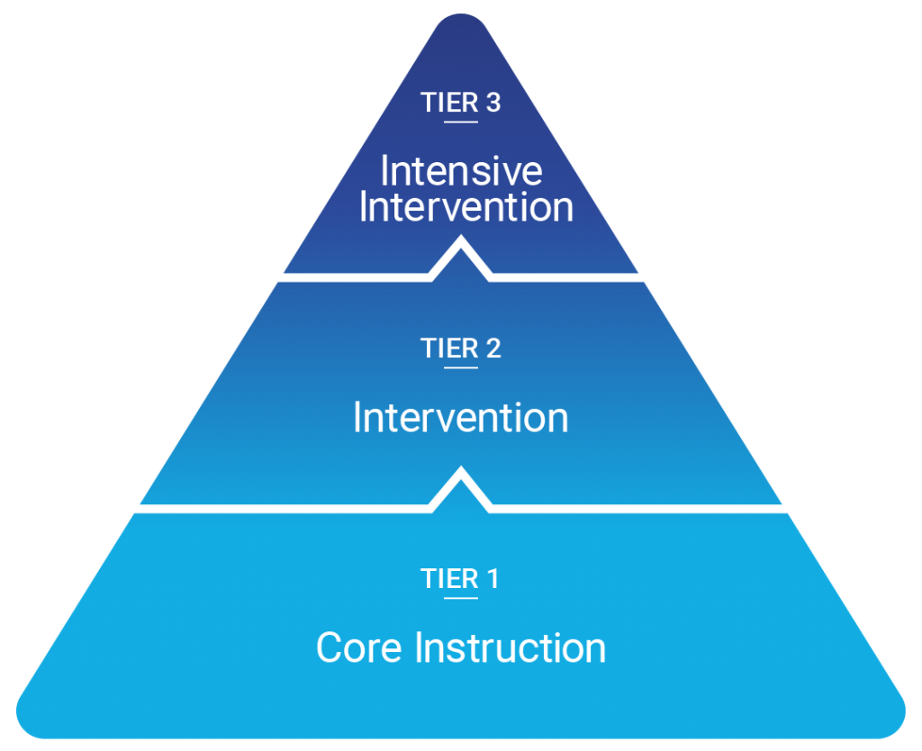
Notes:
My MTSS check-in: Can the Business solution model be applied to Education?
Core Instruction targets the largest percentage, Tier 1
A Substantial Piece of the Problem can be used by Core Instruction
***don’t’ generalize or label students from poverty – right? They are bright, and often ready, to learn
WHAT THEN, MIGHT BE THE GAP, OR THE FACTOR, THAT SEEMS TO BE STUMBLING BLOCK?
Core will be enough to motivate and create opportunity

Slide 15
Definition of Resources
FINANCIAL
Being able to purchase the goods and services of that class and sustain it.
EMOTIONAL
Being able to choose and control emotional responses, particularly to negative situations, without engaging in self-destructive behavior. Shows itself through choices.
MENTAL
Having the mental abilities and acquired skills (reading, writing, computing) to deal with daily life.
SPIRITUAL
Believing in (divine) purpose and guidance.
PHYSICAL
Having physical health and mobility.
SUPPORT SYSTEMS
Having friends, family, and backup resources available to access in times of need. These are external resources.
RELATIONSHIPS/ROLE MODELS
Having frequent access to adult(s) who are appropriate, nurturing, and who do not engage in destructive behavior.
KNOWLEDGE OF HIDDEN RULES
Knowing the unspoken cues and habits of a group.
Notes:
Often, when we think about poverty, we just think it means FINANCIAL struggles, or a lack of money
Johns Hopkins U did a study in Baltimore on families living in poverty (article published in ‘16 in The Atlantic).
Possible for kids who grow up in poverty to be successful – SO, why do some make it out and others do not.
It’s why I like this definition of poverty, as it explains the many facets to culture and how these resources all TIE together.
Resources are interconnected, and strengths in one area tend to lead to increased levels in another. Physical health can influence emotional health. Cognitive reasoning can influence emotional stability.

Slide 16
NARROWING THE GAP
Notes:
For children impacted by poverty, a variety of resources, like those listed in previous slide, could improve the outcomes (success) you/school desires.
In last 3 years I’ve learned that while I did get a good education, and my own life experiences are valuable, there isn’t a better way to keep learning than to ask questions of the people that are struggling. They are resilient and strong, so we include in our Solution discussion the input of the people living in Insecurity and Instability. What do they need?
Share with the group, rather than at your tables, what are some Resources being shared in your community, that helps Families in Poverty, and therefore, is helping in your school or district? (Hopefully, we have some examples!)

Slide 17
changing lives, inspiring futures

Slide 18
HOW DOES THE SOLUTION WORK?
By changing the way under-resourced individuals think about themselves and their situation, AND putting tools in their “tool- box”
By educating the WHOLE community on the effects of poverty, and challenges facing under-resourced individuals
By connecting under-resourced people to agencies and employers across the metro
Notes:
To determine “need”, we use an ASSESSMENT known as the Stability Scale, or the Self-Sufficiency Matrix

Slide 19
success
Remember your measurements?
Do they align with finding and developing Resources
If it takes longer, is it worth the wait to see success for ALL your students?
Burden, responsibility does not fall only on your shoulders, but community assists in success
Notes:
The benefits to seeing success with all children, especially those in poverty, is that no one is excluded from opportunities to succeed, and …
The value isn’t purely EDUCATIONAL, but it also creates EMOTIONAL development, enhances ECONOMIC growth in the state, and …
The inclusive concept has SOCIAL JUSTICE components – there are plenty of reasons why DEVELOPING RESOURCES is a win/win/win for all.
MTSS seems to have a similar mindset, to see ALL children succeed – and GRADUATE high school. And that’s a WIN for everyone!

