Slide 1
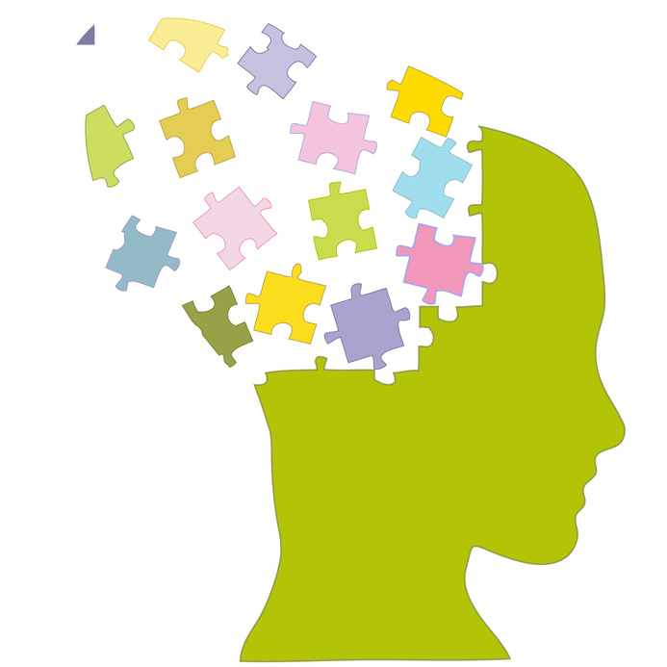
Brain Tips for Literacy
BRAIN TIPS
STRATEGIES FOR MAINTAING METACOGNITION
DEFINING DIFFERENTIATION
INCREASING INSTRUCTIONAL IMPACT
SURGING SYNAPTIC ENERGY
CREATING COGNITIVE CELEBRATIONS

Slide 2

Title One On Demand
Integrate brain-friendly practices to influence teachers’ capacity and increase student engagement.

Slide 3
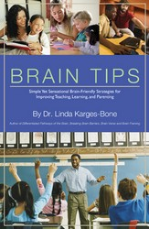
Apply “Brain Tips” to Increase Capacity
Dr. Linda Karges-Bone’s new book will support your work in curriculum, instruction, assessment, and parent engagement.
Changing the brain can change the hearts and minds of your stakeholders.

Slide 4
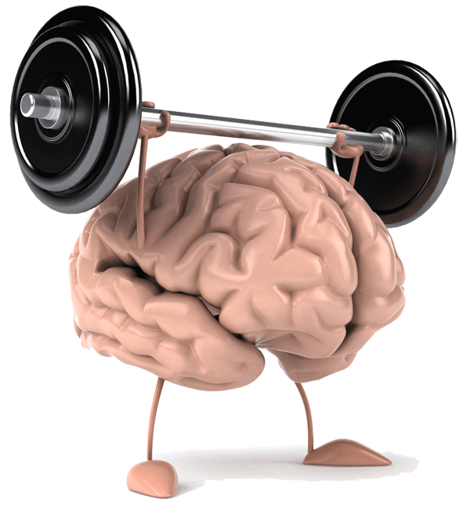
8 Ways to Tip the Brain in Your Favor
Teacher Stress Tips
Boy Friendly Brain Tips
Girl Friendly Brain Tips
Sensory Brain Tips
Accommodation Tips
Neuro-Architecture Tips
Creativity and Critical Thinking Tips
Parenting Tips

Slide 5
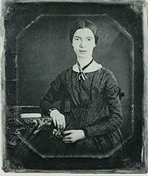
Emily Dickinson Poem #632
The Brain-is wider than the Sky-
For- put them side by side-
The one the other will contain
With ease- and You-beside-
The Brain is deeper than the sea-
For-hold them- Blue to Blue-
The one the other will absorb-
As Sponges-Buckets-do-
The Brain is just the weight of God-
For- Heft them-Pound for Pound-
As they will differ-if they do
As Syllable from Sound-

Slide 6
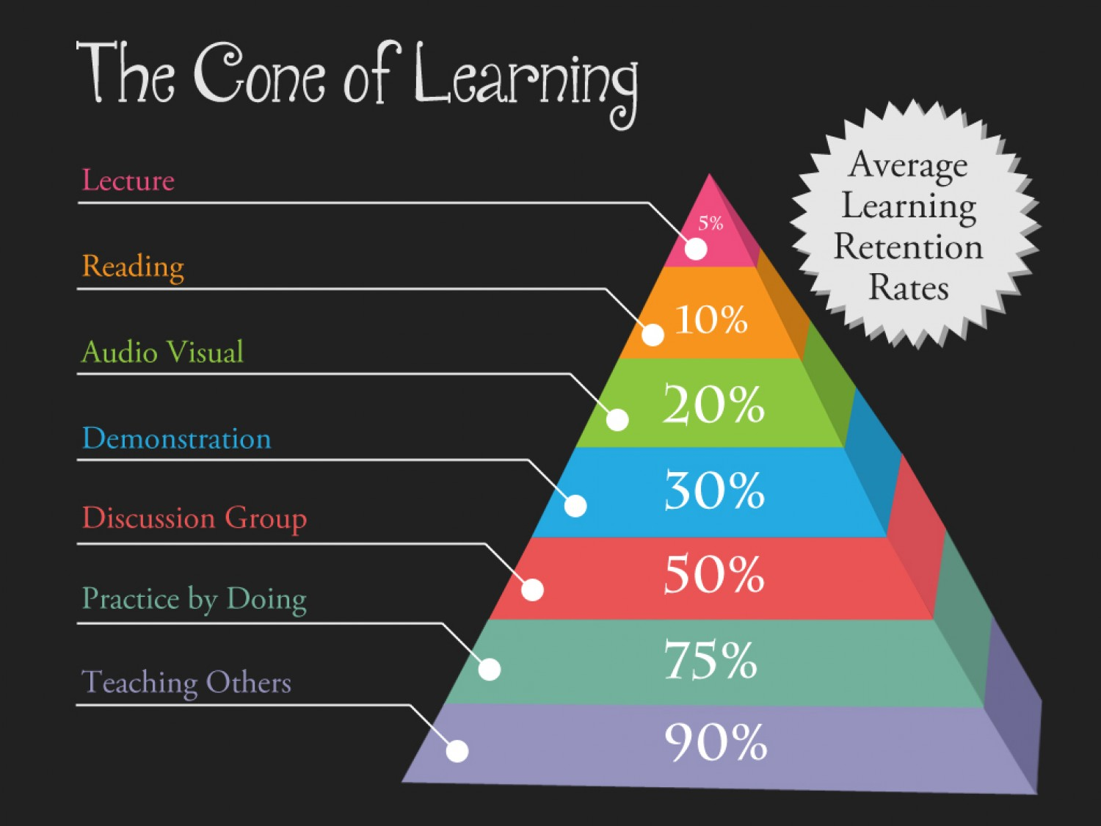

Slide 7
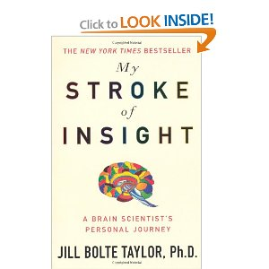
Dr. Jill Bolte Taylor: My Stroke of Insight says….
“It might be of interest to note that all of today’s “brain based learning” techniques… capitalize on what neuroscientists understand about the functions of the limbic system. “
Education InSite

Slide 8
Brain Tips Make Classrooms SAFE for learning.
“With these learning techniques, we try to transform our classrooms into environments that feel safe and familiar. The objective is to create an environment where the brain’s fear/rage response ( amygdala) is not triggered. Although many of us think of ourselves as thinking creatures that feel, biologically, we are feeling creatures that think.”
Jill Bolte Taylor in “My Stroke of Insight”

Slide 9
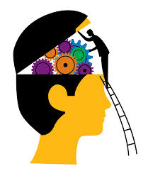
Our purpose is to take the medical and psychological research in cognitive science and translate it into practical strategies for classroom use.
Teaching in Title I Sites is tough….

Slide 10

According to research in the US, Great Britain , and Canada
Teaching is the most stressful of the learned professions.
Teaching adolescents is the most stressful of the teaching assignments.
Teaching in a Title I site compounds all of the above.
Congratulations.

Slide 11

How can we address the stress?

Slide 12
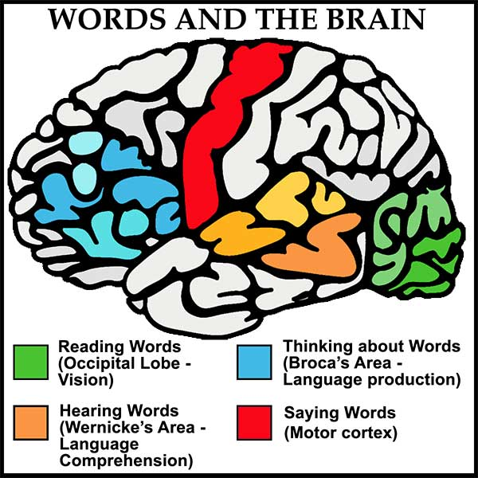
Many of the Tips
Focus on the literacy gaps…
That impede acquisition of knowledge across the curriculum….
And prevent students from reaching their potential.

Slide 13

Background for Brain Friendly Teaching
High Poverty = Brain Stress
Fewer Words
Fewer Experiences
More Cortisol
Less Stimulation
More Anxiety
All of these create Literacy Risks and Deficits

Slide 14

The Poverty/Literacy Risk=ACE
Adverse Childhood Experiences.
Fewer words = Risk to Children’s Learning Potential
Earlier in the year when I met Steven F. Wilson, founder of a network of charter schools that serve poor and largely black communities in Brooklyn, I asked him what he considered the greatest challenge on the first day of kindergarten each year. He answered, without a second’s hesitation: “Word deficit.”
NY Times, 2012

Slide 15
Children of professionals were, on average, exposed to approximately 1,500 more words hourly than children growing up in poverty. This resulted in a gap of more than 32 million words by the time the children reached the age of 4.

Slide 16

The 1995 Hart & Risley Study
Hart and Risley’s Three Key Findings:
1. The variation in children’s IQs and language abilities is relative to the amount parents speak to their children.
2. Children’s academic successes at ages nine and ten are attributable to the amount of talk they hear from birth to age three.
3. Parents of advanced children talk significantly more to their children than parents of children who are not as advanced.

Slide 17
Our Task is to Replicate and Refresh
Add words
Attach words to experiences
Attack the word deficit
Advise Parents
Assist children in connecting school vocabulary to real world experiences
Administer strategies that increase the depth and complexity of literacy

Slide 18
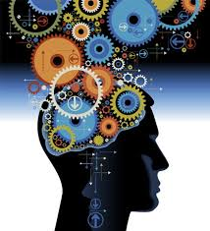
Brain Tips: Tools to Bridge the Poverty Gap

Slide 19
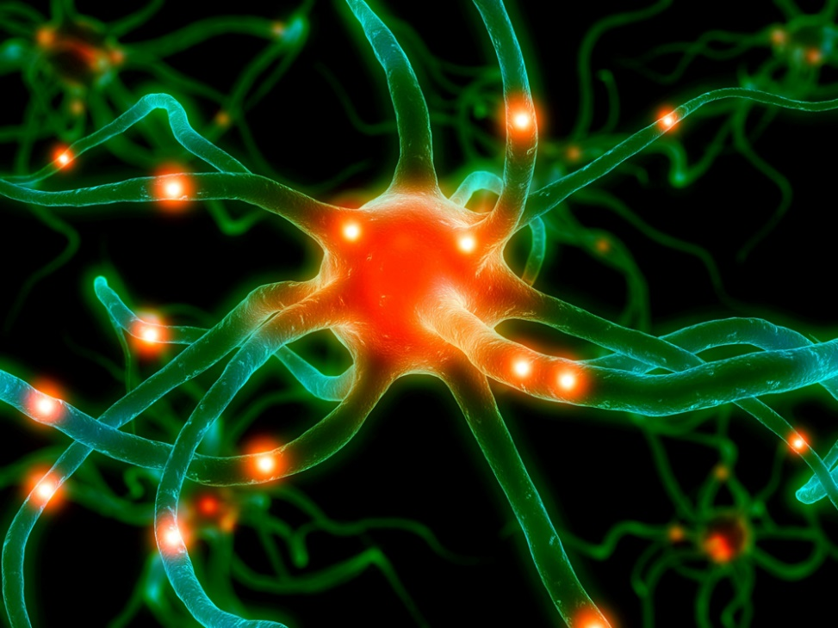
Set up with schema…..
In this first section….
Review brain biology.
Become acquainted with key terms .
Connect with some new research on what the brain likes and what causes cognitive dissonance.

Slide 20
Key Terms for the Brain Tips Journey
Amygdala
Cerebellum
Cognitive Dissonance
Corpus Callosum
Cortex
Cortisol
Hippocampus
Limbic System
Metacognition
Neuro-Architecture
Neuro-genesis
Olfactory Bulb
A. Birthing new neurons
B. Stress hormone
C. Scent
D. Activates and alerts
E. Sleep and memory
F. Filters sensory experiences
G. Movement
H. Frontal lobe divider
I. Brain pain
J. Gray Matter
K. Brain friendly décor and more
L. Thinking about thinking

Slide 21
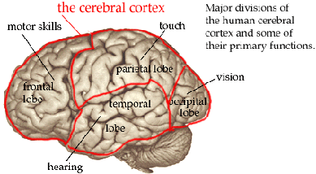
The Gray Matter: Cerebral Cortex
Spread out, it is about the size of a linen dinner napkin.
But, if you were to count the synapses at the rate of 1 per second, you would finish 32 million years after you began!
Sylwester, Bright Air, Brilliant Fire

Slide 22

Teaching should be easy….
But…the millions of neural pathways may be available.
But they are not accessible.
Hence, teaching is a stressful endeavor, not for the faint of heart.

Slide 23
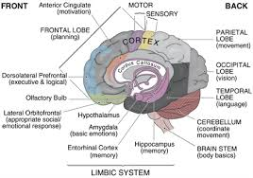
A few facts at first…..
The human brain weighs about 3 lb.
It is organized into 3 parts: the cerebrum, the cerebellum, and the brain stem.

Slide 24
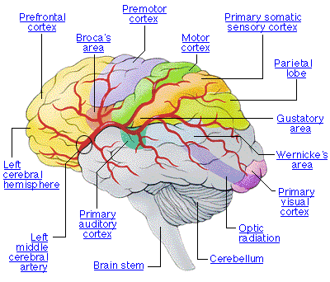
Organization of the Brain
Brain stem: back of the brain/ includes the medulla oblongata, the pons, the midbrain, and the diencephalon.
Mediates between the brain and central nervous system
Contains the hypothalamus: body temperature, pleasure, pain, sex drive

Slide 25

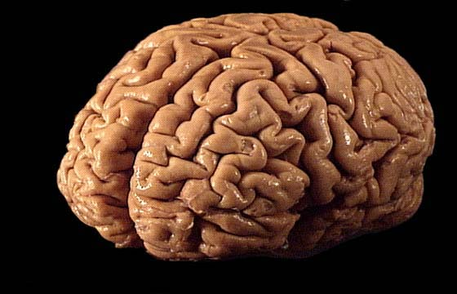
Start With the Brain in Mind: The Cerebrum: Grey Matter and Higher Order Thinking
Most highly developed part of the brain
Two hemispheres
Left: language
Right: visualization, creativity
Divided by the thick bundle of nerve fibers called the Corpus Callosum

Slide 26
It centers on the Cortex
The cortex processes memories and other rational behaviors. It’s a six layer thick sheet of neuronal tissue that folds deeply around the limbic system. Thinks of a stack of 6 sheets of 12X18 construction paper. It occupies 85% of our brain’s mass, and it’s organized into several hundred million neural networks.

Slide 27
Remember this rhyme!
Our premise begins with a poem……
Neurons that wire together, fire together.
Neurons that fire together, wire together.
In Title I Sites, students’ brains demand more enrichment, stimulation, and engagement. Our task is to find ways to gain and maintain focus on learning throughout the instructional day and beyond.

Slide 28
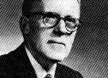
Hebb’s Postulate
Introduced by Donald Hebb…1949
Hebbian theory describes a basic mechanism for synaptic plasticity wherein an increase in synaptic efficacy arises from the presynaptic cell's repeated and persistent stimulation of the postsynaptic cell.

Slide 29
Making Connections is our Goal…
Connect to language
Connect to sensory experiences
Connect to gender, cultural, and learning styles’ differences
Connect to students’ cultures
Connect to the standards
Connect the curriculum in integrated ways
Connect to stress reducing experiences
Connect to fun
Connect to the affective domain

Slide 30
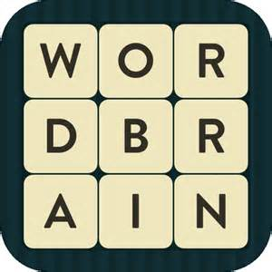
Unlock the puzzle of brain friendly teaching.
P…..powerful strategies.
U….understand differences.

Slide 31
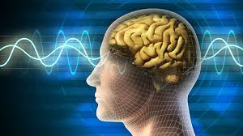
#1….Teacher Stress Must Be Addressed
Teaching is considered the most stressful of the professions.
Your body needs to balance good and bad stress.
Too much stress creates inflammation.
Inflammation makes you age more quickly.
Pages 4-13 of Brain Tips

Slide 32
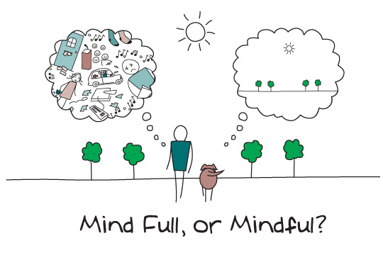
Who Is the “Mindful” Teacher?
Maintaining mindfulness is a challenge for everyone, but as we shall see shortly, it is especially difficult for those who work in the most stressful profession. Note that I did not say “job”….as certainly those who do dangerous, physical labor operate under acute stress, but their work requires more adrenalin and physical strength. Teaching is both a cerebral and physical undertaking, especially when one attempts to maintain a steady practice of meta-cognition. Simply “talking at” students and using rote memorization tasks is not only less demanding, we know it is just about useless for creating meaning.

Slide 33

Teachers must hide their true feelings and perform at high levels.
The study - The scale of occupational stress - found that 20% of people reported high levels of stress at work. Yet among teachers the rate was double that.
Cardiff University, UK

Slide 34
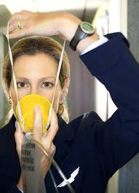
Teacher….heal thyself.
Put the Oxygen Mask on Yourself First.
Maintaining Metacognition is Physically Grueling.
Daily exercise.
Inflammation reducing diet.
Time for quiet and sleep.

Slide 35
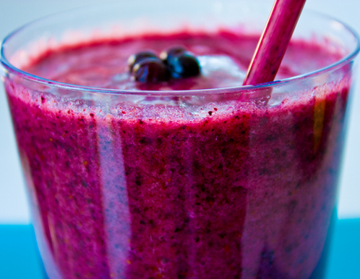
Brain Berry Smoothie
Reduces inflammation
Increases clarity in thinking
Moves neurons 55% faster
1 cup coconut water
1 cup frozen blueberries
1 cup low fat Greek Yogurt ( vanilla, plain)
½ banana ( optional)

Slide 36
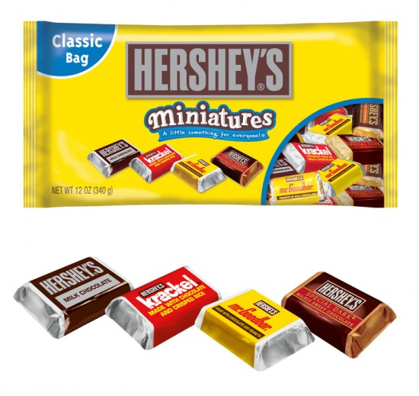
Pause and Play
We are going to get to know your brain a bit.
Taking two simple assessment.
First, a left/right brain assessment.
Then, a delicious, chocolate one.

Slide 37
Left Brain Traits | Right Brain Traits
I like to make lists of tasks and check them off. | I keep ideas in my head and do them when I feel inspired.
I enjoy doing crossword puzzles. | I enjoy watching television or listening to music.
I prefer a magazine with business news or current events. | I prefer a magazine about travel and adventure.
I am a religious person. | I am a spiritual person.
I buy what I need. | I buy what I like.
I try to be early so that I can get a good seat ! | I am sometimes late for events, but always bring treats or gifts !
I like to deal in details. | I like to deal in big ideas.
People call me careful. | People call me creative .
I remember names . | I remember faces.
I deal in facts. | I prefer feelings.
I like to make my point with a chart and data. | I have been accused of “talking with my hands.”
Give me reason and order while making decisions and don’t rush me. | I go with my “gut” or intuition, and by the way, might change my mind!

Slide 38
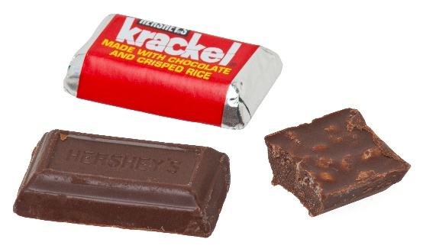


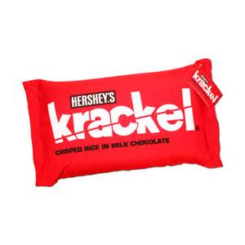
Hershey’s Miniature’s Personality Indicator
If you like Milk Chocolate, you are....
All American: you love baseball, mom, and apple pie
A cheerleader for programs; level-headed; a good PR person and a great fund-raiser
Kind and thoughtful; you always remember everyone's birthday
Playful and practical
Nurturing and interested in helping others shine
Dependable and loyal
The kind others turn to for help
If you like Krackel, you are...
Creative and optimistic; you always see the cup as half full
Messy (desk or office), but organized; you eventually find a missing item or believe you will
Hands-on problem solver
A little off-beat, funny, friendly, and out-going
Always willing to help
Appreciative of the surprising things in life — the "crackle"
Happiest in situations that allow flexibility, change, and growth

Slide 39

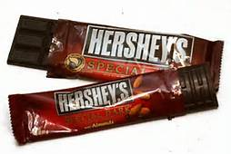
Hershey’s Miniature’s Personality Indicator
If you like Mr. Goodbar, you are...
Analytical and logical; but you can analyze things to death
Prone to gather data before giving an opinion
Good at playing the devil's advocate at meetings
Likely to see all the possibilities in a situation and drive others crazy by sharing all the "what if's"
Not a fan of deadlines; you put off starting project and could be called a procrastinator
Fond of being an expert, but work in your own timeframe
Most comfortable when there are rules that everyone follows: you like structure, and hate surprises
If you like Special Dark, you are...
Patient and thoughtful; an individualist and a problem starter
Prone to seeing a project through from start to finish
A gifted grant or curriculum designer
Insightful and reflective; you work well with difficult people
Not patient with incompetent people or liars
Likely to set high standards for yourself and others
Dependable and resourceful , loyal
Drawn to creative, unusual individuals.

Slide 40

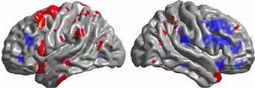
#2 and #3 Gender Friendly Brain Tips
The question of differentiating for boys and girls in the classroom is one of style, not substance. Although some theorists demand a pure, hard-line view on what is called single gender or single sex differentiation, my take on it more subtle. I believe that simple gender-friendly accommodations can make a credible difference in the ways that boys and girls learn.
Pages 14-33 of Brain Tips

Slide 41
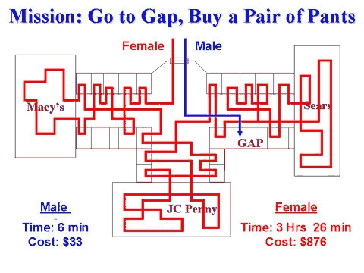
Subtle, yet Significant

Slide 42

There are gender differences in our brains
Women’s brains have up to 15% more cell density in the frontal lobe and the corpus callosum in women’s brains is 14 times larger than in men.
It disseminates information from the cerebral cortex on one side of the brain to the same region the other side .
Men’s brain weigh more.

Slide 43
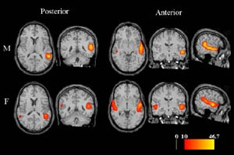
Male/Female Brains “listening”

Slide 44
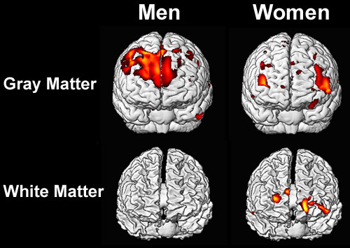
Men and Women and Conversation
The average woman uses 20,000 words per day.
The average man speaks 7000 words per day.
White matter =Connections
Gray matter =Logic
What are the implications for the classroom?

Slide 45
Grey or White? Why Fight?
In general, men have approximately 6.5 times the amount of gray matter related to general intelligence than women, and women have nearly 10 times the amount of white matter related to intelligence than men. Gray matter represents information processing centers in the brain, and white matter represents the networking of – or connections between – these processing centers.

Slide 46
The Brains of Boys
Prefer linear, logical thinking.
Require early, targeted language and literacy.
Seek tactile/ visual learning.

Slide 47
The Brains of Girls
Prefer connected, complex projects.
Require early, targeted spatial skills awareness.
Seek auditory or kinesthetic learning.

Slide 48

Boys: Have a ball with the brain!
Brain Tips: Pg. 15
Use an inflatable beach ball to build schema, practice, and focus.
Create a series of “brain balls” to toss during review and practice.
Adds movement to verbal engagement.
Utilizes testosterone and energy.

Slide 49
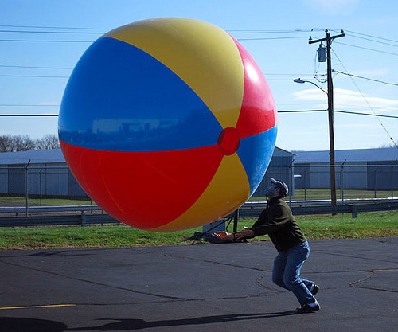
Pause and Play!
Move to centers
Use a vinyl beach ball to create a unique “brain ball”.
Deign it with your classroom in mind.
Language Arts?
Critical Thinking?
Science Process Skills?
Counseling or Therapy?

Slide 50
Girls often prefer collaboration. Pg. 25
Employ the “Think, Pair, Share” Model
It works nicely because: 1) Girls have about 20,000 words per day, so they typically have plenty to say. 2) The task builds leadership and reflective skills; 3) Writing things down on the graphic organizer helps to focus thinking; 4) The “pairing” allows girls to collaborate, a favored choice.5) It works across any area of the curriculum, but is excellent for deconstructing informational text, a Common Core emphasis.
THINK
What was most imporant to you?
PAIR
What did we find to be critical when we discussed it?
SHARE
What do we want to tell our peers to focus on?

Slide 51
#4….The Sensory Brain
TEACHERS CAN PAIR COGNTIVE AND SENSORY EXPERIENCES FOR MAXIMUM RETENTION AND TO CREATE EPISODIC MEMORIES.
The Limbic System at the back of the brain acts like the filter on a clothes dryer, capturing the lint of sensory experiences that have been presented to the brain in tandem with cognitive experiences. I suspect it is a combination of the novelty and the memory that sensor-rich episodes trigger that make the difference. Involving multiple senses evokes even more cognitive payback.

Slide 52
Sensory Tips…Pg. 34
Peppermint and Reviewing for a Test.
Adding clapping to phonemic awareness activities.
Practicing math facts on chilled shaving cream.

Slide 53

Go Green? Pg. 37
People who work in green environments have fewer stomach aches.
It is said that green is the most restful color for the human eye.
Green has great healing power. It can soothe pain.
Green is beneficial around teething infants.
Suicides dropped 34% when London's Blackfriar Bridge was painted green.
Kids who look out on “green” spaces have higher test scores.

Slide 54
#5 Accommodations for RTI and DI
All teachers are now Special Education Teachers.
There is no such thing as “Normal”.
That is only the setting on the dryer!

Slide 55
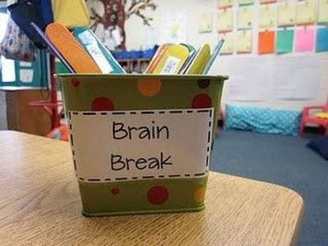
“Pick a Stick”….Pg. 44
Color | Ability Level | Personality or Learning Style
Blue Stick | Gifted or Advanced | ADD/ADHD or Creative
Yellow Stick | Below Basic/Struggling | Quiet/Introvert/Analytic
Green Stick | Proficient | Compliant/Curious/ Balanced Style
Red Stick | Basic Level | Extrovert/global learning

Slide 56

Apply Cognitive SPF..Pg. 46
New research on how one can improve memory turns up some tried and true results.
In order to improve memory, you need 3 things:
Schema ( organizing structure)
Practice
Focus

Slide 57
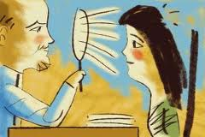


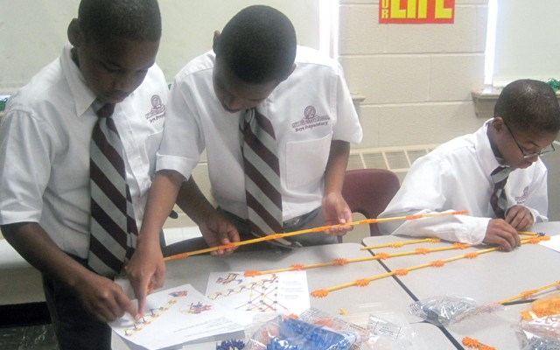
APPLY SPF
Introduce rich, appropriate schema or knowledge.
‘Connect the schema for reading to practice while reading.
Continue to model and maintain focus carefully while schema and practice move on concentric neural pathways.
Let’s Practice SPF with Brain Tips !

Slide 58
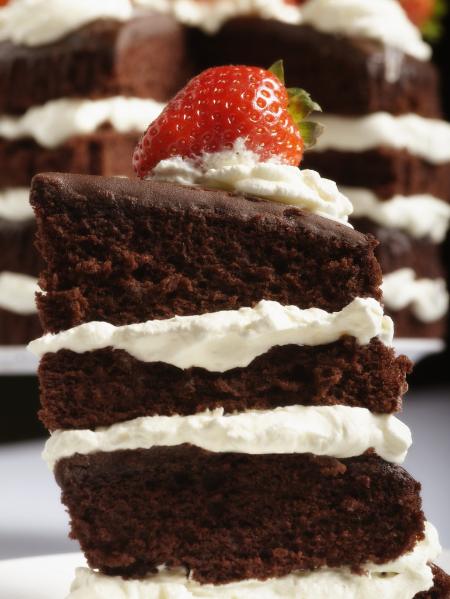
Practice Tip: ….Page 52…..Layer Practice to Sweeten the Cognitive Outcome

Slide 59

#6…..Explore Neuro-Architecture
When is a space more than a space?
When the educator renames himself or herself as a neuro-architect.
This hot new field links design, engineering, psychology, and cognitive science in a high tech blend of creativity that feeds the brains of those who experience a space and those who develop the spaces.
Educators can draw on the emerging field of “neuro-architecture” to create learning environments that send the right “cues” to learners. “

Slide 60
Enriched environments change the brain. WSJ 3/19/13
Harvard University
Studied the brains of mice
Applied toxic Oligomers to the hippocampus
Compared experimental/control groups raised in enriched/sterile settings.
Stimuli seemed to “block” the toxins.

Slide 61
The Latest Brain News
When the children were re-tested five to 20 days after the end of the training programs, researchers did not find any significant increase in verbal intelligence or brain changes for the children who participated in the visual art training module. However, they found quite a different result in the children who took the music-based, cognitive training. Ninety percent of those children exhibited intelligence improvements – five times larger than the other group – on a measure of vocabulary knowledge, as well as increased accuracy and reaction time. The music group also showed brain changes that co-related to their enhanced cognitive performance.

Slide 62

Stress and Short-Term Memory
Scientific American , 6/ 13
Oink, Oink…if you remember
Pigs living in either enriched or barren pens were studied to determine if stress, defined by lack of access to stimulation, affected memory.
Short-term memory was impacted.
Pigs are actually, potentially “smart”, 10% pre-frontal cortex.

Slide 63

Neuro-Architecture Tips
Take the quiz on page 53
Explore lighting, water features, music, color, sound, groupings, props, and centers.
Consider both indoor and outdoor spaces as instructional tools.

Slide 64
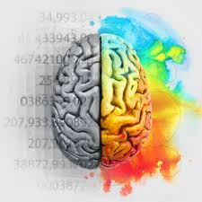

#7……Creative and Critical Thinking Tips
The ability to produce something original and useful by applying divergent thinking.
Seeing the world in ways that are hidden from others.
A state of being…creative.
Research suggests that students in the US are becoming “less creative”. Scores on IQ tests have inched higher, while scores on assessments of creativity have been declining for more than a decade.
We need an Innovation Infusion!

Slide 65
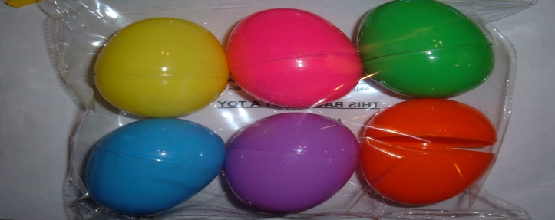

Pg. 64 Lay a Creative Egg
Both creativity and critical thinking feed on “Novelty”. Dopamine is essential.
Activity | Critical Thinking | Creative Thinking
Review for a test by putting “clues” such as page numbers or key vocabulary in an egg and having students search out the evidence in the textbook. | X
“Hide” math problems in eggs around the room and have students find and solve them on a worksheet or whiteboard. |  | X
After reading a story in the basal, nest examples of the literary elements such as setting, point of view, plot, conflict in eggs and toss them out to students to identify. | X | X

Slide 66
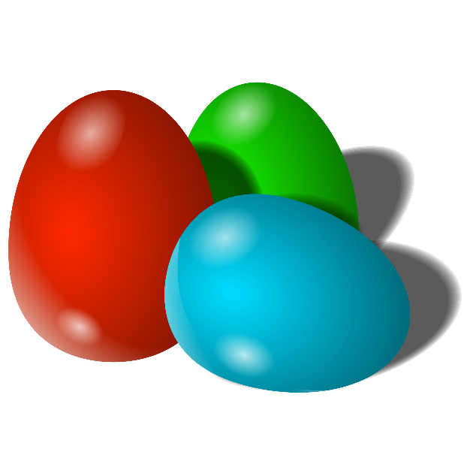
Pause and Play
Center time.
Working in teams.
Create a set of “brain eggs” for your discipline or department.
What content will you address?
What words will you use for focus?
When will you use them?

Slide 67
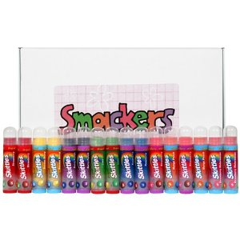
What if you can’t give out treats?
Mr. Rayme Scalise
Mary Massa
Warren, PA
Suggests using “Scenty Sticks” an inexpensive balm to run on the wrist to utilize the power of “scent”. Pg. 69

Slide 68
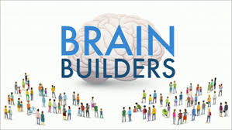
#8……..Parents and Brain Tips
Section 8
Strategies for raising smarter children
Brain Foods
Sleep Issues
Creating a literacy rich environment
Brain Toys
The role of Technology
Reducing Cortisol

Slide 69
Sleep Issues…the Top Parenting Priority for Brain Health and Development

Slide 70
The hippocampus requires a minimum of 6 hours of deep cycle sleep to process learning. Pg. 74
10,000 Children
University of London
Their analysis revealed a clear clinical and statistically significant link between bedtimes and behavior. The researchers say irregular bedtimes affected children’s behavior by disrupting their bodies’ natural rhythms, leading to sleep deprivation that affects the developing brain.

Slide 71
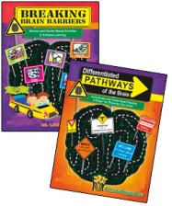

Thanks for your attention!
dr.lbone@knology.net or lbone@csuniv.edu
Visit my web page at www.educationinsite.com
Like my FB Page for Education InSite
Read my new book Brain Tips
Explore the exciting research on brain and gender in Differentiated Pathways of the Brain or Breaking Brain Barriers.
Look for my new book Bibliotherapy: Children’s Books that Train the Brain and JumpStart the Heart

Slide 72

Wrapping It Up: Make a list of three brain tips that YOU want to DO the first week of school!

