Slide 1
What is OER?
“Password OER” by Laura Rachfalski https://youtu.be/Gv8BhUCYJMc
Notes:
Password OER by Laura Rachfalski - My award-winning entry for the "Why Open Education Matters" video contest.
Category - Education
License - Creative Commons Attribution license (reuse allowed)
Source videos - View attributions https://youtu.be/Gv8BhUCYJMc

Slide 2
“Open Educational Resources are teaching, learning and research materials in any medium – digital or otherwise – that reside in the public domain or have been released under an open license that permits no-cost access, use, adaptation and redistribution by others with no or limited restrictions. OER includes full courses, course materials, modules, textbooks, streaming videos, tests, software, and any other tools, materials or techniques used to support access to knowledge.”
~Hewlett Foundation
Notes:
Lacey - take this

Slide 3
What types of content can be OER?
Entire Courses
Course modules
E-textbooks
Streaming video of lectures
Professional Development
Units of Study
Assessments
Software
Video
Activities
Lesson Plans
A Photograph
Rubrics
Charts
Journals
Practice Exercises

Slide 4
Nebraska OER Hub

Slide 5
Nebraska OER Hub
Click the link on the previous slide title
Navigate to group by scrolling down or clicking the “groups” shortcut
To become a member of the Nebraska hub you need to join the Nebraska OER information group
When you open the group there will be a “Join this group” button
Once clicked you will be a member of this group and the Nebraska hub

Slide 6
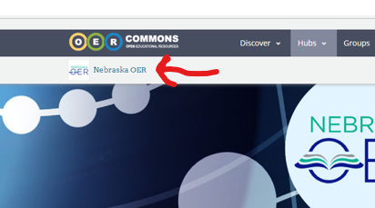
As a member of a NE Group!
Creates a bookmark for the site
Allows you to add Nebraska Standards
Allows you to create your own content and groups

Slide 7
NE Science group
NE Science teachers should join the Nebraska Science group as well
Find the group in the groups section of the site
Click the join this group
A group administrator will approve your request
Discussion tab has other professional learning resources

Slide 8
NE Science Collection
Resources that have been vetted and align to the science standards by Nebraska teachers
Includes: instructional units, lessons, assessments, other states approved resources and templates for creation

Slide 9
For support or more training contact
Dorann Avey - Digital Learning Director, NDE
dorann.avey@nebraska.gov & 402-471-4366

