Slide 1
The ACT State Test
ACT Overview with Iris Owens

Slide 2
2019 Test Dates
Test Administration | Date
Paper and Pencil | April 2, 2019
Online Test Dates | April 2-4, April 9-11, 2019
Accommodation Test - Paper and Pencil | April 2-5, 8-12, 15-16, 2019
Accommodation Test - Online | April 2-4, 9-11, 2019
Make up – Paper and Pencil | April 24, 2019
Make up – Accommodations Paper and Pencil | April 24-26, 29-30, 2019

Slide 3
CONTACTS
You may receive emails about the ACT from the following:
State Testing statetesting@act.org
ACT Accommodations actaccom@act.org
Iris Owens iris.a.owens@act.org or iris.owens@nebraska.gov
DACs or Test Coordinators contact for questions:
Iris Owens Iris.A.Owens@act.org or 402-471-4316
Customer Support 800-553-6244 ext 2800 (7 am – 5 pm CST, Mon – Fri)
ACT Accommodations actaccom@act.org 800.553.6244 ext. 1788 (7 am – 5 pm CST, Mon – Fri)

Slide 4
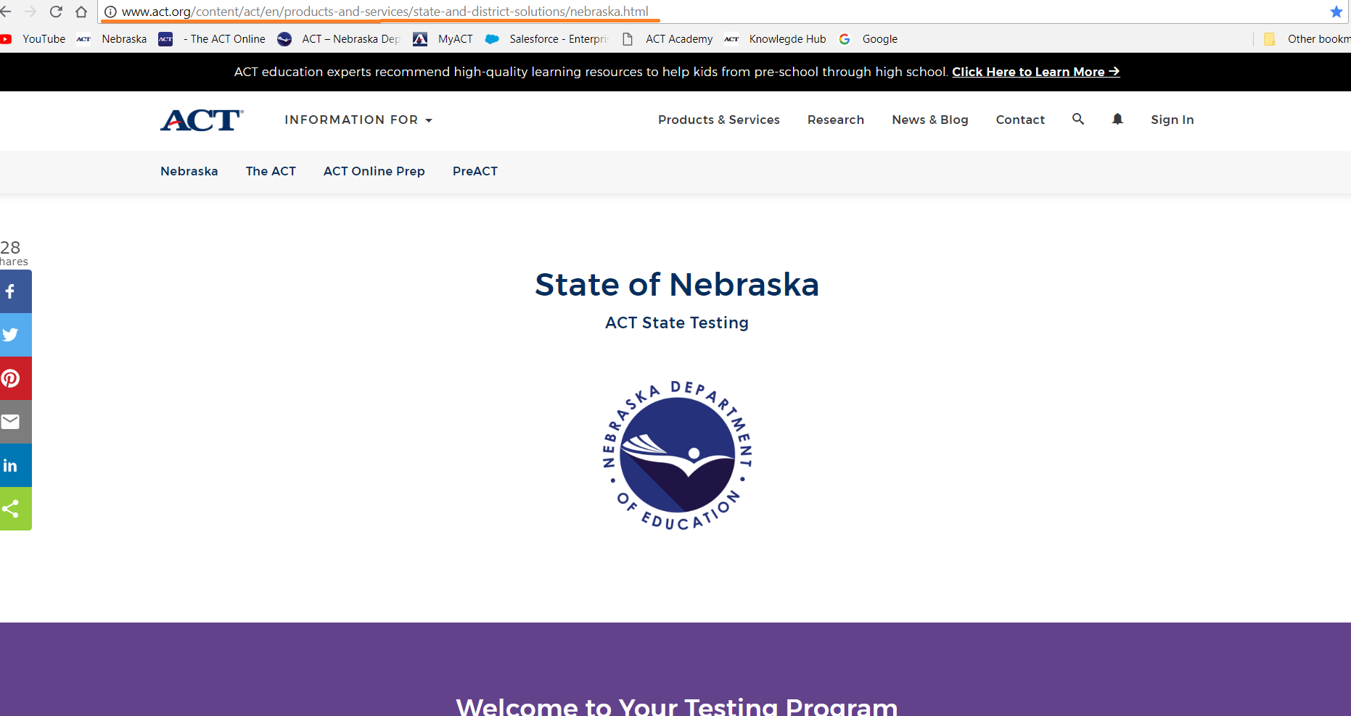
ACT-Nebraska Webpage

Slide 9
ACT Accommodations
Accommodations are available for any student with an IEP or 504 plan and are requested on the Test Accessibility and Accommodations System (TAA)
Dates to apply- Monday November 5, 2018 – Friday February 15, 2019.
Apply for Accommodations as early as possible.
Accommodations analysts are looking information on what happens in the classroom.
Provide the IEP or 504 plan as well as Teacher survey and any other materials the staff believes will give a complete picture of the students’ needs.

Slide 10
PA NEXT and TAA Systems to open today-Monday November 5, 2018!
Schedule of Events available now on ACT-Nebraska webpage
New Look on the ACT-Nebraska webpage
New Manuals and Webinars
Accommodations Questions and Answers on November 14, 2018
Test Administration Questions and Answers on January 15 and February 13, 2019

Slide 11
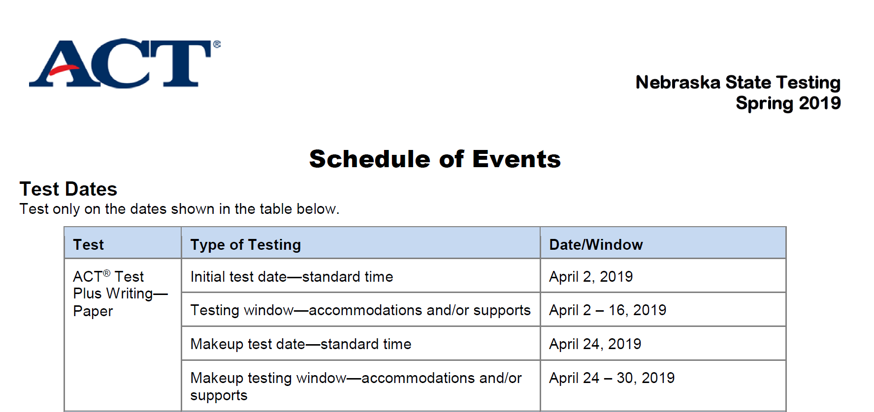
ACT Schedule of Events

Slide 12
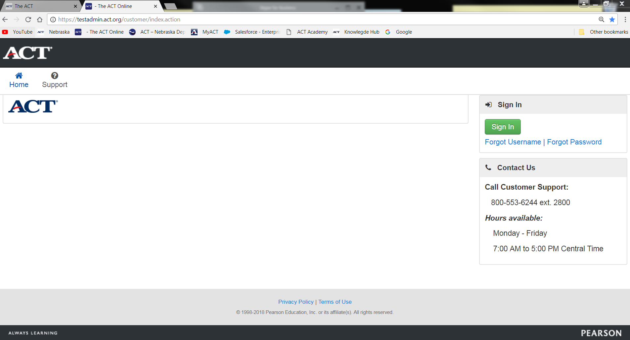
Pearson Accessnext (PA Next)

Slide 13
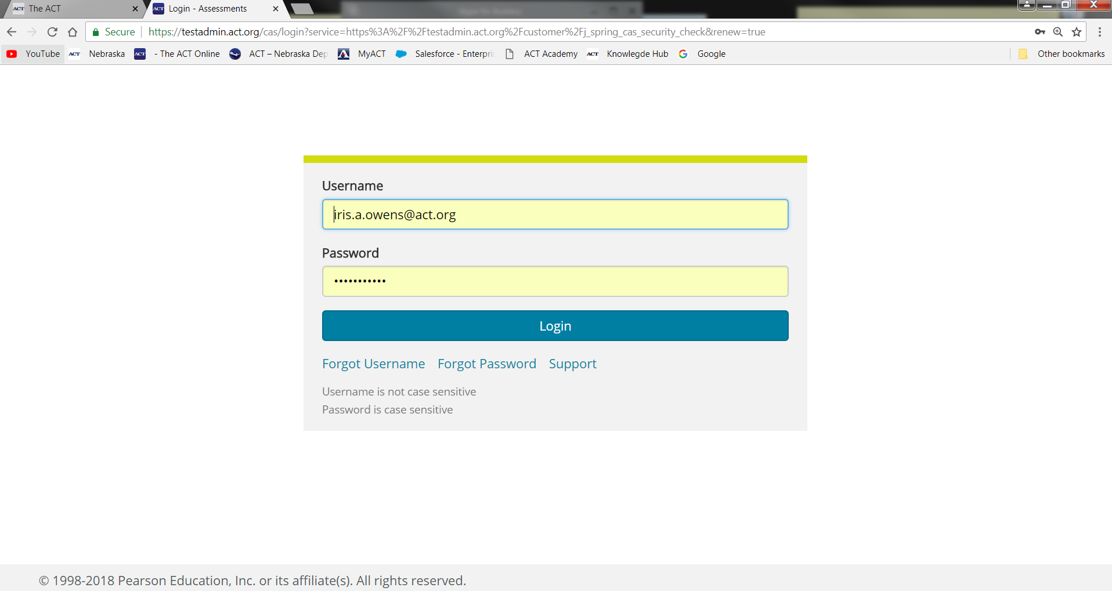

Slide 14
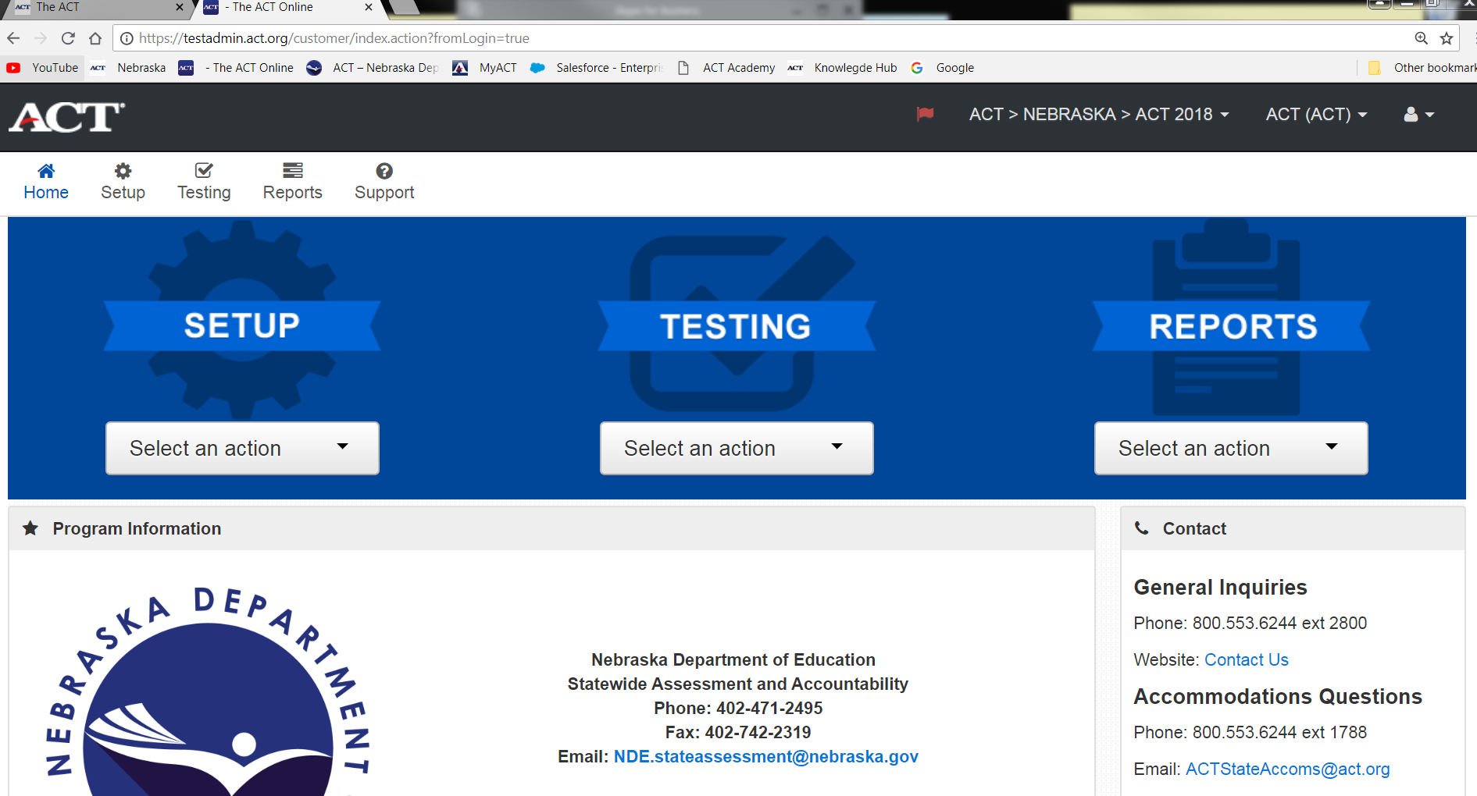

Slide 15
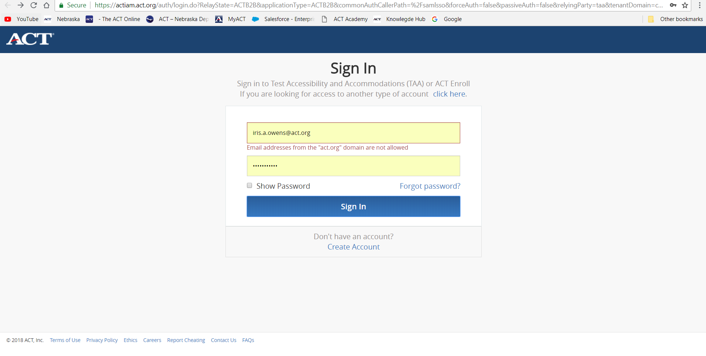
CCRIS TAA and PreACT

Slide 16
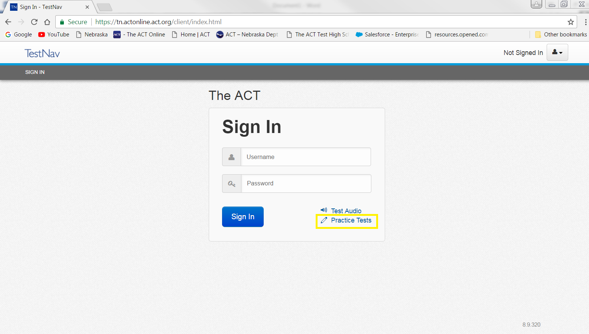
TestNav Online Testing Site

Slide 17
Online Testing
Used for all or partial students or as a makeup option
Manual updates- review the new manual
Mock Administration and Browser Lockdown are key to success
Online Accommodations needs to be requested in TAA 800.553.6244 x 1788
Notes:
The ACT Online Test Manual both the test administration manual and the technical manual will have changes, so please review those once they are available on the webpage. If your district is testing online even as a make up option, please prepare for the Mock Admin, it is the key to success. Use the opportunity to set up all of the devices you believe you will be using and allow for up to an hour to process the mock admin. Another key to success is the browser lockdown just days before the tests are given. ACT doesn’t want to prohibit the use of the devise, just not any updates once it is set up for the online test. Last but not least, if your accommodations student is testing online, you will need to request that in TAA. If you have questions on accommodations, please call their number above.

Slide 18
PreACT and ACT Online Prep Options 2018-2019
Superintendents were provided a survey to choose one of the options NDE purchased for their district
Option 1- ACT Online Prep (AOP), each third year cohort student will have AOP available to them for 365 days from the initial log-in
Option 2- PreACT Test, each district could choose from a fall test window for juniors or sophomores or a spring test window for sophomores only.

Slide 19
Test dates for the PreACT
Fall test window is October 1- December 21, 2018
All fall test folders are due to ACT no later than January 7, 2019
Spring test window is March 1- May 3, 2019, emails will be sent in January with the schedule of events.
For assistance with the PreACT, please call 877.789.2925 or email them at preact@act.org.

Slide 20
ACT Online Prep
Open on September 24, 2018
Need additional licenses- contact Iris
Once student logs in, access is for 365 days
AOP provides 2 practice tests and 2 writing prompts that are AI scored, with additional sample questions for each section.

Slide 21
Questions?

