Slide 1
ESSA CODING UPDATE

Slide 2
BUDGET CAUTION

Slide 3
Allocating District Expenditures

Slide 4
Increased Retirement Contributions Object Code 237

Slide 5
Worker’s Compensation Object Code 27X

Slide 6
Stipends

Slide 7
Student Information System

Slide 8
District Financial Software

Slide 9
Professional Services Object Codes

Slide 10
271X Pupil Transportation Training Related Expenses

Slide 11
Pupil Transportation Related Expenses

Slide 12
Coding Mileage Costs

Slide 13
Coding Mileage Costs

Slide 14
Personnel Coding Categories

Slide 15
Personnel Coding Categories

Slide 16
Teacherages

Slide 17
Miscellaneous Coding Questions

Slide 18
Reminders

Slide 19
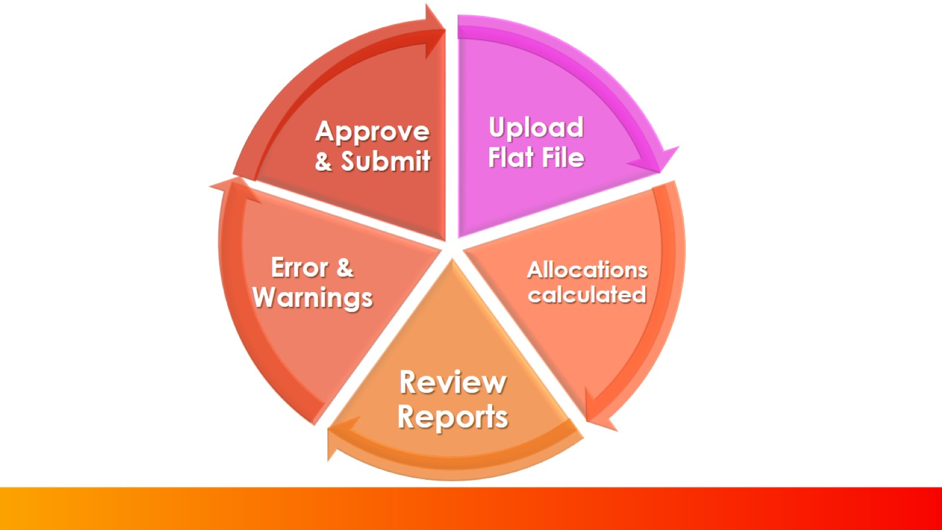

Slide 20
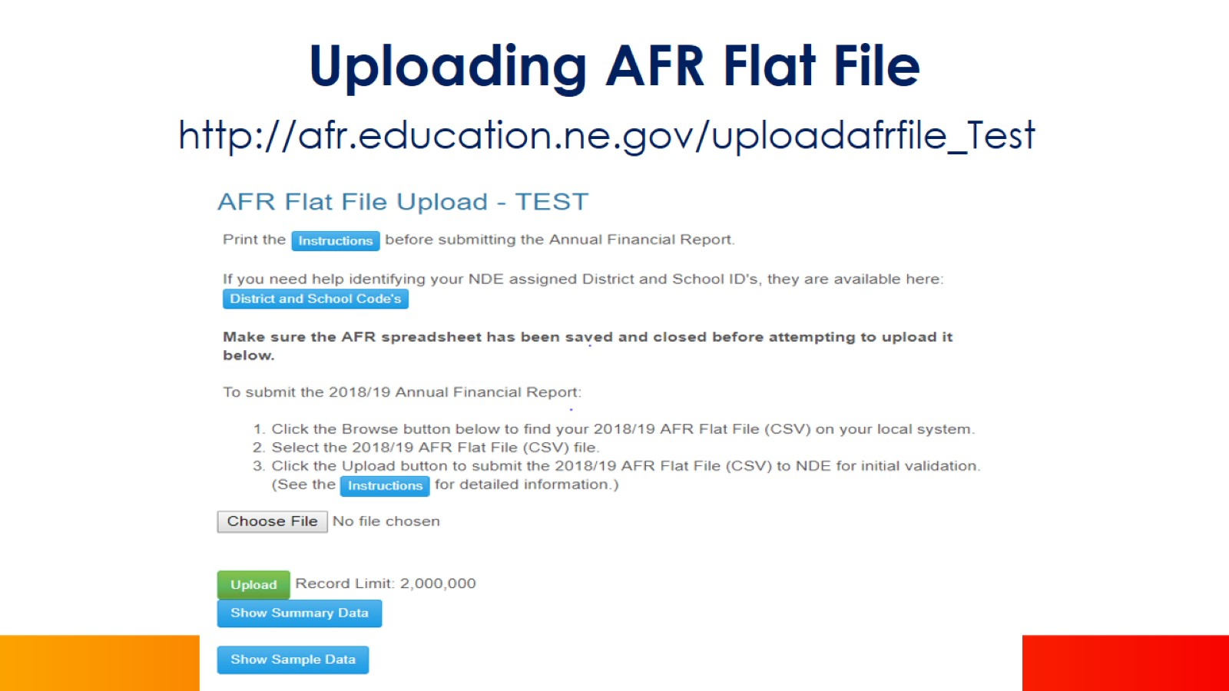
Uploading AFR Flat File

Slide 21
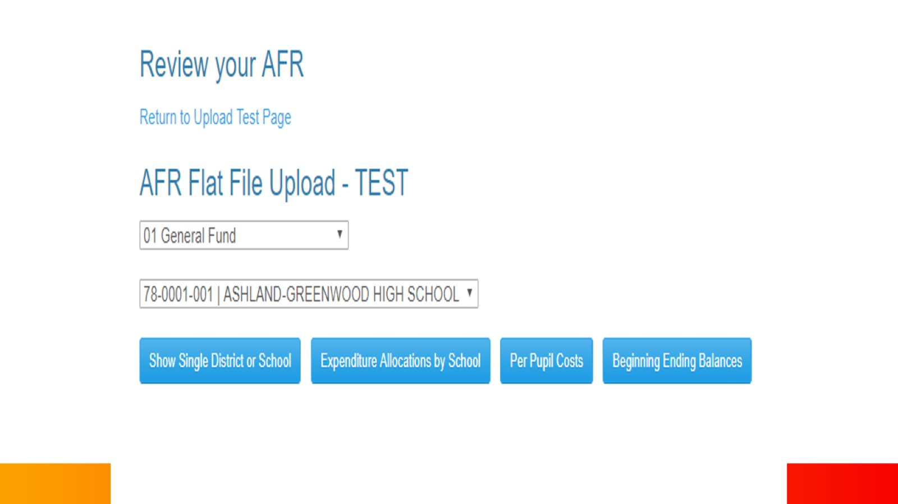

Slide 22
Review AFR Information

Slide 23
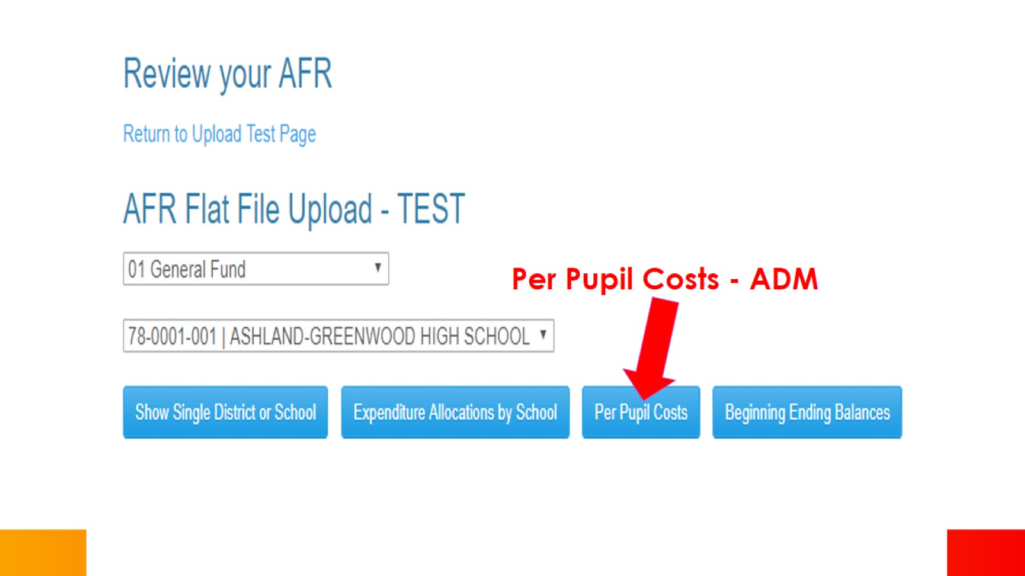

Slide 25
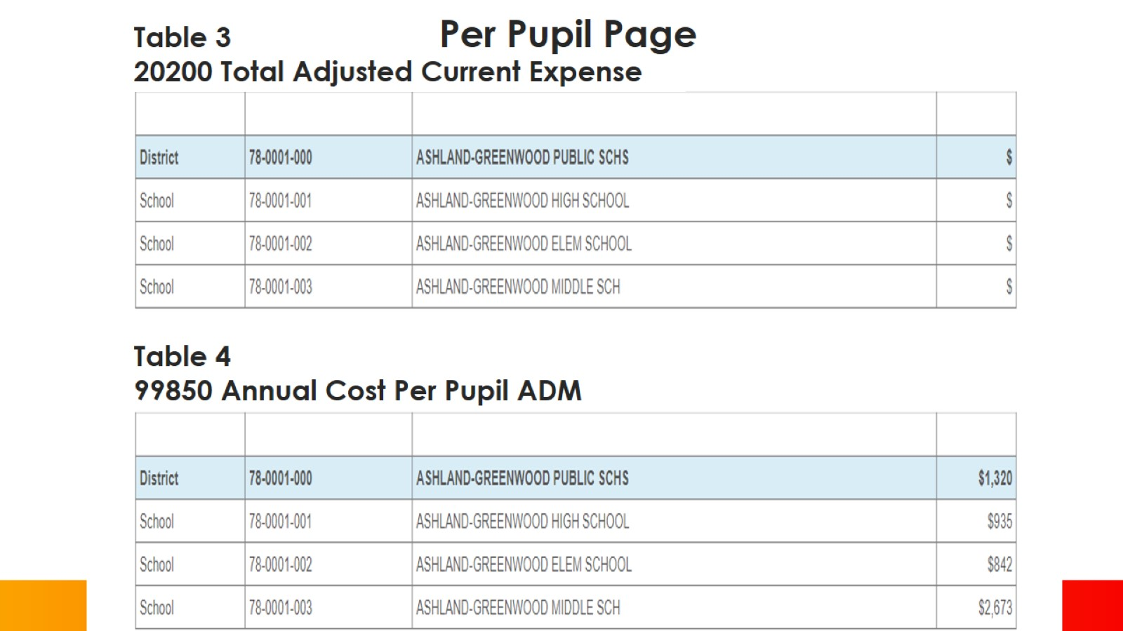

Slide 26
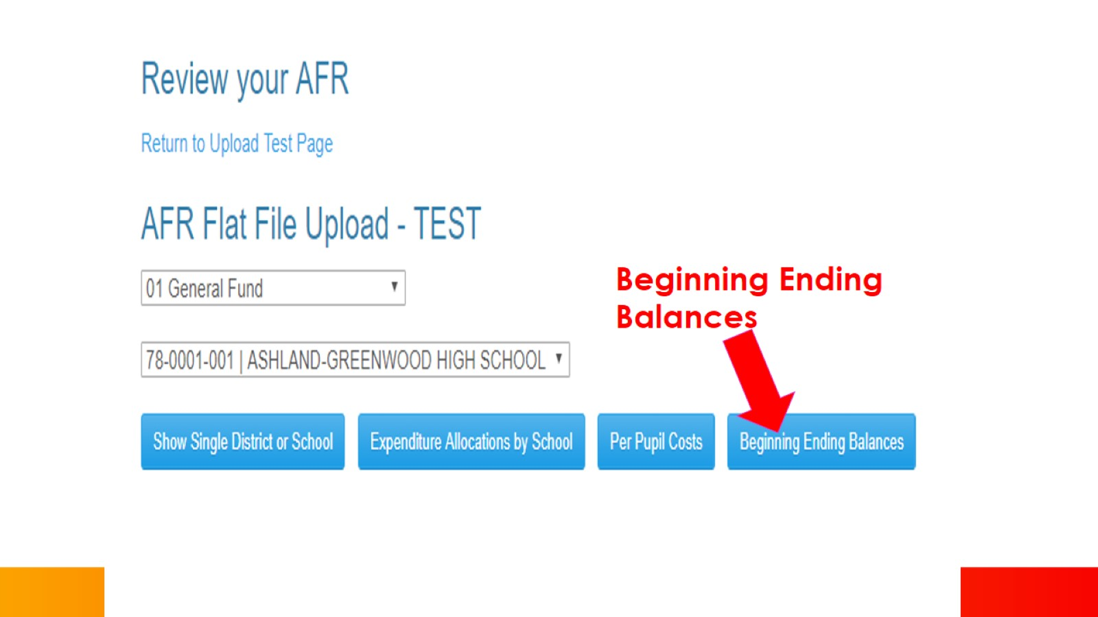

Slide 28
Additional Reports Available

Slide 30
System Generated Reports

