Slide 1
Meal Modifications in School Meal Programs
Date: February 5, 2018
Time: 2:00-3:00pm CST
Presented by:
Brittany Spieker, MS RD LMNT
Nutrition Services Program Specialist
Notes:
Welcome to Nebraska Department of Education, Nutrition Service’s webinar on Meal Modifications in the School Meal Programs! The first part of this webinar will consist of meal modification training and the last part of the webinar will be a question and answer session. As you have questions, please type them into the chat box. I will do my best to answer them at the end.

Slide 2
Brittany Spieker MS, RD, LMNT
Program Specialist
Nebraska Department of Education
– Nutrition Services
Email: brittany.spieker@nebraska.gov
Notes:
My name is Brittany Spieker and I am a Registered Dietitian and Nutrition Services Program Specialist. In this slide, you will find my email if you should ever need to contact me with questions about meal modification requests.

Slide 3
Objectives
Identify federal laws and policies and recent changes
Discuss the “Request for Meal Accommodation” and “Medical Statement” forms
Explore various meal modification requests
Define common terminology
→
→
→
→
Notes:
During this training, I will define several common terms and phrases. I will then explore federal laws and policies and recent updates. I will discuss, in detail, two different documents to be used for requesting meal modifications. These include the “Request for Meal Accommodation” and “Medical Statement” forms that have been developed by the Nebraska Department of Education, Nutrition Services. I will also spend some time describing common requests and the appropriate actions for each.

Slide 4
Why Meal Modifications?
Feed students nutritious, well-balanced meals
Keep students safe
“Provide an equal opportunity [for students] to participate in the School Meal Programs” SP 26-2017
Notes:
Before getting into the details of policy and law, it is important to understand why accommodating meals is significant. As food service professionals, you want to feed students nutritious and well-balanced meals so they may succeed in school, ensure the safety and health of each and every student, and ultimately, “provide an equal opportunity [for students] to participate in the School Meal Programs.” SP 26-2017
All three of these reasons drive home the need for making meal modifications.

Slide 5
USDA Policies & Memos
SP 59-2016:
Policy Memorandum on Modifications to Accommodate Disabilities in the School Meal Programs
Notes:
We have established that making meal modifications is very important for the success and health of a student, but what parameters do we have to make those accommodations? This is where the law, policy, and federal guidance comes in.
The 3 most recent pieces of guidance have been published in the last two years. These publications play a large roll in how SFAs can accommodate for meal modification requests. With each publication that’s come out, more clarification has been made and updates have been included.
The first piece of guidance is called SP 59-2016 (also known as the Policy Memorandum on Modifications to Accommodate Disabilities in the School Meal Programs): This memo incorporated the Americans with Disabilities Act (also known as ADA’s) definition of disabilities, indicating that SFA’s should make reasonable meal accommodations at no extra charge for the students with restrictive or modified diets.

Slide 6
USDA Policies & Memos
SP 26-2017:
Accommodating Disabilities in the School Meal Programs: Guidance and Questions and Answers (Q&As)
Notes:
The second piece of guidance is called SP 26-2017 (also known as Accommodating Disabilities in the School Meal Programs: Guidance and Questions and Answers (Q&As)): This is a Q&A covering common questions that were raised following the release of SP 59-2016. It answers questions on how to ensure all students have access to the School Meal Programs.

Slide 7
USDA Policies & Memos
Accommodating Children with Disabilities in the School Meal Programs: Guidance for School Food Service Professionals (July 25, 2017)
Notes:
Accommodating Children with Disabilities in the School Meal Programs: Guidance for School Food Service Professionals is the third and last piece of guidance I will mention. It was released July 25, 2017 and is meant to supplement SP 59-2016 and SP 26-2017. At the very end of this guidance manual, there is a thorough list of additional outside resources that may be helpful to you.
Each of these 3 documents are great resources if you have specific questions for certain meal modifications. I recommend everyone read through the new 2017 guidance as it answers many questions and emphasizes recent updates.

Slide 8
Important Updates
SFAs to notify families of the process for requesting meal modifications
Expanded definition of disability
Impairments no longer have to be “life-threatening”
Notes:
So what are those updates that I have been talking about? I am briefly going to outline the main points here.
The first main point, is an emphases being put on SFAs notifying families of the process for requesting meal modifications and also identifying the responsible individual at the school for receiving this information. Schools may post notices in school publications, in radio announcements, and other relevant forms of media.
The second main point focuses on the definition of disability. Policy memos prior to the 2017 guidance focused on accommodating for students that had a life-threatening disability. But, the definition of disability has been expanded and no longer needs to be life-threatening in order for SFAs to make modifications. It is expected that most requests be accommodated as long as the need is based on a mental or physical impairment.
These updates will be important to keep in mind as we continue through this training.

Slide 9
Common Terminology
Disability
Food Intolerance
Food Allergy
Celiac Disease
State Licensed Health Care Professional
Notes:
When it comes to meal modification requests, there is some language to be familiar with. I will only be discussing the 5 terms and phrases found on this slide. If you have questions about additional terminology that you have come across, please leave your question in the chat box.

Slide 10
Disability
“A physical or mental impairment that substantially limits one or more major life activities.”
Expanded definition
Accommodating Children with Disabilities in the School Meal Programs:
Guidance for School Food Service Professionals
Notes:
The first term is disability. Disability is defined as a physical or mental impairment that substantially limits one or more major life activities. With this expanded definition, more meal accommodations can be made.

Slide 11
Disability
Major life activities may include:
May impact the ability to:
Care for oneself
See
Hear
Eat
Sleep
Walk
Stand
Lift
Bend
Speak
Breath
Learn
Read
Concentrate
Think
Communicate
Work
May impact major bodily functions:
Immune system
Normal cell growth
Digestive
Bowel
Bladder
Neurological
Brain
Respiratory
Circulatory
Endocrine
Reproductive functions
Accommodating Children with Disabilities in the School Meal Programs:
Guidance for School Food Service Professionals
Notes:
The definition of disability talks about major life activities, but what does that all entail?
A major life activity may include anything that limits a person from taking care of oneself, or alters how someone can see, hear, speak, learn, read, think, etc. A major life activity also includes anything that limits bodily functions such as the immune, digestive, endocrine systems, etc.
Although this slide includes many ways major life activities may be impacted, this list is not limiting. There may be major life activities that are not on this list, and because of this, you are encouraged to assess each situation as a unique request.

Slide 12
Food Intolerance
“An abnormal response to a component of a food that does not involve an immune system reaction”
Gluten & lactose intolerances are common
Accommodating Children with Disabilities in the School Meal Programs:
Guidance for School Food Service Professionals
Notes:
Another common phrase to be familiar with is food intolerance. Food intolerance is “an abnormal response to a component of a food that does not involve an immune system reaction.” In other words, a food intolerance is NOT life threatening, but commonly causes discomfort especially with the digestive system. If symptomatic foods are eaten, the person may experience abdominal pain, bloating, gas, or diarrhea.
The most common types of intolerances you may encounter revolve around gluten and lactose. Gluten intolerances have to do with the consumption of wheat, barley, or rye. Lactose intolerances have to do with the consumption of dairy products.

Slide 13
Food Allergy
“An immune system reaction to a component of a food, at times, producing a life-threatening response.”
Accommodating Children with Disabilities in the School Meal Programs:
Guidance for School Food Service Professionals
Notes:
Next up is food allergy. A food allergy is “an immune system reaction to a component of a food, at times, producing a life-threatening response.” This means that the body’s response to an allergen may be life threatening, but not necessarily always. Whether the allergen is life-threatening or not, it is of the upmost importance to keep students safe and healthy.

Slide 14
Food Allergy
The Big 8 (and their derivatives)
Peanuts
Tree nuts (walnut, almond, pecans, cashews, etc.)
Milk
Eggs
Wheat
Soy
Fish (tuna, carp, salmon, cod, etc.)
Shellfish (shrimp, crab, lobster, etc.)
Notes:
About 90% of all food allergies fall within what’s called the Big 8. The Big 8 includes allergens such as peanuts, tree nuts (i.e. walnuts, almonds, pecans, cashews, etc.), milk, eggs, wheat, soy, fish (i.e. tuna, carp, salmon, cod, etc.), and shellfish (i.e. shrimp, crab, lobster, etc.). All of these allergens can be found in many other forms or under different names. It is important to know all the forms and names of an allergen, because even the smallest amounts can cause an allergic reaction.
Although a majority of food allergies fall within these 8 categories, food allergies are not limited to this list. You may potentially come across food allergies to kiwi, beef, corn, certain spices, among many, many other types of foods.

Slide 15
Food Allergy
Common Allergic Reactions
Hives, itching, or skin rash
Swelling of lips, face, tongue, or throat
Wheezing, nasal congestion, or trouble breathing
Abdominal pain, diarrhea, nausea, or vomiting
Dizziness, lightheadedness, or fainting
Accommodating Children with Disabilities in the School Meal Programs:
Guidance for School Food Service Professionals
Notes:
If someone is exposed to an allergen, they may experience adverse health affects. The person may develop hives, itching, or skin rashes. Experience swelling of the lips, face, tongue, or throat. They may start wheezing, develop nasal congestion, or experience trouble breathing. Develop abdominal pain, diarrhea, nausea, and/or vomiting. They may also become dizzy, lightheaded, or faint. A person with a food allergy will likely experience several of the above symptoms and potentially other symptoms that are not listed here. Be sure to communicate with the household and other school staff so everyone knows what to expect and the correct actions to take if a reaction should occur.

Slide 16
Food Allergy
Preventing Allergic Reactions
Understand each student’s diet request
Standardize recipes
Avoid cross-contamination
Be willing to work with others
Read nutrition facts label
National Food Service Management Institute
Fact Sheets
http://nfsmi.org/documentlibraryfiles/pdf/20100505094118.pdf
Notes:
Although it is important to know the signs and symptoms of an allergic reaction, the best defense is to prevent the allergic reaction from occurring in the first place. In order to prevent adverse reactions, there are many proactive things you can do.
First, you should know each student and understand what their exact needs are. If you feel a meal modification request is unclear, be sure to reach out to the household and/or school nurse to try to clear any confusion. Having a strong understanding of a student’s situation is of upmost importance in order to prepare foods correctly.
You are also encouraged to use standardized recipes. If you are using standardized recipes, you ensure that the same ingredients and amounts are being used every time the recipe is made. This can prevent any unexpected ingredients from making it into the food.
Another importance piece of safety is to prevent cross-contamination through good food safety practices. This will help prevent allergens from crossing from one food to the next. This will also help prevent the spread of any illnesses that potentially could be carried by food. Thus protecting all of your student population.
It is important to be willing to work with others. Call the household if clarification about the diet is needed, discuss the student’s meal plan with your coworkers in the kitchen, reach out to the school nurse, etc. Open communication between individuals is important in keeping a student safe and healthy.
And finally, know how to read nutrition facts labels. Be familiar with the set-up of a label and what items and terms to look for. If you are unsure if a food item contains a specific allergen or not, it is your responsibility to contact your distributor or the manufacturer to make that determination. Being proactive with nutrition facts labels will prevent you from ordering foods that contain an allergen.
If you are looking for more information on food allergies and other health conditions, you can click on or type the following link into your web browser. The National Food Service Management Institute has much food and nutrition information that is organized into various fact sheets.

Slide 17
Celiac Disease
“Immune reaction from gluten that occurs in the small intestine, causing abdominal pain, bloating or diarrhea.”
Gluten can be found in wheat, barley, and rye
Accommodating Children with Disabilities in the School Meal Programs:
Guidance for School Food Service Professionals
Notes:
The next common phrase is Celiac Disease. Celiac Disease is the “immune reaction from gluten that occurs in the small intestine, causing abdominal pain, bloating or diarrhea.” Although this reaction sounds similar to an allergy, it is something different. Celiac Disease is an autoimmune disease that causes damage in the small intestine and prevents the person from absorbing nutrients effectively. It is essential that these individuals avoid gluten containing grains such as wheat, barley, and rye – which is the same treatment for gluten intolerance. By avoiding these grains, we can make sure that the student is healthy, safe, and are absorbing important nutrients.

Slide 18
State Licensed Health Care Professional
“An individual who is authorized to write medical prescriptions under State law.
May include:
Physician (MD or DO)
Physician’s Assistant (PA)
Advanced Practice Registered Nurse–Nurse Practitioner (APRN-NP)
Chiropractor
Licensed Medical Nutrition Therapist (LMNT) that is working with a licensed physician
Accommodating Children with Disabilities in the School Meal Programs:
Guidance for School Food Service Professionals
Notes:
The last phrase is state licensed health care professional. This is “an individual who is authorized to write medical prescriptions under State law.” These individuals may include a Physician, Physician’s Assistant, Advanced Practice Registered Nurse-Nurse Practitioner, Chiropractor, or Licensed Medical Nutrition Therapist that is working with a licensed physician.
Although we only discussed 5 different phrases, there are many other definitions you may want to look up if you have questions. Additional definitions can be found at the back of “Accommodating Children with Disabilities in the School Meal Programs: Guidance for School Food Service Professionals.”

Slide 19
Meal Modification Forms
Request for Meal Accommodation
Medical Statement
Notes:
Now that we have some common language in our back pocket, we can now talk about Meal Modification requests and forms.
SFAs are to make reasonable meal accommodations for students with mental or physical impairments. What deems a reasonable meal accommodation is to be determined by the SFA.
Because SFAs are encouraged to provide meal modifications, open communication is key to keep students safe and encourage participation in the school meal programs. The “Request for Meal Accommodation” and “Medical Statement” forms are meant to be a documented form of communication between the student, the parents/guardians, and the SFA.
The Request for Meal Accommodation form can be seen on the left and the Medical Statement form can be seen on the right. We will discuss each of the forms in detail.

Slide 20
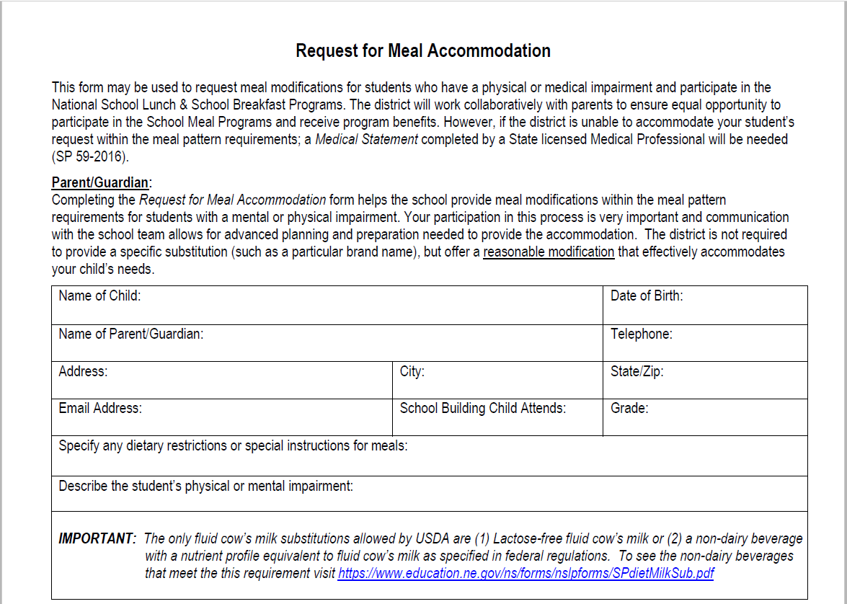
Request for Meal Accommodation
Notes:
This first form is called “Request for Meal Accommodation.” This is to be completed by the student or parent/guardian when requesting modifications that fall within the Program meal pattern. For example, this form could be utilized if a student has an allergy to a single fruit or vegetable, such as strawberries. In this case, the SFA would simply offer the student another fruit in place of strawberries.
To fill out the form, the student or parent/guardian will need to provide the student’s information. This information includes the student’s name, date of birth, the name of the parent/guardian, and the school building the student attends. Several different forms of communication with the household are also requested; such as, a telephone number, address, and email address.
In the next section, it is requested that the type of dietary restrictions or modifications be described.
Following that, a description of the physical or mental impairment needs to be listed. It is not required that a medical diagnosis be included – only a description is required.

Slide 21
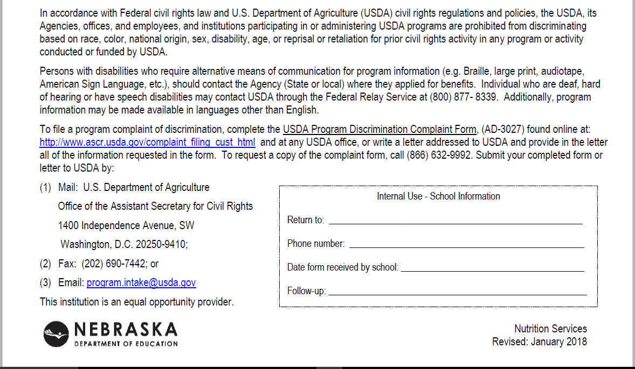
Request for Meal Accommodation
Notes:
The bottom half of the form includes the civil rights statement that protects individuals from discrimination. The statement includes contact information for individuals to request accommodations or to file a complaint of discrimination.
A few examples of discriminatory actions may include: providing an individual an opportunity that is not equal to the opportunity provided to others, providing an individual services that are not as effective as the services provided to others, or denying an individual the opportunity to benefit from or participate in aid, benefits, or services granted to them. These three examples really drive home the importance of providing meal accommodations to students with specific diet needs. As food service professionals, you want to ensure that all students have the same opportunities to eat nutritious and well-balanced meals as other students do.
In the bottom right corner is a box that the SFA is to complete. The school should indicate who the form can be returned to, their phone number, the date the form was received back at the SFA, and a spot to indicate if and when the school made a follow-up with the family. It is recommended that the SFA follow-up with the family at least once a year to ensure the information is up to date.
By federal regulation, this form is not required if accommodations can be met within Program meal pattern. However, there must be some form of documentation regarding a meal modification request. Nutrition Services strongly encourages SFAs to utilize this form as a communication tool.

Slide 22
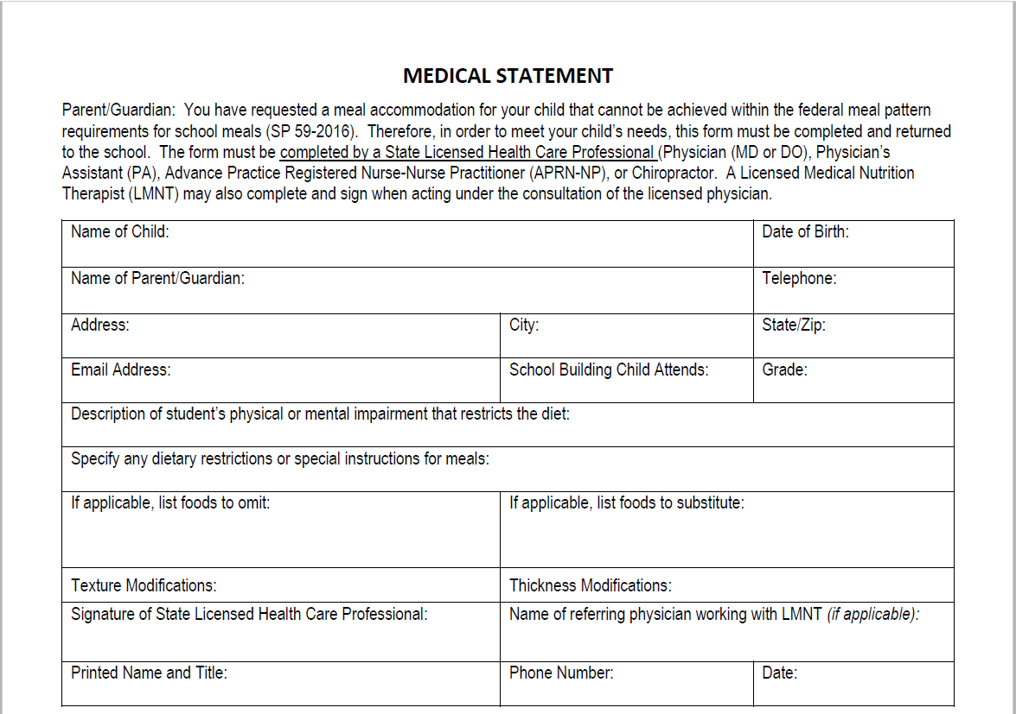
Medical Statement
Notes:
The second form is the “Medical Statement.” This is to be used if meal accommodations cannot be made within the Program meal pattern. An example of this might be a student’s family requesting a gluten-free diet due to Celiac Disease. Gluten-free products are not always whole-grain rich and because of this these meals would not fall within meal pattern thus requiring a Medical Statement.
The medical statement requires the same student information and contact information as the “Request for Meal Accommodation” form. This form also requires a description for the physical or mental impairment and any dietary restrictions or modifications. Again, a medical diagnosis is not required to be listed.
Foods to omit and foods to substitute can be listed – if applicable. There is also a section to indicate if texture or thickness modifications are needed. With a medical statement on file, an SFA can be reimbursed for meal modifications outside of the Program meal pattern.
On this form, there is a space for the signature of a state licensed medical professional, their printed name and title, contact information, and date the document was signed. This form may also be signed by a practicing Licensed Medical Nutrition Therapist (LMNT) along with the name of the physician they are working with.

Slide 23
Medical Statement
Notes:
Similar to the “Request for Meal Accommodation” form, the civil rights statement is found on the bottom half of the document and the school’s information section can be found on the bottom right.

Slide 24
Assess on a
case-by-case basis.
BY
Notes:
A key point to remember as you receive meal modification requests is each student has their own individualized needs. With that said, each request needs to be assessed on a case by case basis. If you have questions about a request or need clarification, reach out to the student’s parents/guardians. Open communication between the household and the SFA helps encourage participation in the school meal programs and also promotes safety of the student.

Slide 25
DO NOT DELAY
Notes:
Another key point: An SFA should not delay a meal modification if a medical statement is not yet on file. Modifications should be made as soon as possible in order to keep the student safe and healthy. The SFA should continually follow-up the household until a medical statement is provided. Documentation is to be kept on file each time the household is contacted for follow-up on receiving said documentation.

Slide 26
Download Forms
Medical Statement
Request for Meal Accommodation
Spanish Version – Medical Statement
Coming Soon!
https://www.education.ne.gov/ns/forms-resources/national-school-lunch-program/special-diets-2/
Notes:
Both the “Request for Meal Accommodation” and “Medical Statement” forms can be found on NDE’s website at the following links. A Spanish version of the Medical Statement will also be available on the website soon.

Slide 27
Record Retention
Current student
Entirety of time spent at school district
Follow-up at least once a year
No longer needing modifications
3 years plus the current year
Notes:
Once you receive the completed forms, how long do you keep them on file? Record retention is an important part of the school meal programs and documenting meal modifications is no different!
For those students that are currently part of your school district, keep the documentation on file for as long as the student attends your school. Be sure to make follow-up calls at least once a year to keep information up to date!
For those students who are part of your school district and no longer need meal modifications, keep that documentation on file for 3 years plus the current year. This is the same time frame for any other documentation pertaining to the school meal programs.

Slide 28
Meal Reimbursement
SFAs can receive reimbursement for…
Modifications within meal pattern
Modifications outside of meal pattern supported by a Medical Statement
Notes:
As far as reimbursement goes, SFA’s can claim meals for reimbursement when modifications are made within meal pattern and modifications that are made outside of meal pattern that have supporting documentation, such as the Medical Statement.
There is no additional reimbursement for any extra costs accrued for providing meal accommodations.

Slide 29
Offer Versus Serve
Students CANNOT be asked to exclude a food component
Students must be able to select all food components
SFA MUST offer appropriate substitutions
Notes:
Offer Versus Serve gives students more control in the foods they choose to take and eat. OVS may help reduce food waste and even encourage students to try new foods. With OVS, a student can create a reimbursable meal without taking all 5 components.
In the case of meal modifications, a student cannot be asked to exclude a food component. This would not be considered a reasonable modification and could not be claimed for reimbursement. The student must still be offered all 5 components. If a student cannot have a food component being offered, the SFA is expected to offer a reasonable substitution for that component. Even if the student does not take the component offered, the option still needs to be available to them.
For example, you have a student needing a gluten-free diet and you are serving Hamburgers on a bun one day. Best practice would be to offer the student a gluten-free bun or equivalent to go with their hamburger. The student cannot be asked not to take a bun because a gluten-free option is not available. A gluten-free option should be available to the student every day.

Slide 30
Situational Requests
Each request will be unique to the student
Meal modification requests cover a wide spectrum of scenarios
Notes:
As I have previously emphasized, SFAs must take requests on a case by case basis because each request will be unique.
That said, requests can cover a wide spectrum of scenarios. I will cover some basics of the more common requests you might receive.

Slide 31
Peanut Allergies
Peanut ~safe~ table
Students not allowed to have peanuts or derivatives at this table
Peanut ~safe~ school
Students not allowed to have peanuts or derivatives across the entire school
Notes:
Peanut allergies are a fairly common food modification request. Because this allergy is so common, some schools have decided to create peanut safe tables in the lunch room and have even gone as far as making the entire school peanut safe. Be careful with verbiage if your SFA would like to go this route. You cannot have a peanut “free” table/school. The SFA can ensure the products going through the kitchen are peanut free, but we cannot ensure that all outside food coming into the SFA is absolutely peanut free. Thus, the SFA can advertise as peanut safe, not peanut free.

Slide 32
Portion Sizes
Requesting portions less than or more than minimum requirements
Requires “Medical Statement”
No additional reimbursement for SFA to cover added costs
Notes:
Another meal modification request you might receive revolves around portion sizes. An SFA may come across a meal request that would fall under or over the minimum portion sizes for the school meal Programs meal pattern. Whether for smaller portions or larger portions, the request must be verified with a medical statement signed by a licensed health care professional. If the SFA is accommodating for larger portion sizes, the SFA will not receive additional reimbursement from the school meal programs to cover extra costs. To cover these costs, the SFA may use funds from the school food service account, general fund account, or special education funds (if it is specified in a student’s Individualized Education Plan (IEP)).

Slide 33
Brand Name
Specific brand names may be requested
Requires “Medical Statement”
Clarify request with the family
Generic brand may be sufficient
Notes:
Another meal modification request an SFA might receive is to serve a specific brand name item. In this case, it would need to be verified with a Medical Statement in order for the SFA to provide the brand name product. It is recommended that the SFA to follow-up with the household to determine if the brand name product is the only product that can be served or if certain generic brands may be equivalent to the name brand items. Many times the generic brand will be sufficient.

Slide 34
Preferences
Requests may be based on cultural, religious, or ethnic preferences
Not a requirement to accommodate
Accommodating may help with participation
Modifications must fall within meal pattern
Notes:
Some households may request meal accommodations based on preferences. These requests may be based on cultural, religious, or ethnic backgrounds. SFAs are not required to accommodate for meal preferences; although, providing such accommodations may help participation in school meal programs.
SFAs are strongly encouraged to consider making accommodations even if it is as simple as providing more information on monthly menus. The SFA may choose to indicate meals that have pork in them, indicate foods that are vegetarian, indicate foods that may contain milk, soy, or egg products, etc. The SFA can adapt the menu information depending on what the needs of the student population are.
Any meal modifications made based on preference must fall within meal pattern.
SFAs are responsible for any additional costs accrued from making such accommodations. No additional funding will be granted to the SFA to cover these expenses.

Slide 35
Milk
Most common modification
May be:
A preference
Not required to accommodate
Or medically necessary
Required to accommodate
Medical Statement may be necessary
Notes:
Milk is by far the most common accommodation requested. The request may be based on a preference or may be deemed medically necessary.
Again, if the request is a cultural, religious, or ethnic preference, the SFA is not required to accommodate, but are encouraged to consider the request.
If the request is based on a mental or physical impairment, the SFA is expected to make accommodations. Some cases may be accommodated within meal pattern and do not require a medical statement. A good example of this would be providing lactose-free milk for a student with a lactose intolerance. In other cases, a Medical Statement may be required. An example of this might be when a family is requesting almond milk be served to a student. In this case, almond milk would not be nutritionally equivalent to cow’s milk and would fall outside the meal pattern. This particular request would require a Medical Statement signed by a licensed health care provider indicating that almond milk is the appropriate substitution for that particular student. With the Medical Statement on file, the SFA is required to provide the student almond milk.

Slide 36
Milk
Milk alternate must be nutritionally equivalent to cow’s milk
Unless Medical Statement deems otherwise
Water and juice are not acceptable substitutes
Notes:
As I briefly mentioned in the previous slide, milk alternates must be nutritionally equivalent to cow’s milk. In this chart is listed the nutrients and their minimum amounts required in order for a milk alternate to meet the nutrient requirements. The required nutrients to be present in milk alternates are calcium, protein, Vitamin A, Vitamin D, magnesium, phosphorus, potassium, riboflavin (Vitamin B2), and Vitamin B-12. The only exception to this rule would be if a Medical Statement is on file indicating an alternate milk that does not meet the minimum nutrient requirements.
Water and juice are never acceptable substitutions for milk.

Slide 37
Meal Modification Scenarios!
Notes:
We are now approaching the end of the webinar and have acquired much information. Let’s take that information and apply it to some realistic scenarios! Some of these examples have been taken and adapted from the USDA’s guidance manual or policy memos.

Slide 38
Example #1
A parent calls and requests a
gluten-free diet.
Do you encourage the parent to complete a “Request for Meal Accommodation” or “Medical Statement” form?
Request for
Meal Accom.
Medical Statement
Notes:
Example #1: A parent calls and requests a gluten-free diet. Do you encourage the parent to complete a “Request for Meal Accommodation” or “Medical Statement” form?
Please select your answer now.
Thank you all for answering.
I mentioned this example a little earlier in this session. In this case, I would encourage the family to complete a Medical Statement. Many times gluten-free items are not whole grain rich and because of this would not fall within meal pattern. A Medical Statement will also allow an SFA to claim the student’s meals for reimbursement.

Slide 39
Example #2
Is an SFA required to make meal modifications for food preferences rather than for a physical or mental impairment?
Yes
No
Notes:
On to Example #2.
Is an SFA requires to make meal modifications for food preferences rather than for a physical or mental impairment?
Please select your answer now.
Thank you for participating!
No, SFAs are not required to provide meal modifications for preference requests. Although, it is strongly encouraged that the SFA consider making accommodations. Making preference modifications may help with participation in the school meal programs. Just remember, that if you would choose to make modifications based on preference, the modification must fall within meal pattern.
Page 15: SP 26-2017

Slide 40
Example #3
A student no longer requires modified meals outside the Program meal pattern.
Must an SFA obtain an amended medical statement prior to ending the student’s meal modification?
Yes
No
Notes:
We are now on our final example!
A student no longer requires modified meals outside the Program meal pattern. Must an SFA obtain an amended medical statement prior to ending the student’s meal modification?
Please select your answers now.
No, an SFA would not need a new Medical Statement. The SFA is encouraged to follow-up with the family and ensure that the student no longer needs the modification. Document this interaction on the Medical Statement that you currently have and keep this information on file for 3 years, plus the current year. This information will be beneficial to have on hand in case the student ever needs meal modifications again.
Page 16

Slide 41
Wrapping Up
Meal modifications are important for students’ health and safety
Federal laws help determine how SFAs accommodate
“Request for Meal Accommodation”
“Medical Statement”
Many different modifications may be requested
Each request should be individualized
Notes:
It’s time to start wrapping up what we’ve learned!
The main points we discussed today include the following…
First - Providing meal accommodations are important for a student’s health, safety, and participation in the school meal Programs.
Second - Federal laws and guidance can help us determine how to accommodate for meal modification requests. Because of the new guidance, NDE Nutrition Services has created “Request for Meal Accommodation” and “Medical Statement” forms to help with communication between the household and the SFA.
And third - There is potential for many different modifications to be requested. Most importantly, each request should be individualized to ensure the student is properly cared for.

Slide 42
Resources
SP 59-2016: Policy Memorandum on Modifications to Accommodate Disabilities in the School Meal Programs
https://fns-prod.azureedge.net/sites/default/files/cn/SP59-2016os.pdf
SP 26-2017: Accommodating Disabilities in the School Meal Programs: Guidance and Questions and Answers (Q&As)
https://fns-prod.azureedge.net/sites/default/files/cn/SP26-2017os.pdf
Accommodating Children with Disabilities in the School Meal Programs: Guidance for School Food Service Professionals
https://fns-prod.azureedge.net/sites/default/files/cn/SP40-2017a1.pdf
Links for additional resources can be found at the end of this guidance manual.
All images in this presentation can be found on Pickit.
Notes:
This presentation was created using these resources. Again, I encourage you to read through the new guidance manual. There is a lot of great meal modification information included. The guidance may even help answer some of your questions.

Slide 43
Resources
Would you like more training?
Check out Moodle!
https://moodle.education.ne.gov/course/index.php?categoryid=15
Thanks Team Nutrition!
Notes:
Would you like to learn more about meal modifications and diet requests?! Feel welcome to jump over to watch Team Nutrition’s online Moodle trainings. Just click the link on the PowerPoint slide or type the link into your web browser search bar. This link will take you to a page that has several school meal program trainings listed. If you see any other trainings that you think may be beneficial to watch, please do so!
To specifically learn more about meal modifications and diet requests, click on “Working with Special Diet Students.” Moodle will then prompt you to login. If you already have an account, login. If not, you can create a free account in just a few minutes. After getting signed in, Moodle will then display three separate training videos you can watch. These videos will not include the recent updates that we talked about today, but have so much valuable information in them! The first video discusses the basics of meal modifications. It talks about why we need to provide modifications, who might need modifications, and how to make modifications. The second video focuses on food allergens, reading food labels, and substituting menu items. And finally, the third video provides information on Celiac Disease and gluten-free diets.
These Moodle videos are well worth the watch!

Slide 44
Questions?
Call Nutrition Services
Direct line: 402-471-2488
Toll Free (Nebraska): 800-731-2233
Visit Nutrition Services webpage
https://www.education.ne.gov/ns/forms-resources/national-school-lunch-program/special-diets/
Notes:
If you do have additional questions that have not been discussed during this session today, please contact Nutrition Services through our direct line or toll free line. My email can also be found at the beginning of this training. You may also visit the Nutrition Services special diet webpage. This webpage has additional information that you may find useful in your food service operation.
Later this week, you will be notified that the recording of this webinar, the PowerPoint slides, and a certification of completion that is worth 1 CEU are posted to the NDE website and are available to you. In the chat box of this webinar is a link to a survey. I encourage you to complete this survey as it will provide me with feedback on this webinar and how I can better serve you.

Slide 45
FAQ Sheet - Coming Soon!
Notes:
I will now open this webinar to questions. I have Shawn Vondracek here with me today and she is going to help me sort through and answer your questions. I may not get to all of your questions today, but will document them and get back to you with an answer. A FAQ Sheet will be created and provided to you at a later date.

