Slide 1
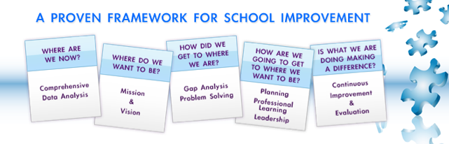
Using Data for Continuous
School Improvement
Nebraska DOE Data Cadre, ESUPDO
Education for the Future
http://eff.csuchico.edu
Bradley J. Geise
bgeise@csuchico.edu
Notes:
1

Slide 2

BACKGROUND
Education for the Future – Non-Profit Initiative
  Victoria L. Bernhardt, Exec Director
California State University, Chico
Our Mission
Funded by contracts.
17 Books, Conferences, Institutes, Workshop.
Manage long-term implementation contracts.
Monthly online meeting series.

Slide 3


Slide 4
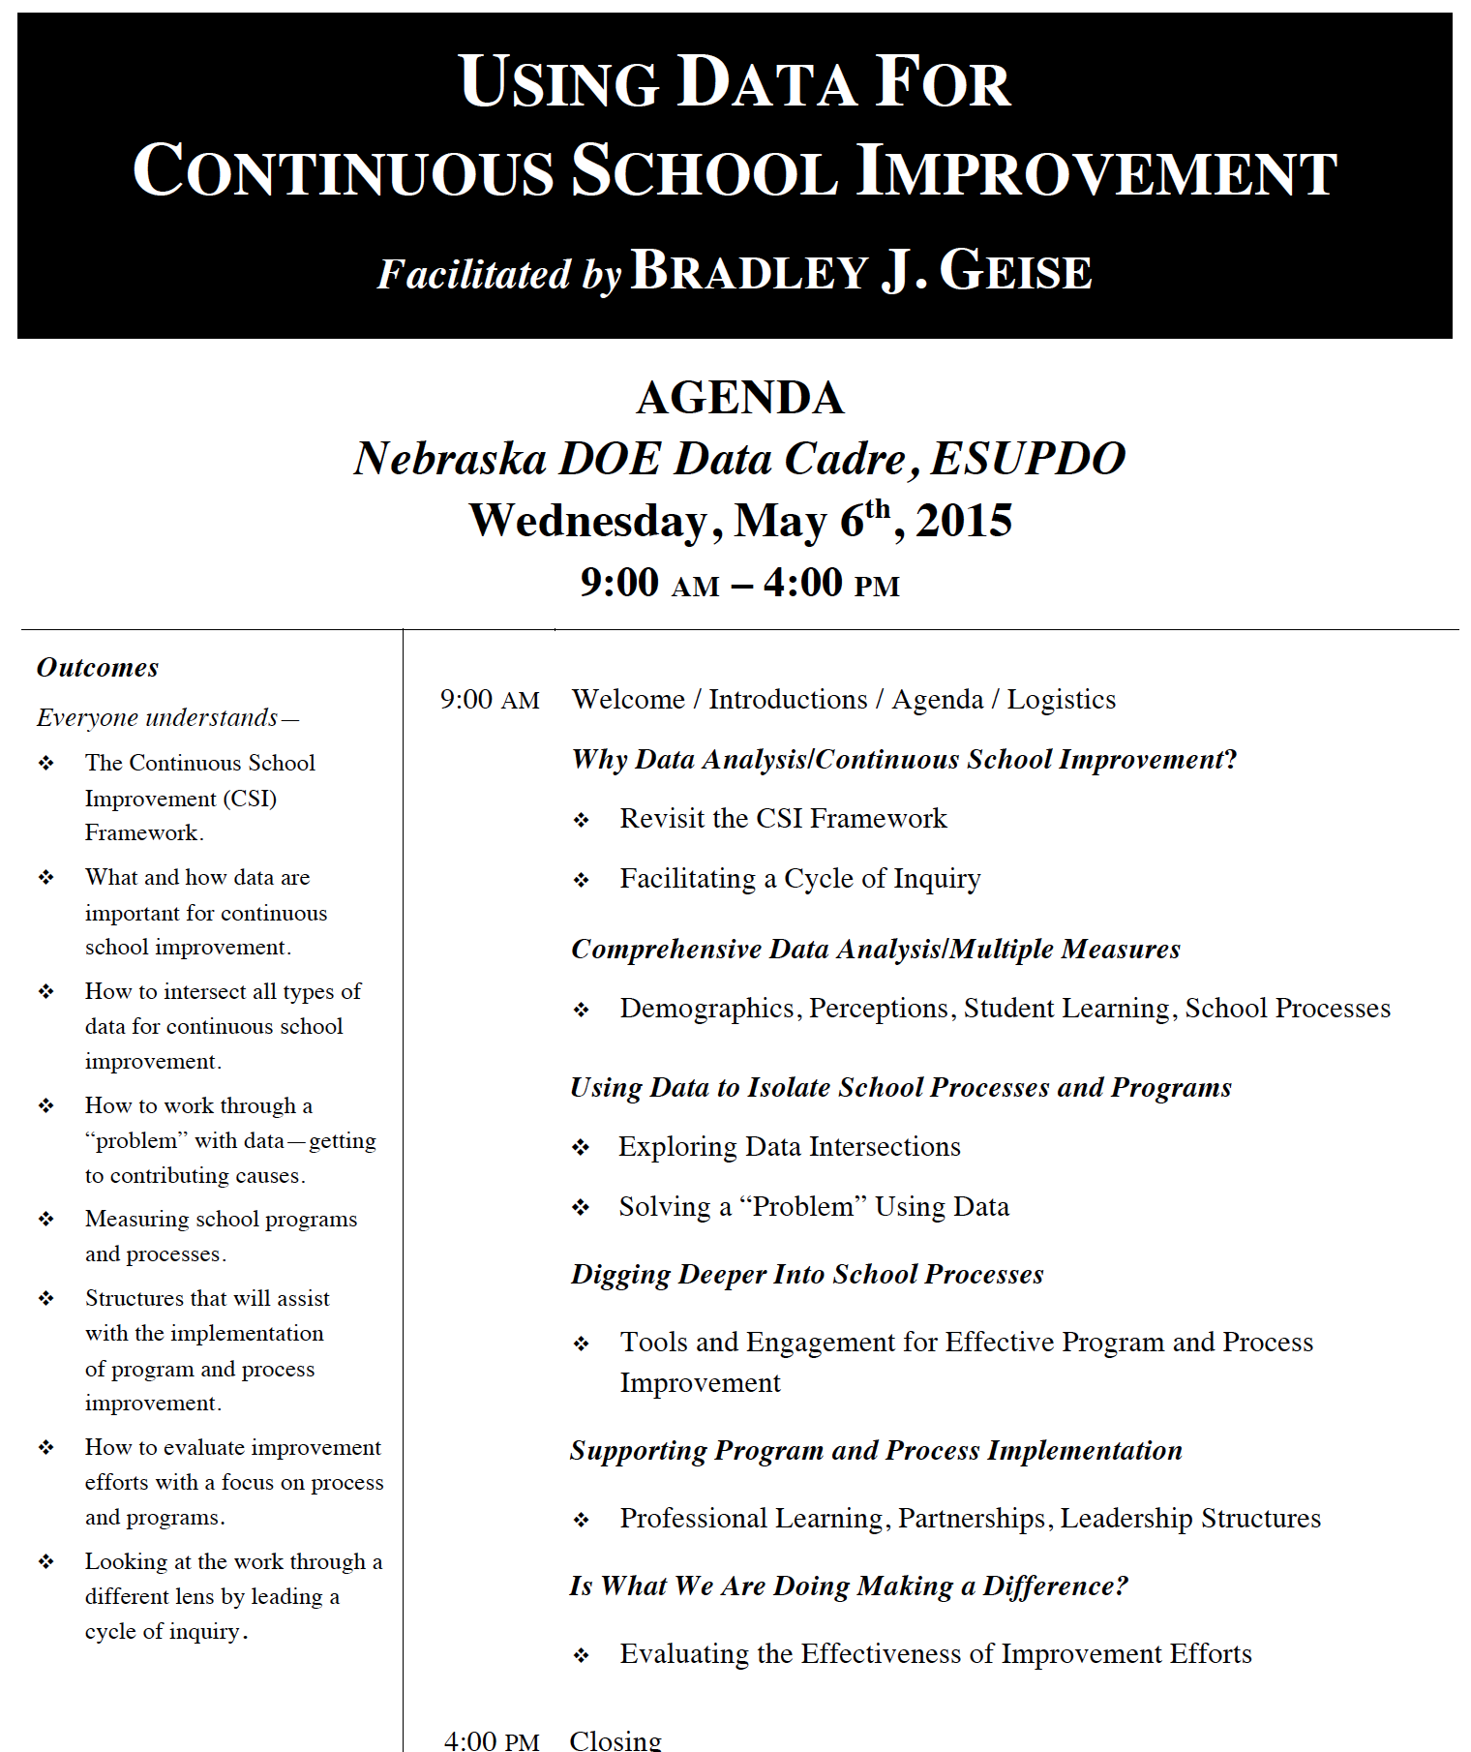

Slide 5

Bernhardt, V.L. (2013)
Data Analysis for Continuous School Improvement
(Third Edition)
New York, NY: Routledge

Slide 7

WHY Data Analysis/Continuous
School Improvement?

Slide 8
What do you know about data?
What do you need to know about data?

Slide 10
“In times of change, learners inherit the earth, while the learned find themselves beautifully equipped to deal with a world that no longer exists.”
- Eric Hoffer

Slide 11
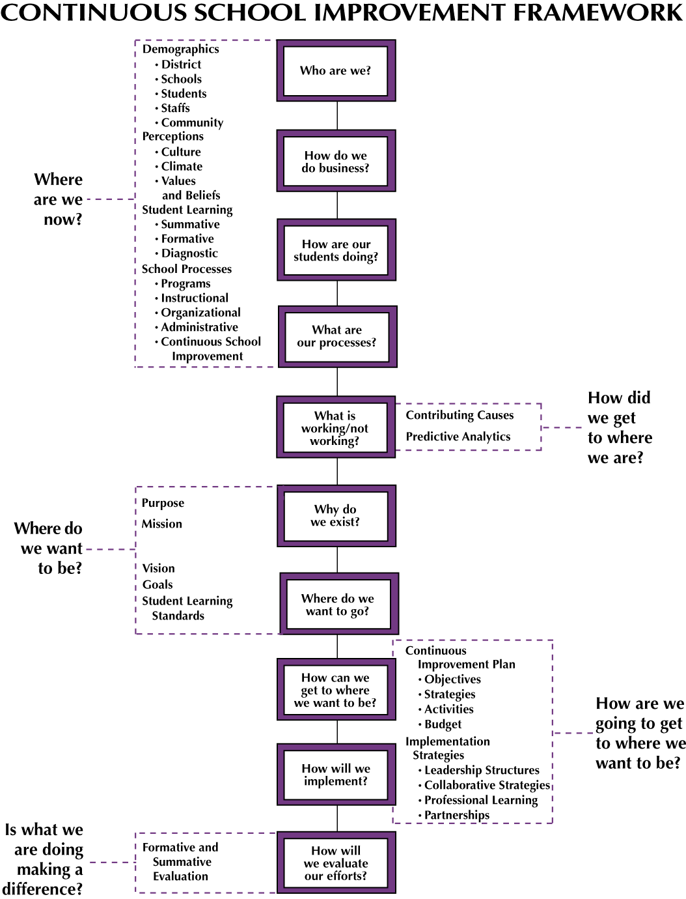
Page 14
Notes:
11

Slide 12
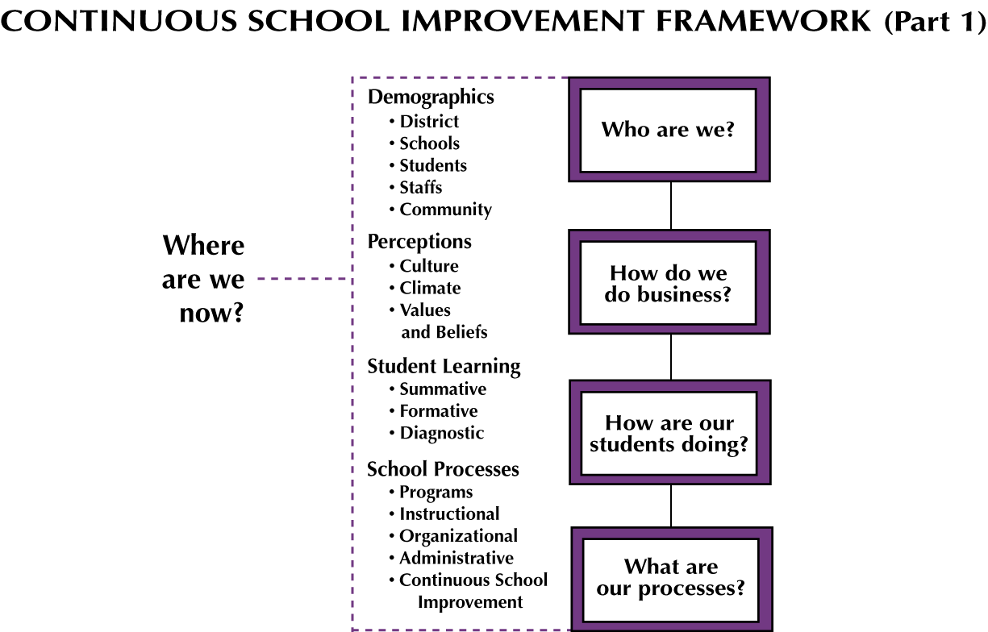
Notes:
12

Slide 13
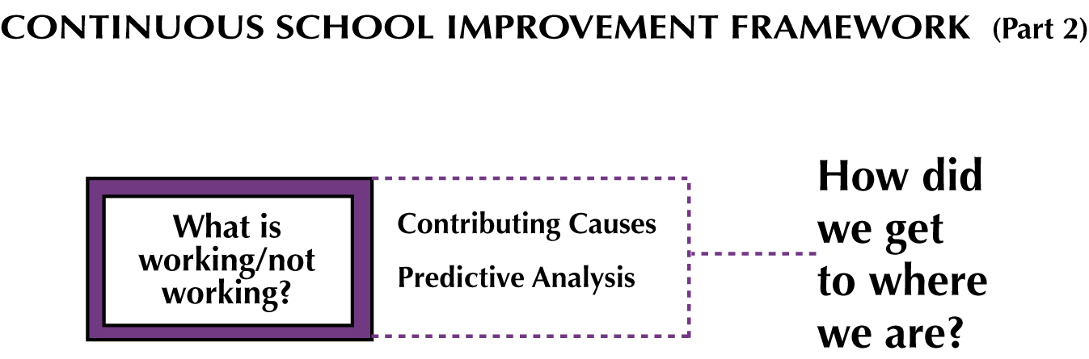
Notes:
13

Slide 14
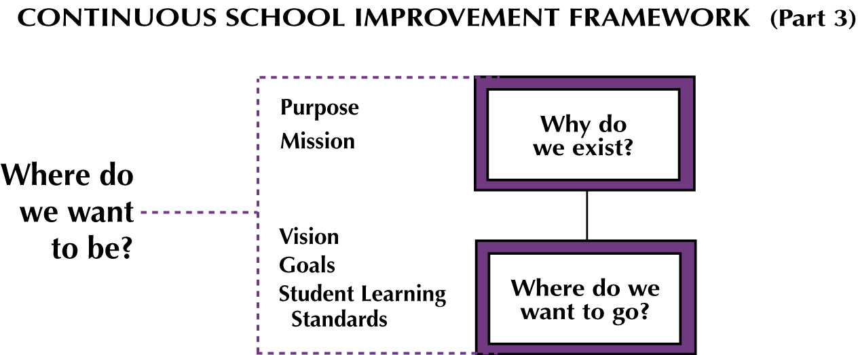
Notes:
14

Slide 15
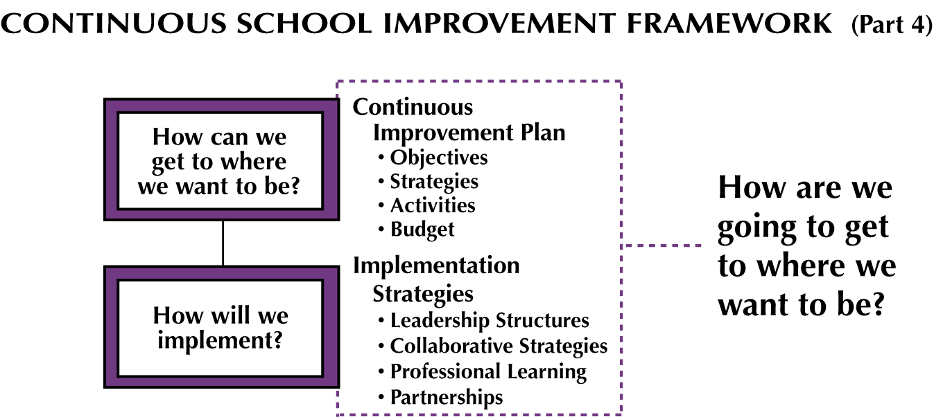
Notes:
15

Slide 16
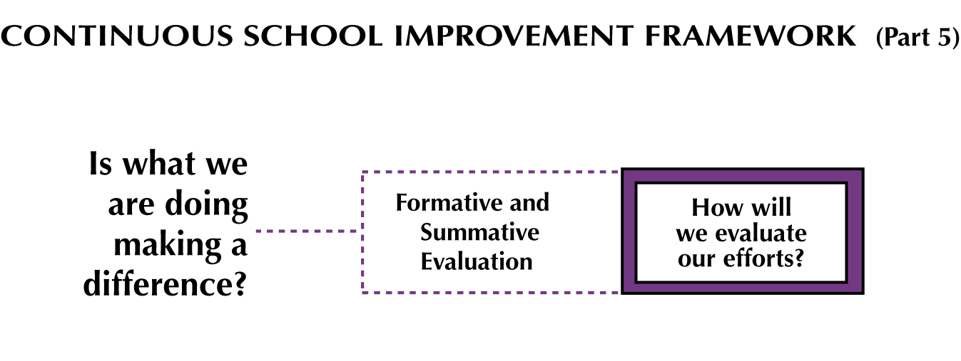
Notes:
16

Slide 17
Page 14
Notes:
17

Slide 18
IMPORTANT NOTES
It describes the work that schools do, linking the essential elements
It is a process of evidence, engagement, and artifacts

Slide 19

A PROCESS OF EVIDENCE, ENGAGEMENT, AND ARTIFACTS
Evidence:
Data to inform and drive a logical progression of next steps.
Engagement:
Bringing staff together to inform improvement through the use of data, moving from personality driven to systemic and systematic.
Artifacts:
The documentation of your improvement efforts.

Slide 20
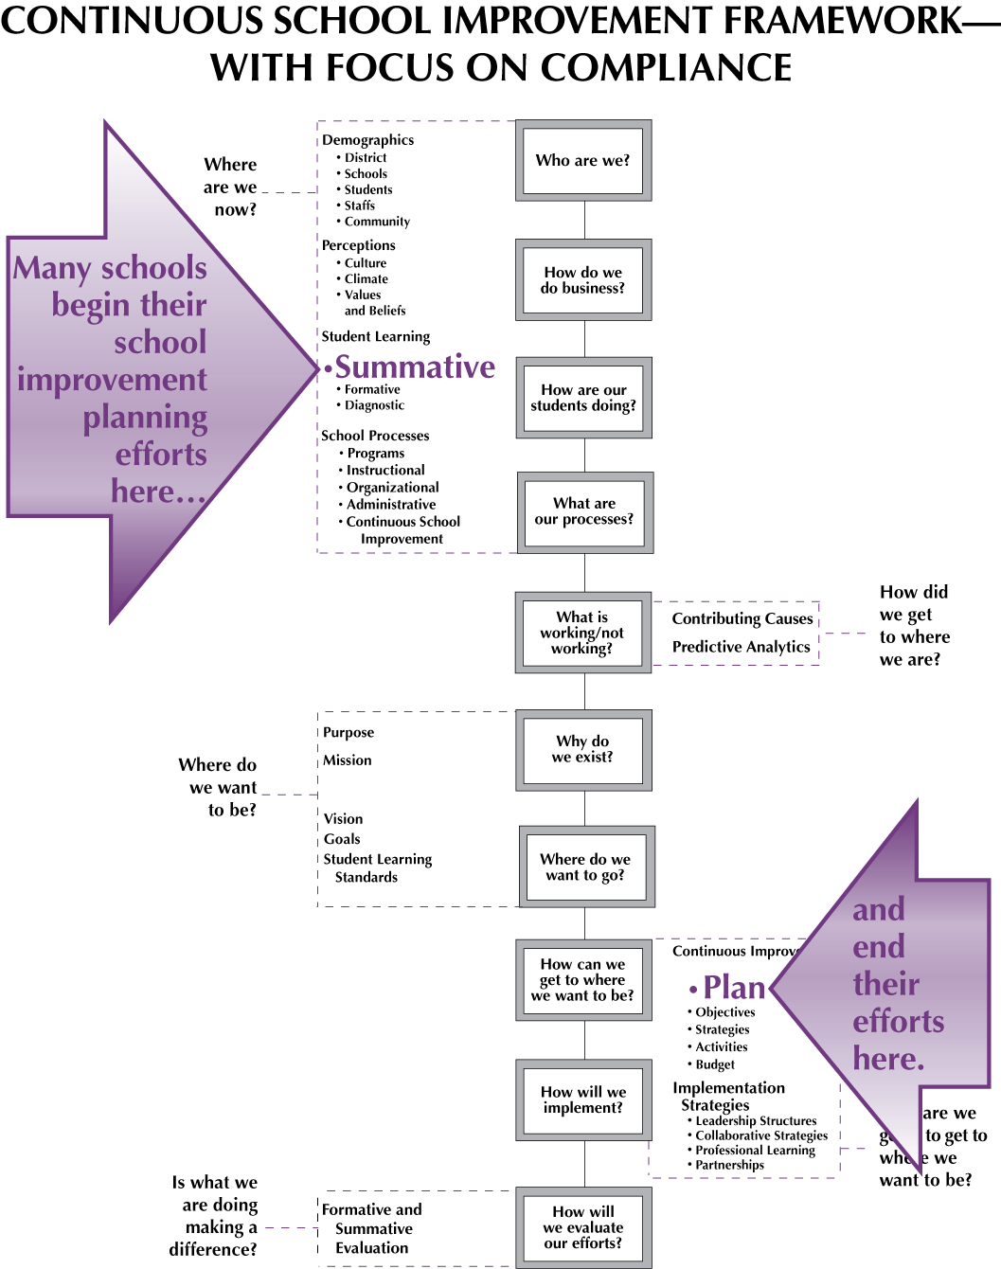
Notes:
20

Slide 21
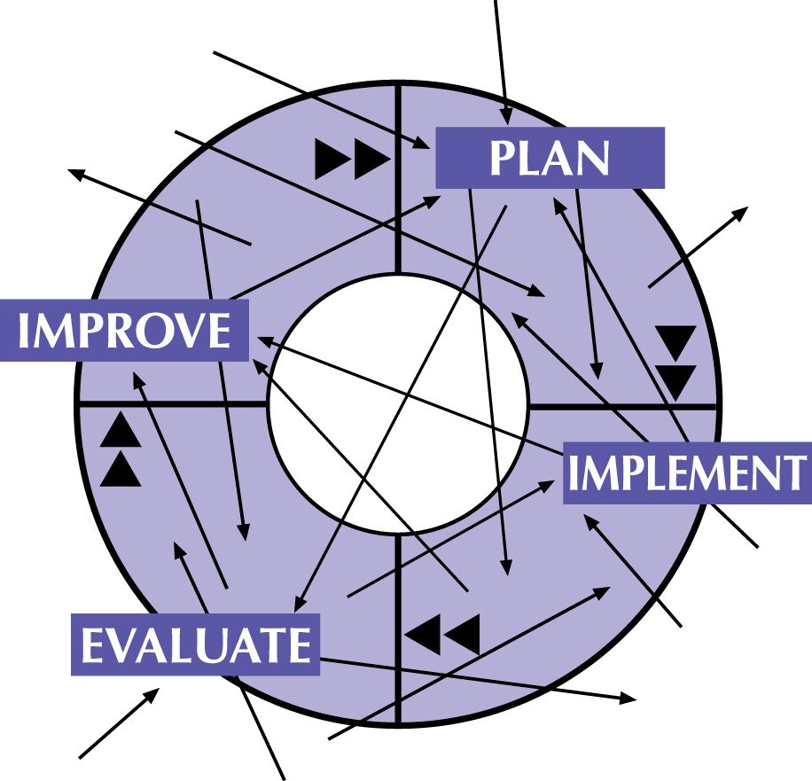
RANDOM ACTS OF IMPROVEMENT
Notes:
Data analysis is only one piece of the puzzle in continuous school improvement.
Without one critical piece of information, a target, our results might resemble “Random Acts of Improvement.”

Slide 22
Notes:
22

Slide 23
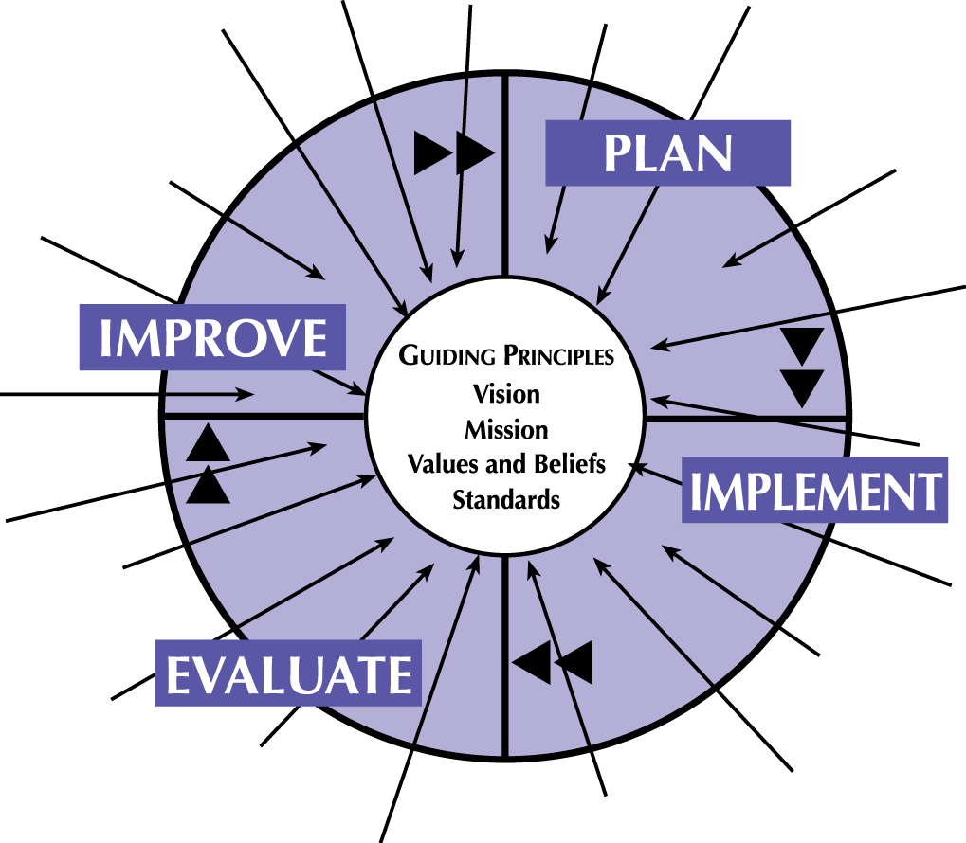
FOCUSED ACTS OF IMPROVEMENT
Notes:
The vision of the school which is created from what we expect students to know and be able to do, values and beliefs of the staff, and the purpose and mission of the school, must be at the center of everything that the school does. When the vision is shared and clear, everything that is planned is planned to implement the vision. Everything implemented in the school must be about the vision. Everything is evaluated in terms of how it will get the school to its vision, and everything is improved to better implement the vision.
This will lead to Focused Acts of Improvement.

Slide 24
VISION defines the desired or intended future state of an organization or enterprise in terms of its fundamental objectives relative to key, core areas (curr, inst, assess, environ).

Slide 25
VISION
  Curriculum—
  What we teach.
  Instruction—
  How we teach the curriculum.
  Assessment—
  How we assess learning.
  Environment—
  How each person treats every
  other person.

Slide 26
MISSION succinctly defines the fundamental purpose of an organization or an enterprise, describing why they exist.

Slide 27
Data Analysis for Continuous School Improvement Is About What You Are Evaluating Yourself Against

Slide 28
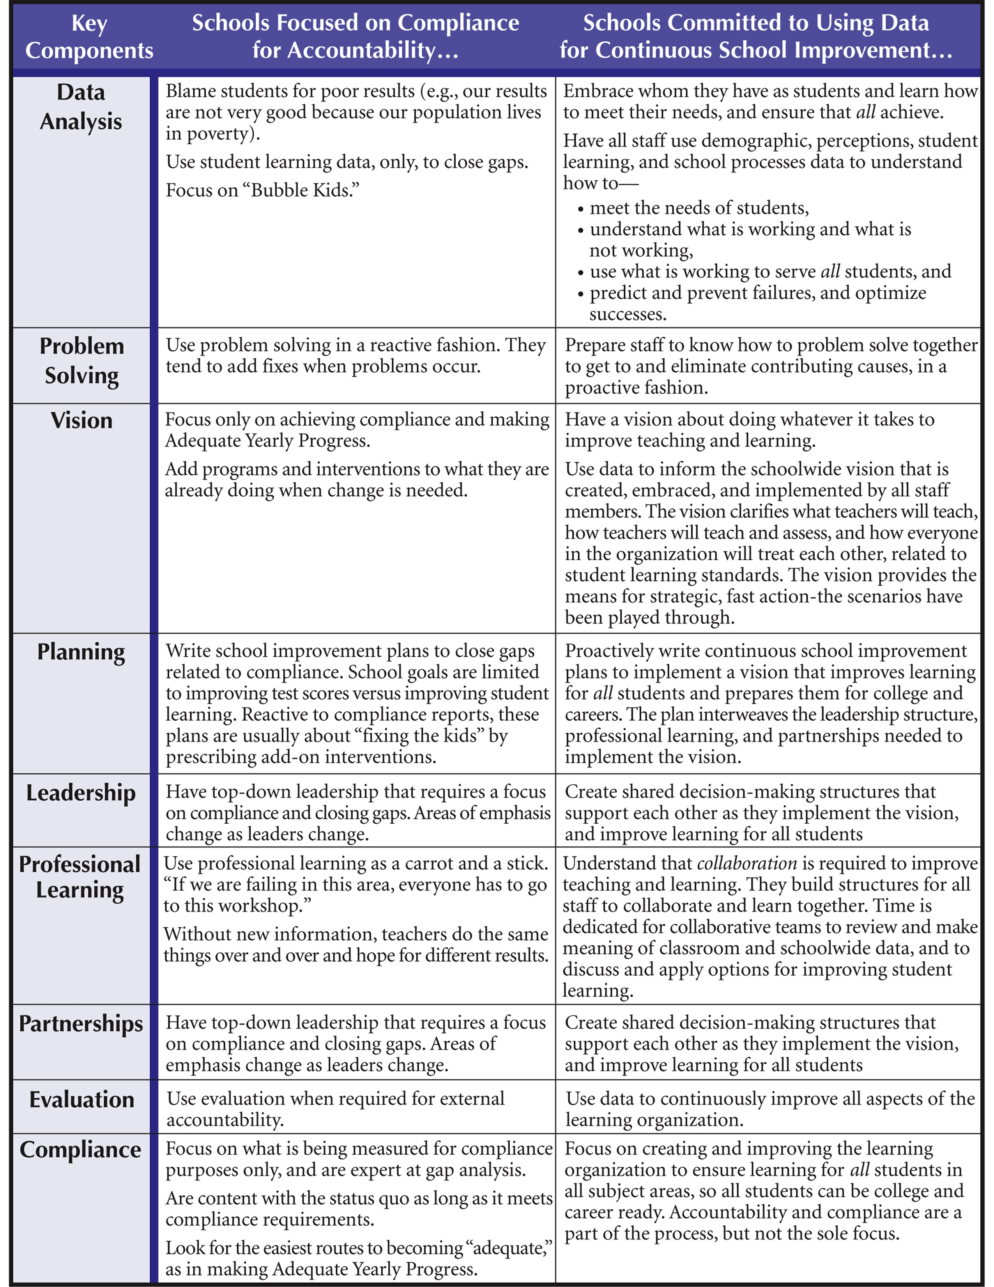
COMPLIANCE VERSUS COMMITMENT
Page 4
Bernhardt, V.L. (2013).
Data Analysis for
Continuous School
Improvement. Third Edition.
New York, NY: Routledge.
Page 4. Reproducible.

Slide 30
“Study the past if you would like to define the future.”
- Confucius

Slide 31
Notes:
31

Slide 32
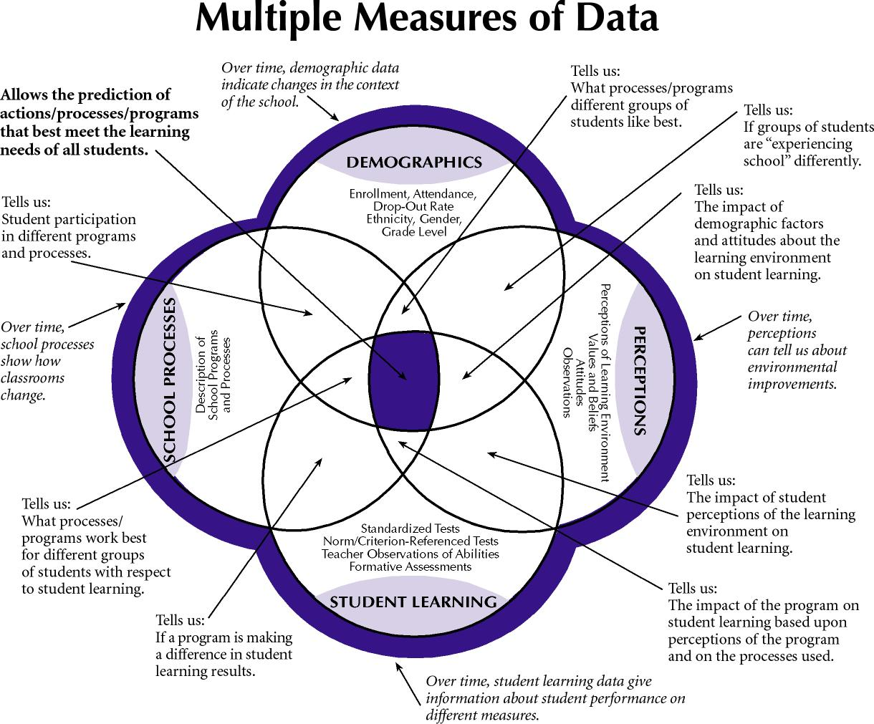
Page 17

Slide 33
DEMOGRAPHICS ARE
IMPORTANT DATA
Describe the context of the school
and school district.
Help us understand all other numbers.
Are used for disaggregating
other types of data.
Describe our system and leadership.

Slide 34
DEMOGRAPHICS
Enrollment
Gender
Ethnicity / Race
Attendance (Absences)
Expulsions
Suspensions
Notes:
Note: Tell audience to bring yoga clothes tomorrow!

Slide 35
DEMOGRAPHICS (Continued)
Language Proficiency
Indicators of Poverty
Special Needs/Exceptionality
IEP (Yes/No)
Drop-Out/Graduation Rates
Program Enrollment
Notes:
Note: Tell audience to bring yoga clothes tomorrow!

Slide 36
STAFF DEMOGRAPHICS
School and Teaching Assignment
Qualifications
Years of Teaching/At this School
Gender, Ethnicity
Additional Professional
Development
Notes:
Note: Tell audience to bring yoga clothes tomorrow!

Slide 37
Page 17

Slide 38
PERCEPTIONS ARE
IMPORTANT DATA
Help us understand what
students, staff, and parents are perceiving about the learning environment.
We cannot act different from
what we value, believe, perceive.
Notes:
Note: Tell audience to bring yoga clothes tomorrow!

Slide 39
PERCEPTIONS INCLUDE
Student, Staff, Parent,
Alumni Questionnaires
Observations
Focus Groups
Notes:
Note: Tell audience to bring yoga clothes tomorrow!

Slide 40

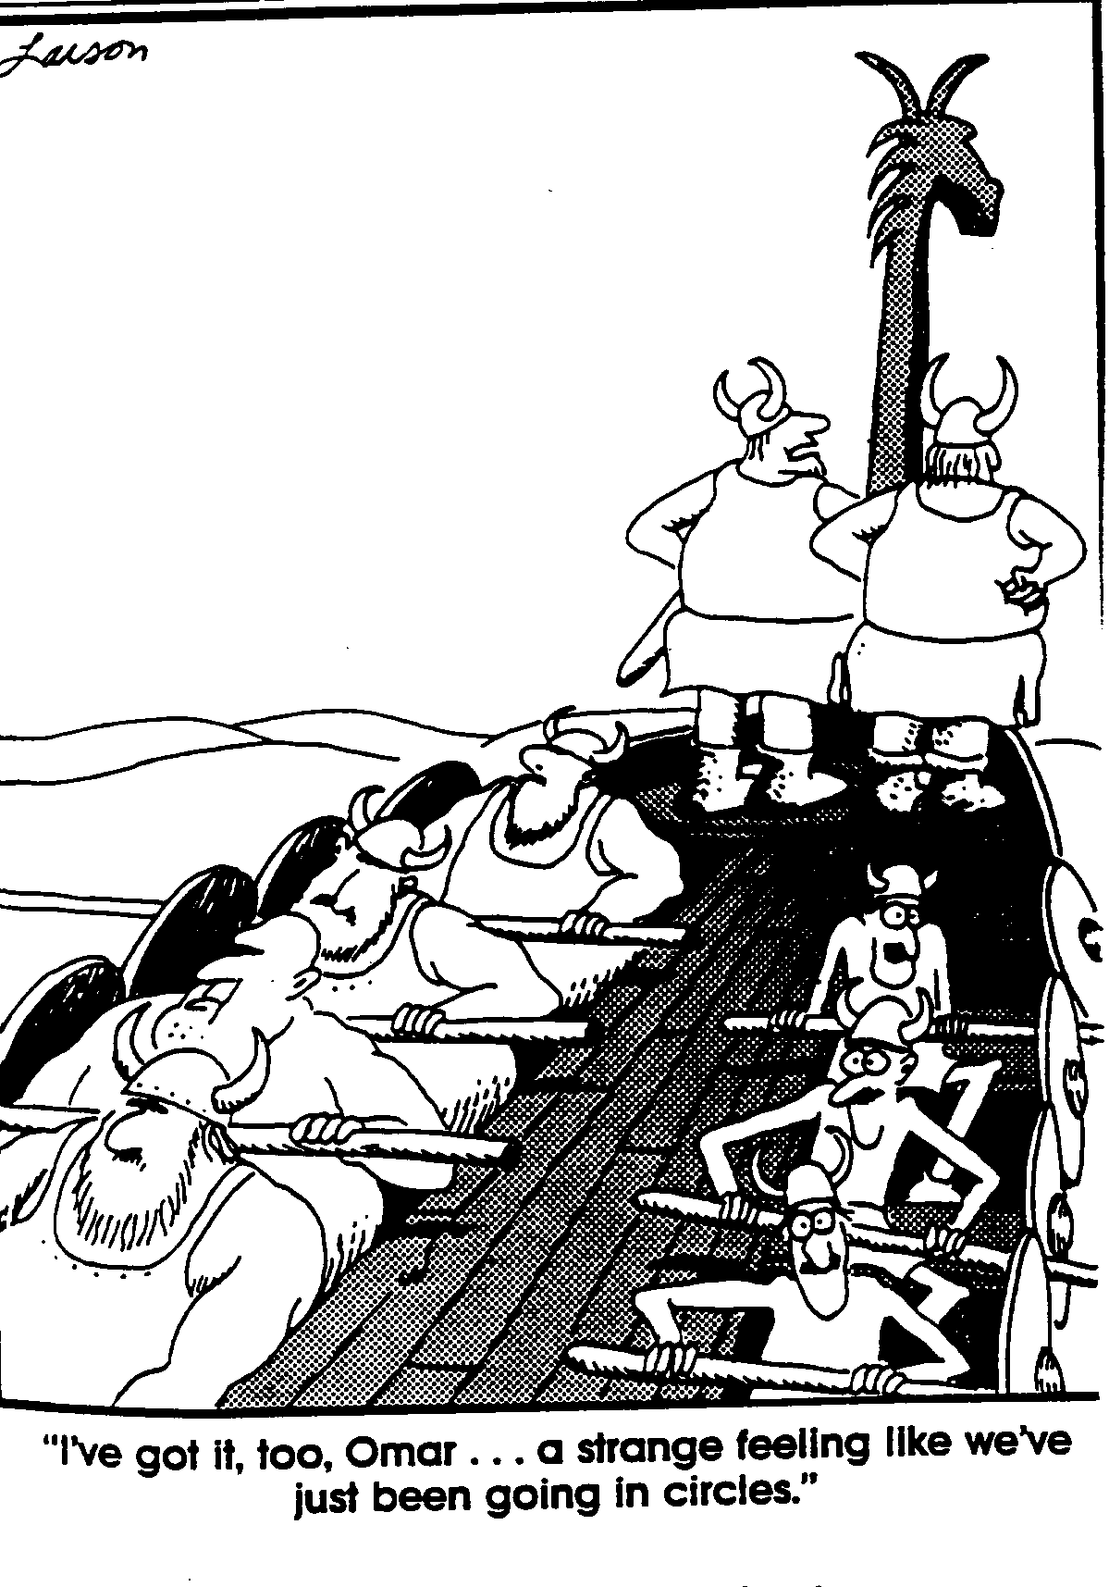
“I’ve got it, too, Omar….
a strange feeling like we’ve just been going in circles.”

Slide 41
Page 17

Slide 42
STUDENT LEARNING ARE
IMPORTANT DATA
Know what students are learning.
Understand what we are teaching.
Determine which students
need extra help.

Slide 43
STUDENT LEARNING
DATA INCLUDE
Diagnostic Assessments
(Universal Screeners)
Classroom Assessments
Formative Assessments
(Progress Monitoring)
Summative Assessments
(High Stakes Tests, End of Course)
Defined:
Pages
54-57

Slide 44
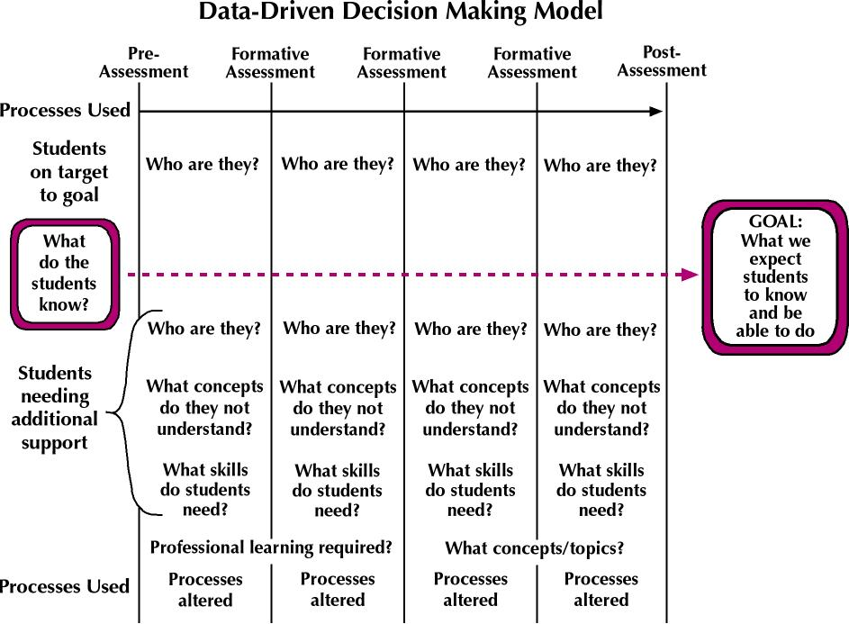

Slide 45
STUDENT LEARNING ARE
IMPORTANT DATA
What happens when learning organizations react solely to the measures used for compliance and accountability?

Slide 46
Page 17

Slide 47
SCHOOL PROCESSES
  Schools are perfectly designed to
  get the results they are getting now.
  If schools want different results,
  they must measure and then change
  their processes to create the
  results they really want.

Slide 48
SCHOOL PROCESSES
Processes include…
  Actions, changes, functions that bring about a desired result
  Curriculum, instructional strategies, assessment, programs, interventions …
  The way we work.

Slide 49
SCHOOL PROCESSES ARE
IMPORTANT DATA
Tell us about the way
we work.
Tell us how we get the
results we are getting.
Help us know if we have instructional coherence.

Slide 50
SCHOOL PROCESSES DEFINITIONS
INSTRUCTIONAL: The techniques and strategies that teachers use in the learning environment.
ORGANIZATIONAL: Those
structures the school puts in place
to implement the vision.

Slide 51
SCHOOL PROCESSES DEFINITIONS
ADMINISTRATIVE: Elements about schooling that we count, such as class sizes.
CONTINUOUS SCHOOL IMPROVEMENT: The structures and elements that help schools continuously improve their systems.
PROGRAMS: Programs are planned series of activities and processes, with specific goals.

Slide 53
ENGAGEMENT
Data Inventories

Slide 54
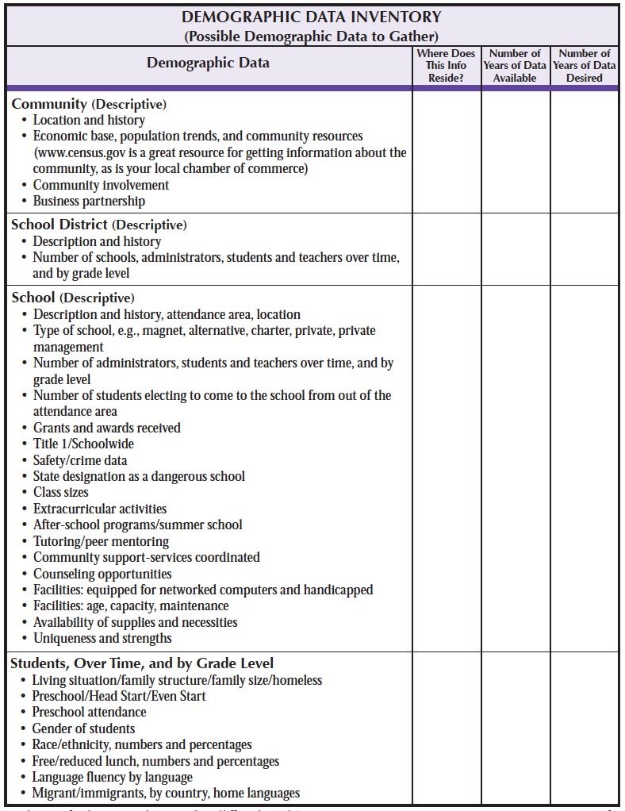
Pages
206-208

Slide 55
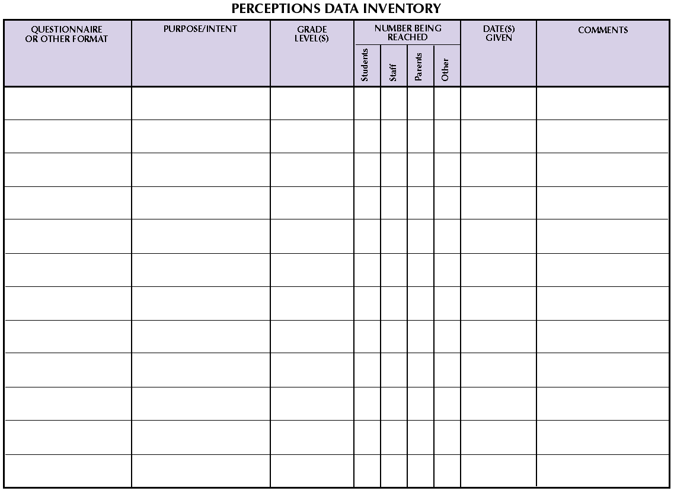
Page 210

Slide 56
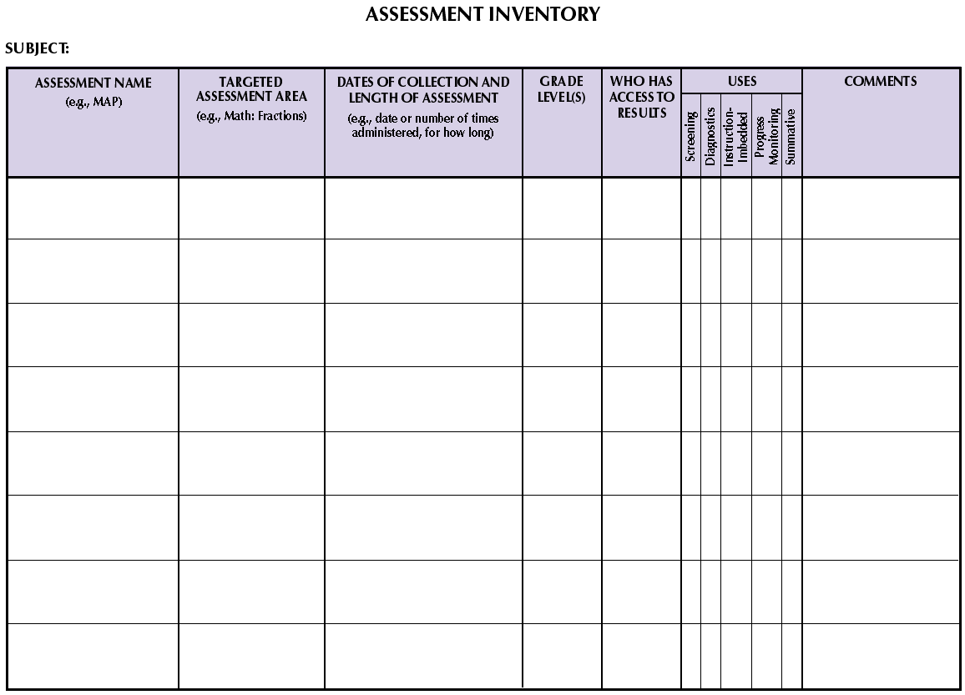
Page 213

Slide 57
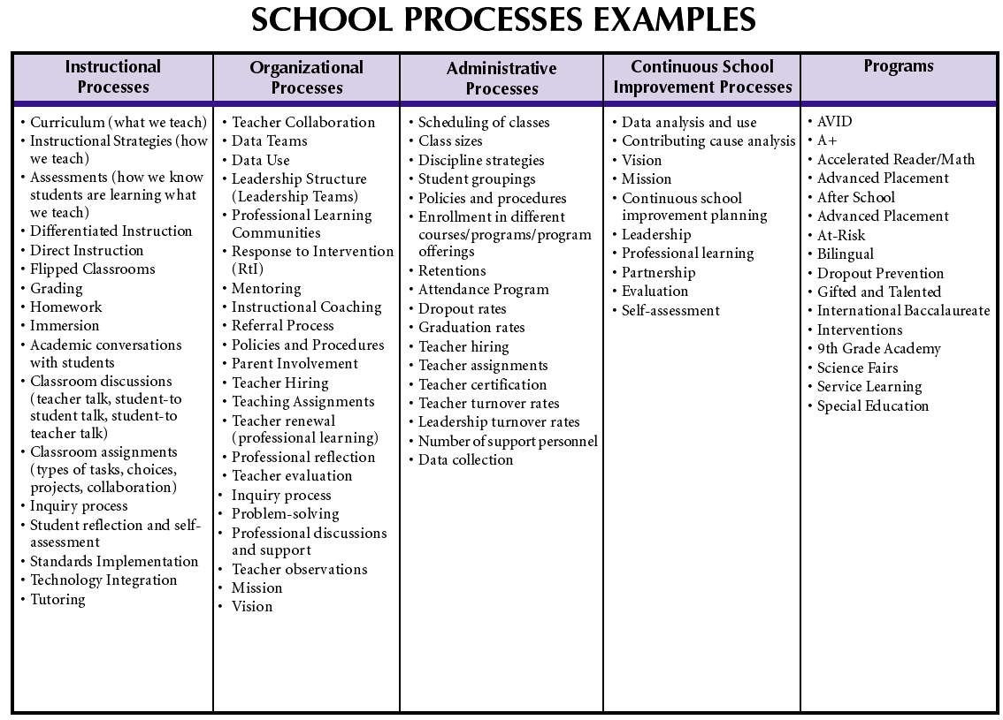
Page 215

Slide 58
SCHOOL PROCESSES DEFINITIONS
INSTRUCTIONAL: The techniques and strategies that teachers use in the learning environment.
ORGANIZATIONAL: Those
structures the school puts in place
to implement the vision.

Slide 59
SCHOOL PROCESSES DEFINITIONS
ADMINISTRATIVE: Elements about schooling that we count, such as class sizes.
CONTINUOUS SCHOOL IMPROVEMENT: The structures and elements that help schools continuously improve their systems.
PROGRAMS: Programs are planned series of activities and processes, with specific goals.

Slide 60
What are the benefits of completing a data inventory?
  Demographics
  Perceptions
  Student Learning
  School Processes

Slide 61

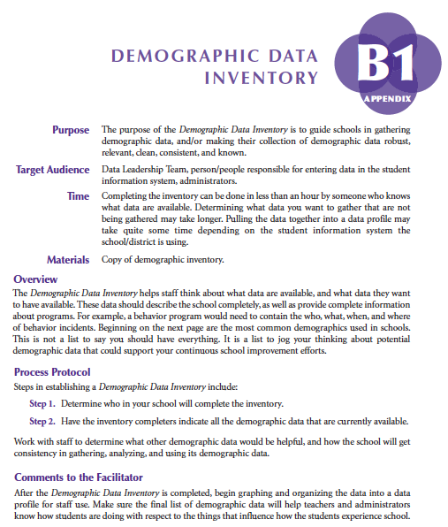
FACILITATION GUIDE
Page 205-208

Slide 62
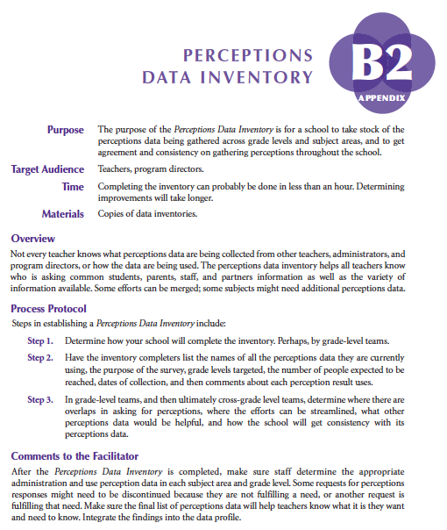
FACILITATION GUIDE
Pages 209-210

Slide 63
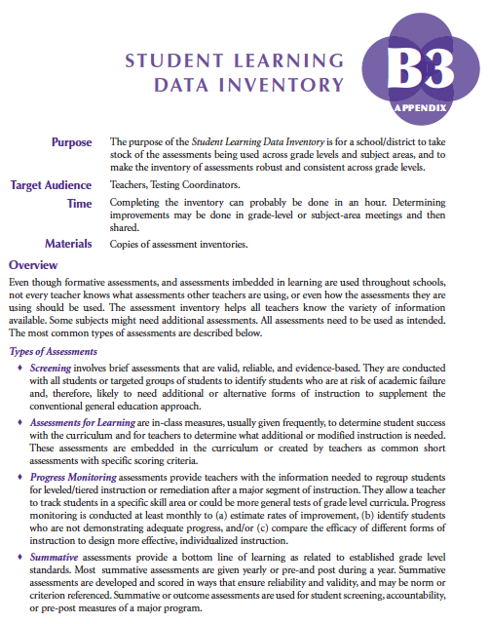
FACILITATION GUIDE
Pages 211-213

Slide 64
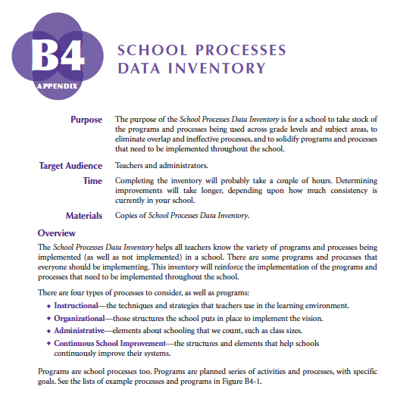
FACILITATION GUIDE
Pages 214-217

Slide 66
Exploring The Intersections

Slide 67
Page 17

Slide 68
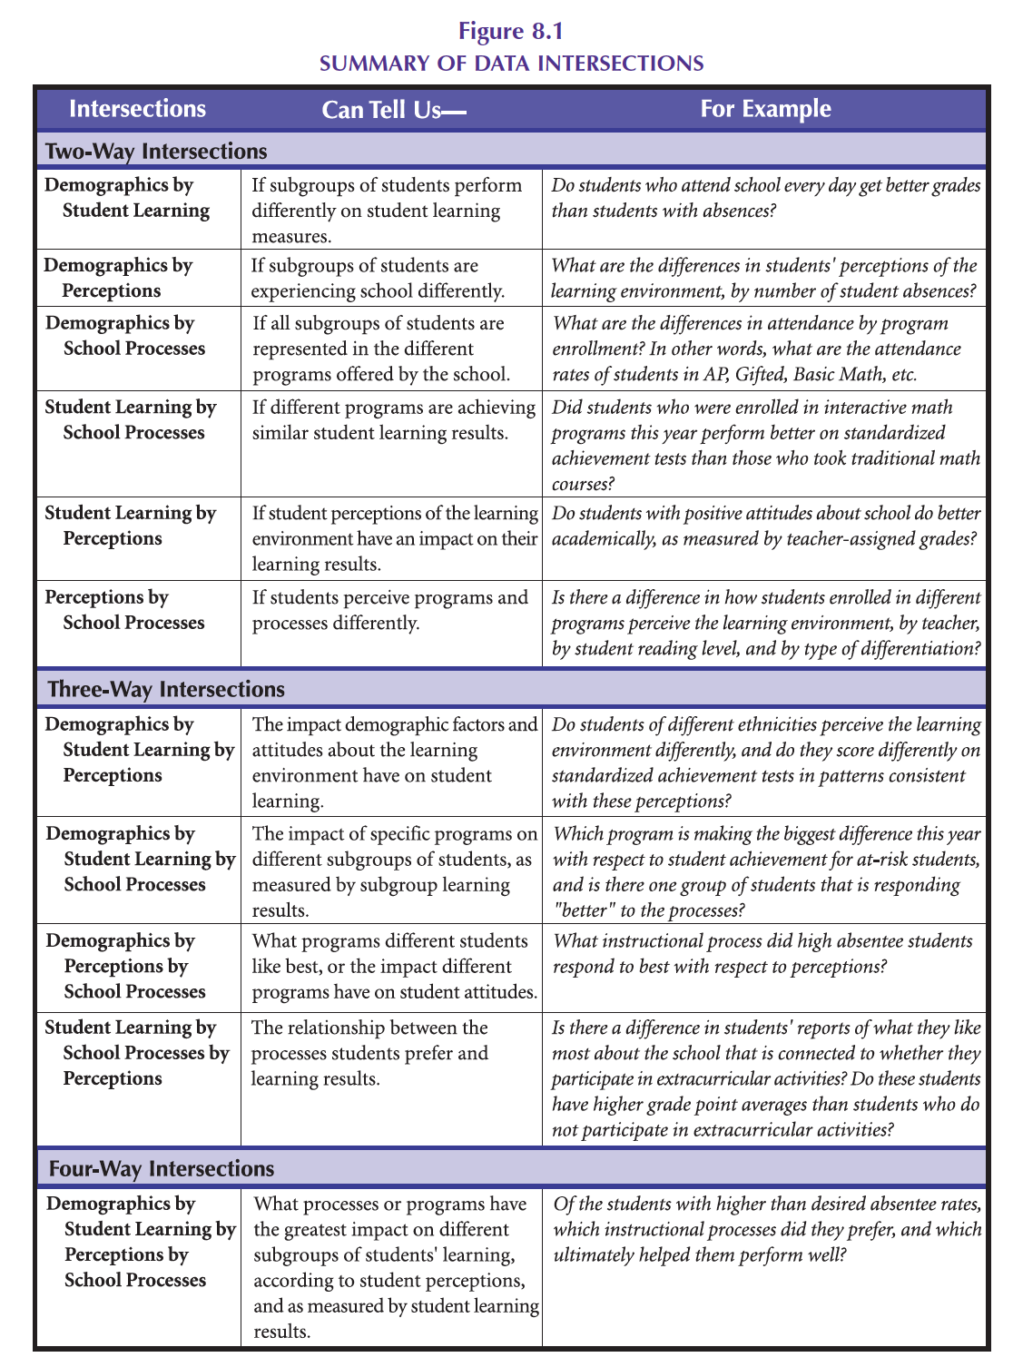
INTERSECTIONS
Independently, read through Pgs. 102-105
Notes:
68

Slide 69
INTERSECTIONS
What is the greatest benefit of intersections analysis?
What are the challenges?
Notes:
69

Slide 70
THE CHANGE/IMPROVEMENT
PROCESS
Closing the loop on a cycle of inquiry:
Identify the agents of improvement.
Empower with data to identify need(s).
Collaboratively prescribe change.
Support through prof learning,
leadership, partnerships.
Evaluate to make sure it is making the
intended difference.
VISION

Slide 72
Facilitating the Intersections of Multiple Measures

Slide 73
Notes:
73

Slide 74
ENGAGEMENT
Data Profile

Slide 75
Notes:
75

Slide 76
Page 17

Slide 77
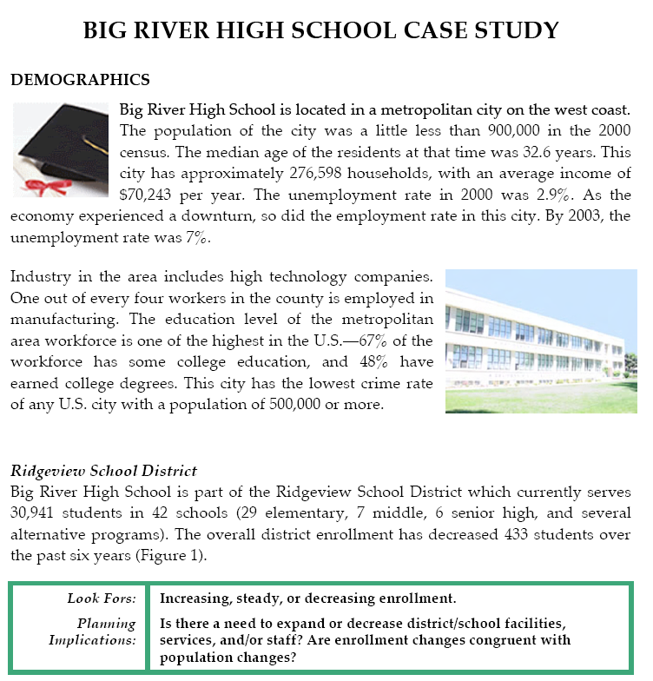
Notes:
77

Slide 78
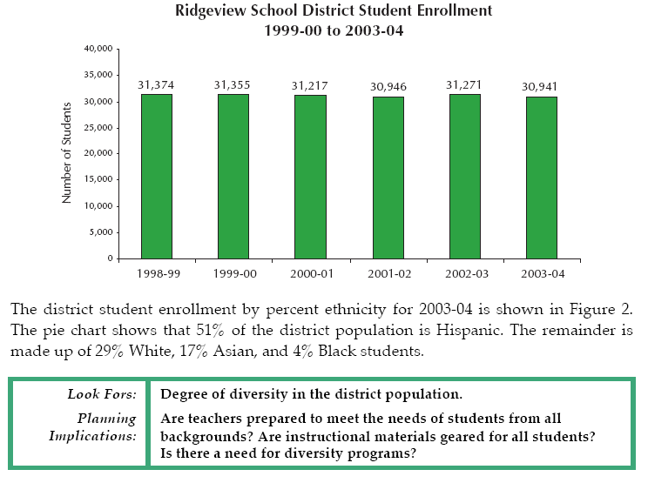
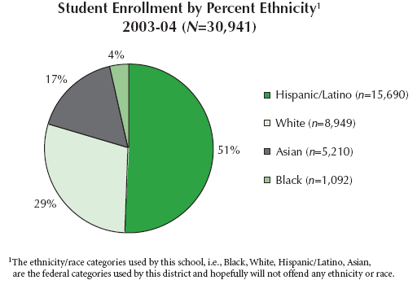
Notes:
78

Slide 79
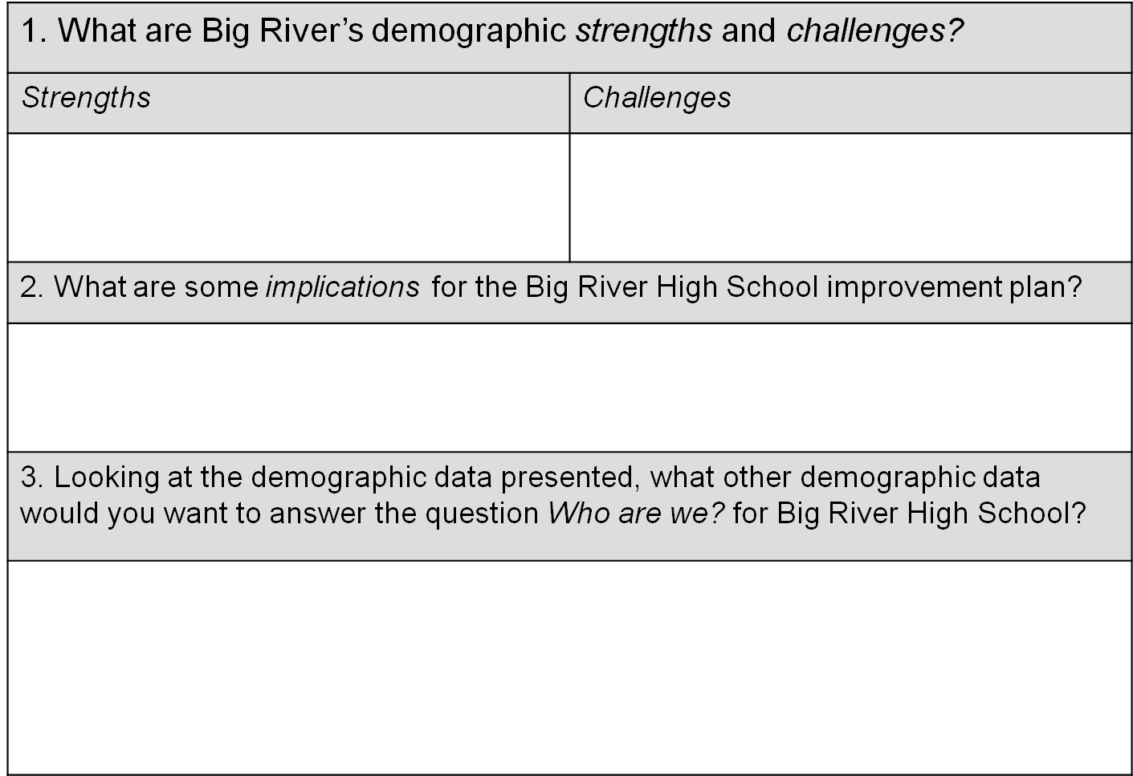
Study Questions—Demographic Data
Notes:
79

Slide 80
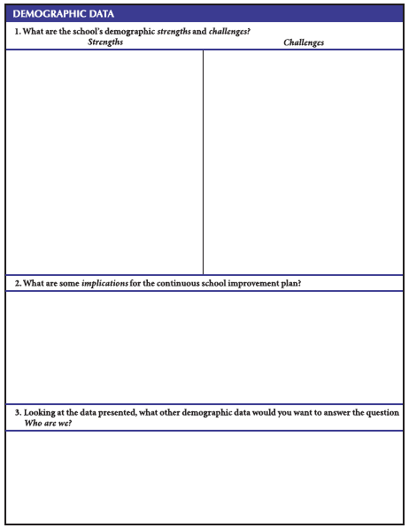
STUDY QUESTIONS
Demographic Data
Strengths
Challenges
Implications for the continuous school improvement plan.
Other data . . .
Notes:
STUDY QUESTIONS — DEMOGRAPHIC DATA

Slide 81
DEFINITIONS
STRENGTHS: Something positive
that can be seen in the data. Often
leverage for improving a challenge.
CHALLENGES: Data that imply
something might need attention,
a potential undesirable result,
or something out of a school’s control.
Notes:
81

Slide 82
DEFINITIONS
IMPLICATIONS FOR THE
SCHOOL IMPROVEMENT PLAN
are placeholders until all the data are
analyzed. Implications are thoughts
to not forget to address in the school
improvement plan. Implications
most often result from CHALLENGES.
Notes:
82

Slide 83
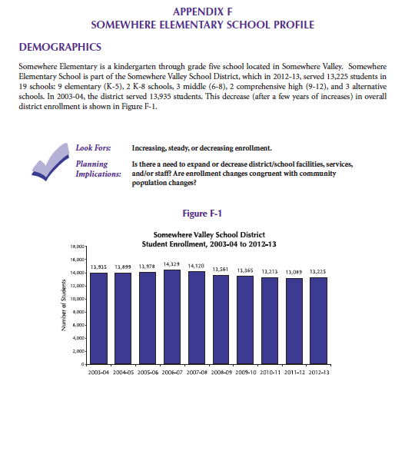
LETS SEE WHAT IT LOOKS LIKE
Pages 265-334

Slide 84
Pages 265-296
CASE STUDY DEMOGRAPHIC DATA
Please review the demographic data independently and answer questions.
Notes:
STUDY QUESTIONS — DEMOGRAPHIC DATA

Slide 85

Pages 265-296
CASE STUDY DEMOGRAPHIC DATA
In your teams, please combine your thinking on chart paper.
Notes:
STUDY QUESTIONS — DEMOGRAPHIC DATA

Slide 86
ANALYZING THE DATA
Answer Questions—
Strengths, Challenges,
Implications, Other
Demographic Data.
Independently
In Small Groups
Merge to Whole Group
WHAT ARE
THE BENEFITS OF THIS APPROACH?

Slide 87
ANALYZING THE DATA
WHAT ARE
THE BENEFITS OF USING A CASE STUDY?

Slide 88
Page 17

Slide 89
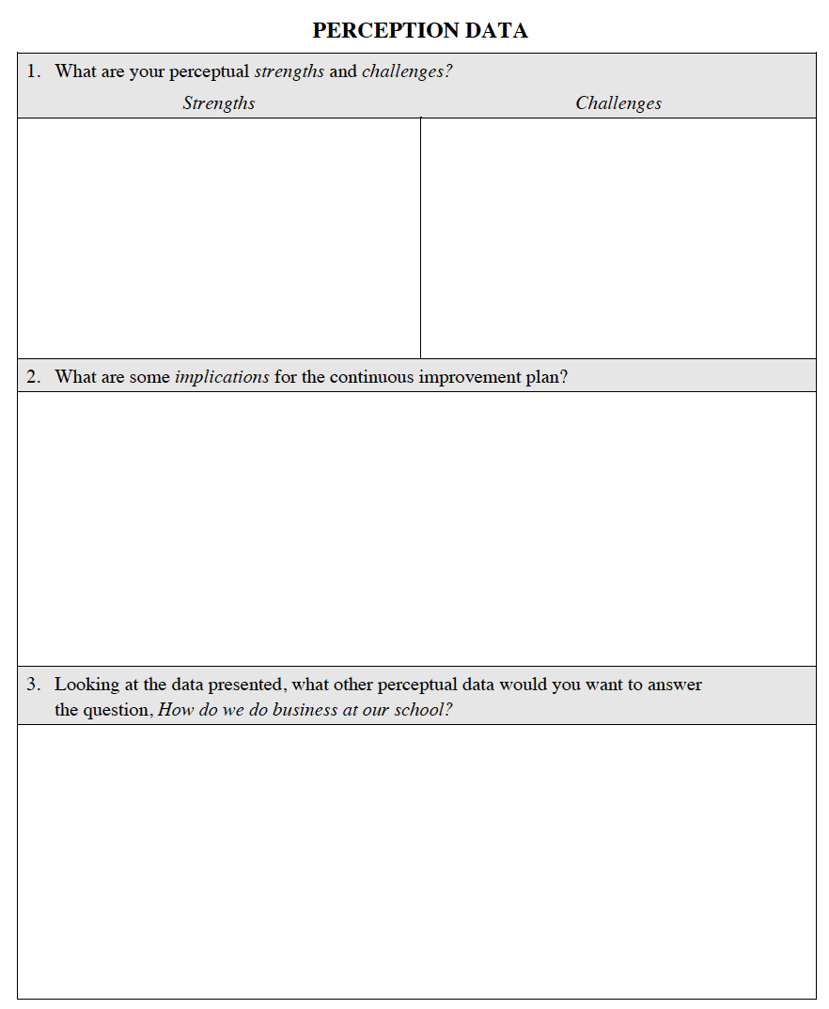
PERCEPTION DATA
Review the data to identify strengths, challenges, implications
for planning, and further data needed.
CASE STUDY QUESTIONNAIRES:
Staff: Pages 307 - 315
Students K-1: Pages 297 - 300
Students 2-5: Pages 301 - 306
Parents: Pages 316 - 321
Notes:
89

Slide 90
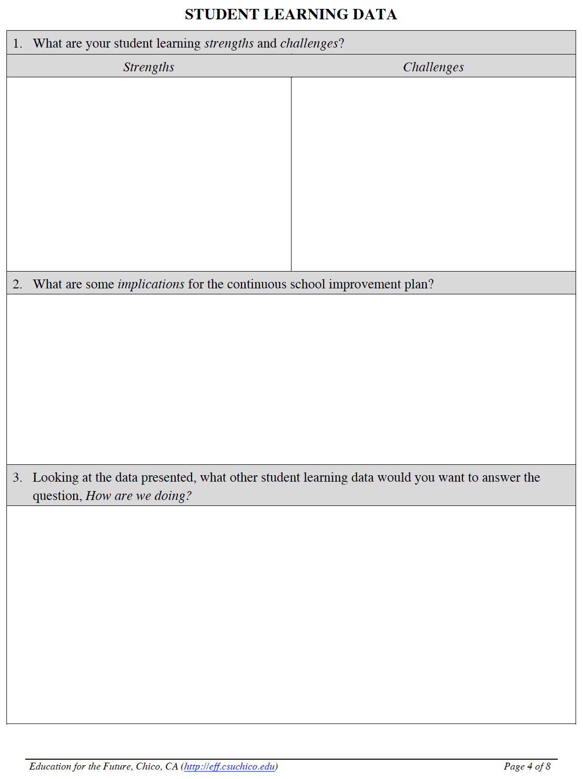
STUDENT LEARNING DATA
Review the data to identify strengths, challenges, implications for planning, and further data needed.
Prepare findings on poster paper.
PAGES 322-334
Notes:
90

Slide 91
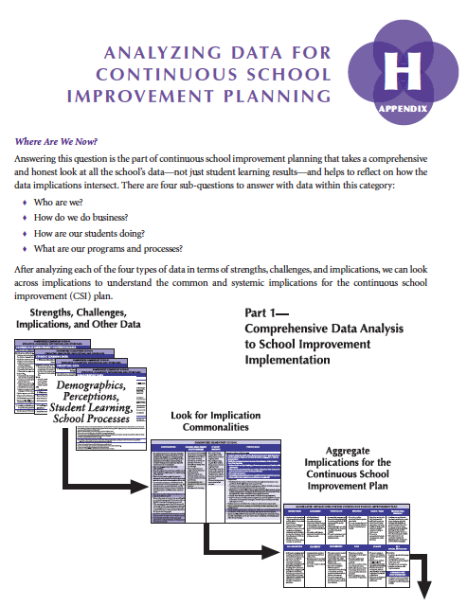
FACILITATION GUIDE
Pages 343-353

Slide 92
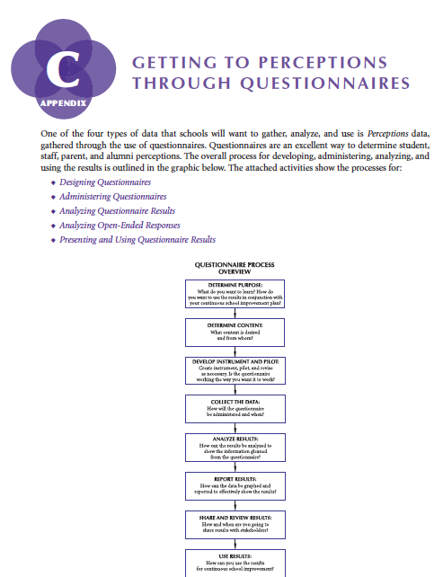
FACILITATION GUIDE
Pages 218-252

Slide 94
Aggregating Implications for Planning Across All Areas of Data

Slide 95
MERGE STRENGTHS, CHALLENGES,
AND IMPLICATIONS FOR THE SCHOOL IMPROVEMENT PLAN
Review implications across data.
Look for commonalities.
Create an aggregated list of
implications for the school
improvement plan.

Slide 96
AGGREGATING IMPLICATIONS
Intersections
Presentation and interpretation/engagement as a function of analysis.
Page 17

Slide 97
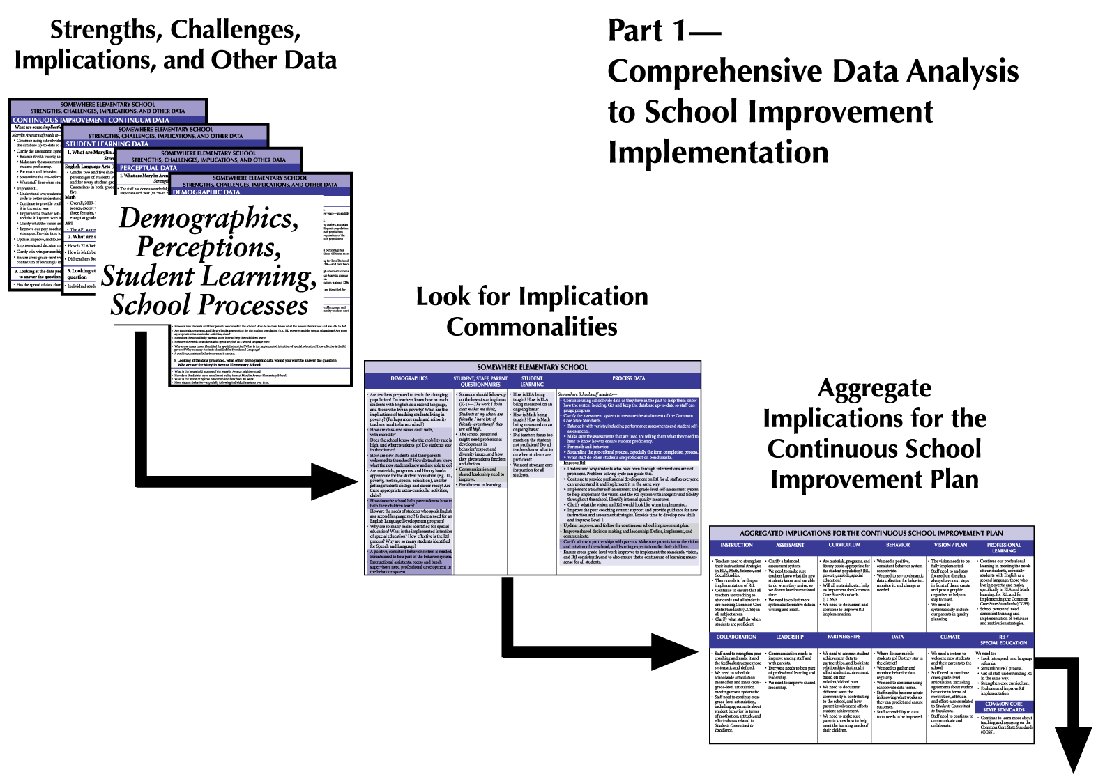
Page 343

Slide 98
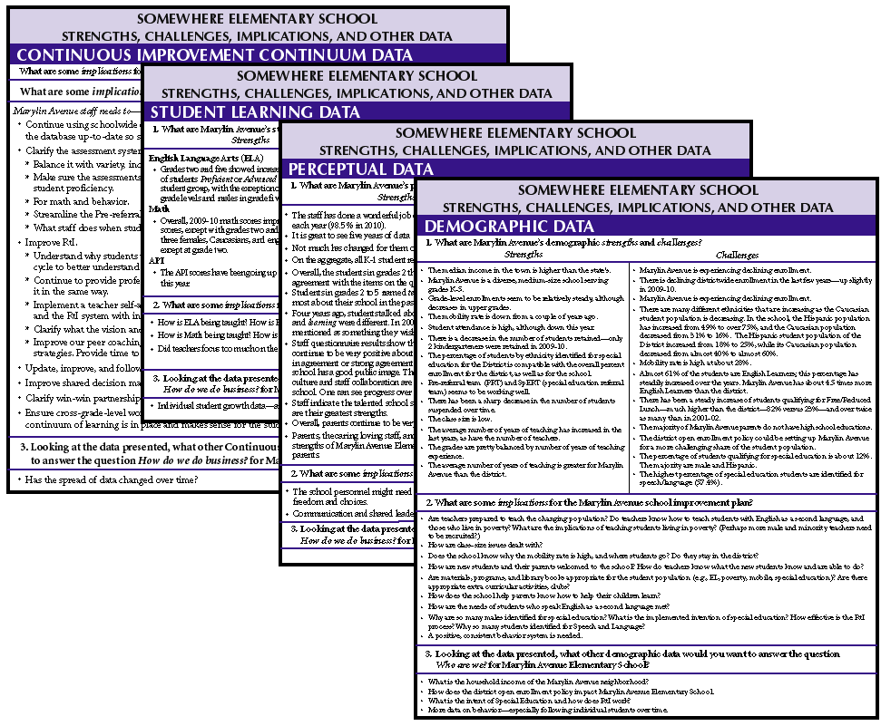
Pages 336-339

Slide 99
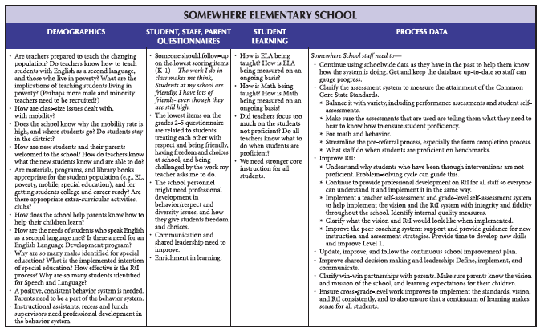
Page 340
What We Saw in the Data: IMPLICATIONS

Slide 100
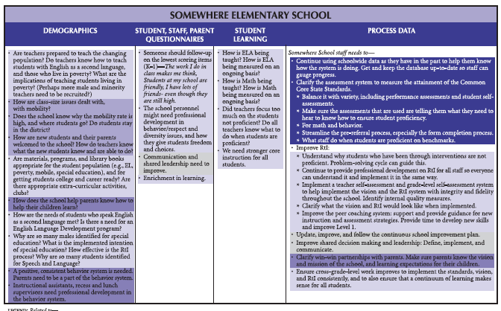
Page 341
What We Saw in the Data: IMPLICATION COMMONALITIES
Notes:
Big Picture

Slide 101
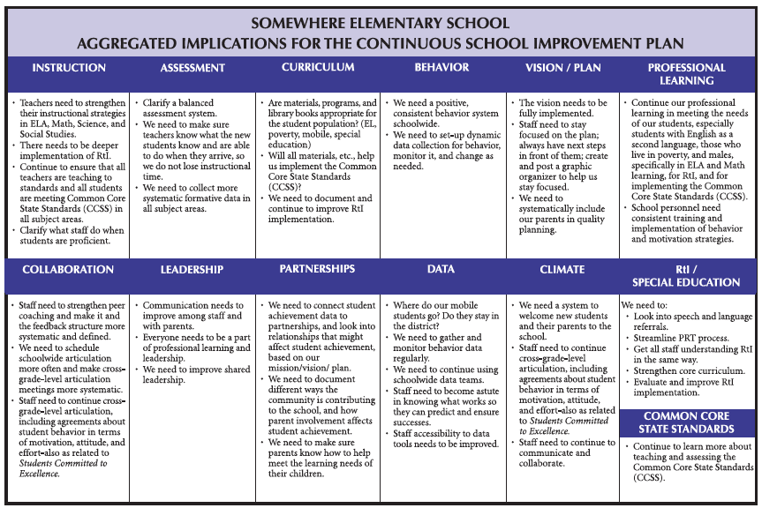
Page 342
What We Saw in the Data: AGGREGATED IMPLICATIONS
Notes:
Big Picture

Slide 102
AGGREGATE YOUR IMPLICATIONS
Look across the planning implications from each area of data and aggregate relative to the categories provided by the planning study sheet.
Notes:
102

Slide 103
FACILITATION GUIDE
Pages 343-353

Slide 104
BENEFITS OF USING A DATA PROFILE
Multiple measures. Intersections.
Trends and patterns across the data to inform deeper analysis.
Analyzing the system.
Consensus through individual, small group, large group.
Used to satisfy requirements.

Slide 106
Notes:
106

Slide 107
“Education is learning what you didn’t even know you didn’t know.”
- Daniel J. Boorstin

Slide 108
Pages 105-108
CONTRIBUTING CAUSES:
Underlying cause or causes
of positive or negative results.

Slide 109
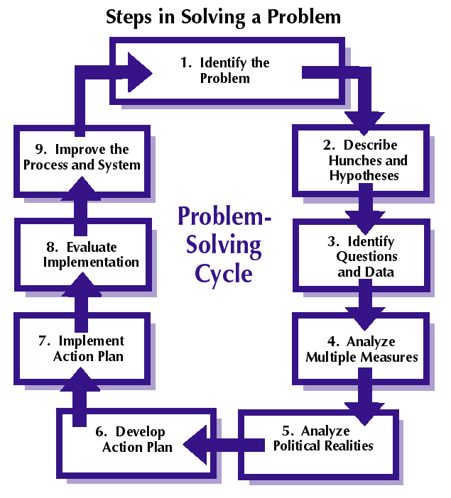
Page 106-108
PROBLEM SOLVING CYCLE EXAMPLE

Slide 110
IDENTIFY THE PROBLEM
Not enough students
are proficient in
Mathematics.

Slide 111
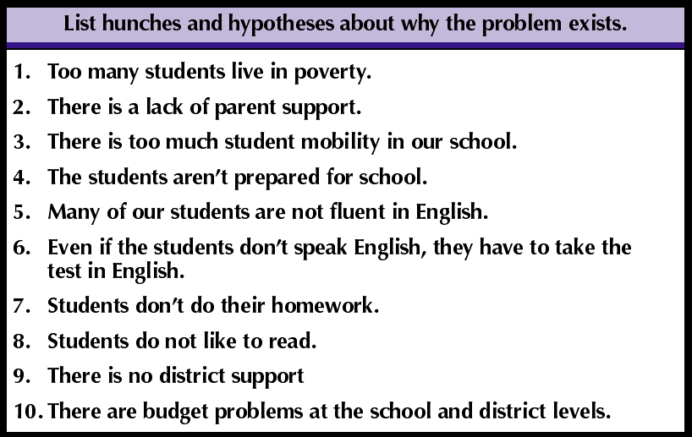
THE PROBLEM-SOLVING CYCLE
Example Hunches/Hypotheses
Page 106

Slide 112
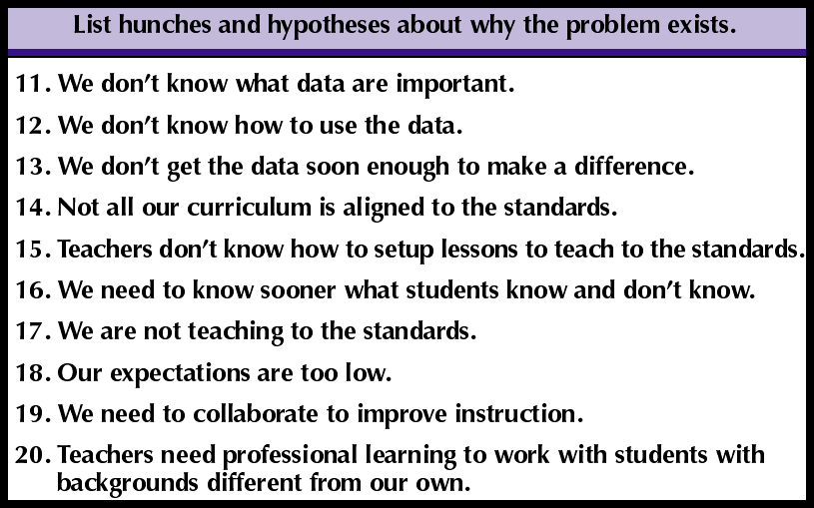
THE PROBLEM-SOLVING CYCLE
Example Hunches/Hypotheses
Page 106

Slide 113

THE PROBLEM-SOLVING CYCLE
What questions do you
need to answer to know
more about the problem
and what data do
you need to gather?

Slide 114
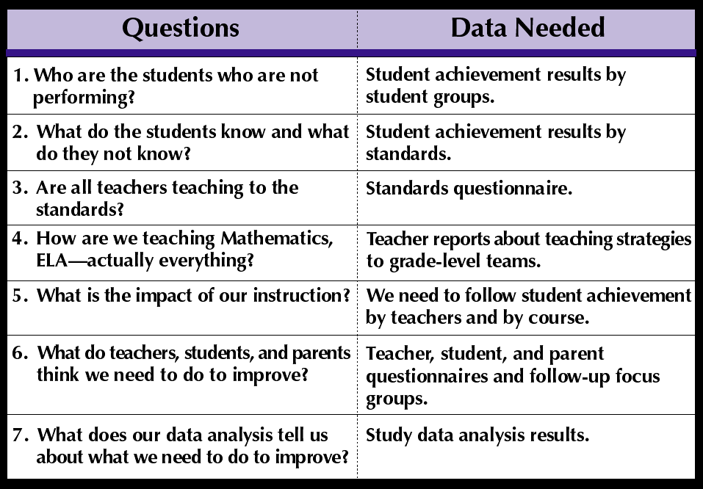
THE PROBLEM-SOLVING CYCLE
Example Questions/Data Needed
Page 107

Slide 116
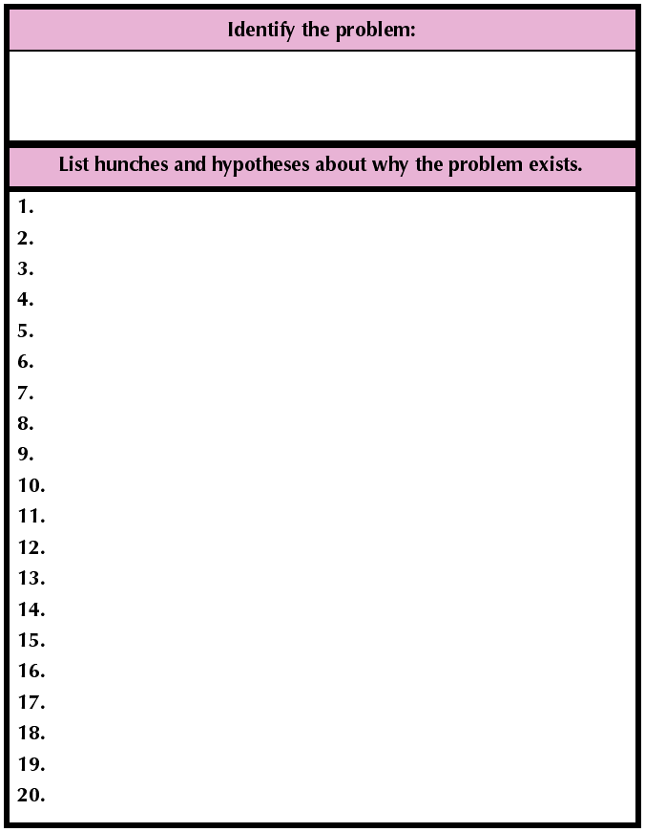
THE PROBLEM-SOLVING CYCLE
1. Identify a problem/
undesirable result.
2. List 20 reasons
this problem exists
(from the perspective
of your staff).

Slide 117
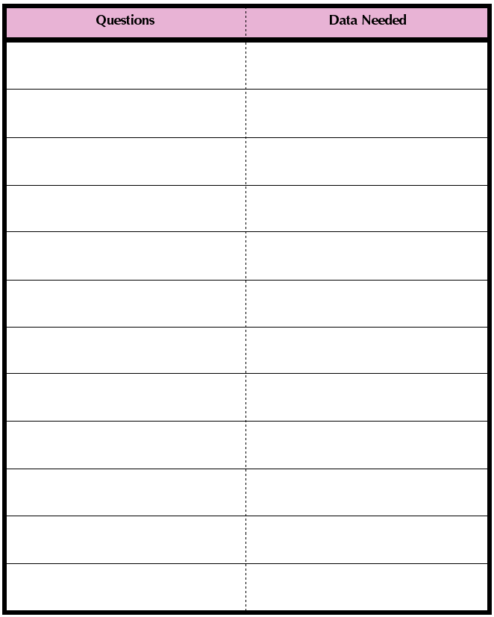
THE PROBLEM-SOLVING CYCLE
3. Determine what
questions you need
to answer with data.
4. What data do you
need to gather to
answer the questions?

Slide 118
THE PROBLEM-SOLVING CYCLE
Please record
on chart paper.

Slide 119
PROBLEM SOLVING CYCLE
Evidence:
  Automatically end up at the 4 circles.
  Focus on the process(es) at the root.
Engagement:
  Makes big problems manageable.
  Time savings.
  Key in making the move from personality driven to systemic and systematic.

Slide 120
AGGREGATE YOUR IMPLICATIONS
Were your implications validated, or do you need to add to the list?
Notes:
120

Slide 121
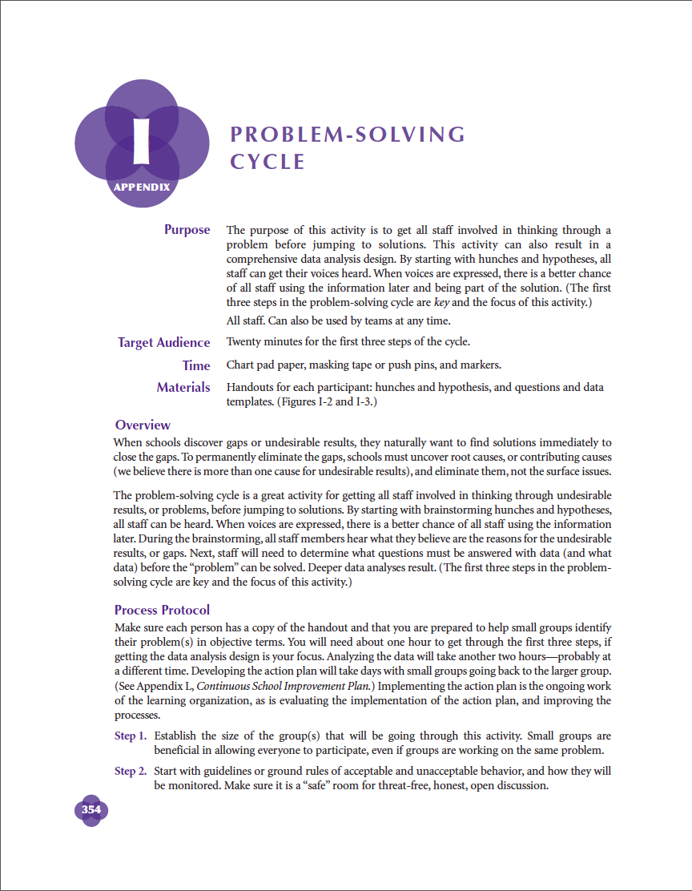
FACILITATION GUIDE
Pages 354-358

Slide 123
THE CHANGE/IMPROVEMENT
PROCESS
Closing the loop on a cycle of inquiry:
Identify the agents of improvement.
Empower with data to identify need(s).
Collaboratively prescribe change.
Support through prof learning,
leadership, partnerships.
Evaluate to make sure it is making the
intended difference.
VISION

Slide 125
Digging Deeper Into Process Measurement

Slide 126
SCHOOL PROCESSES
  Schools are perfectly designed to
  get the results they are getting now.
  If schools want different results,
  they must measure and then change
  their processes to create the
  results they really want.

Slide 127
"We cannot solve our problems with the same thinking we used when we created them."
- Albert Einstein

Slide 128
MONITORING SCHOOL
PROGRAMS AND PROCESSES
  If you are not monitoring
  and measuring program implementation, the
  program probably
  does not exist.

Slide 129
EVALUATING SCHOOL
PROGRAMS AND PROCESSES
  You cannot evaluate
  a program that you
  cannot describe.

Slide 130
MONITORING AND EVALUATING
PROGRAM IMPLEMENTATION
If you can describe what a program will look like when implemented, you can monitor its implementation, and evaluate its impact.

Slide 131
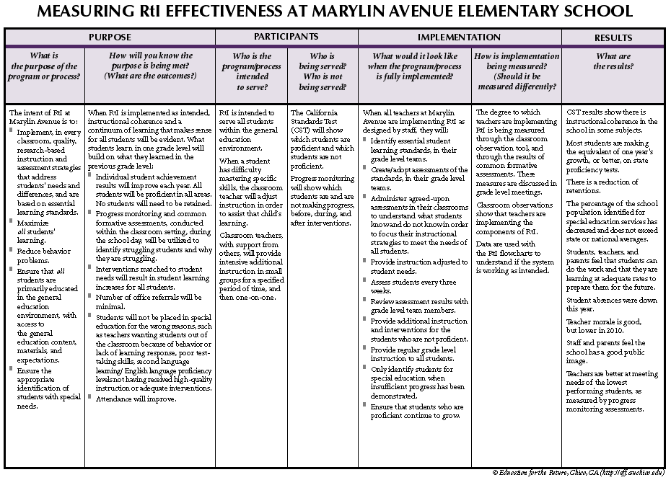
Page 256

Slide 132
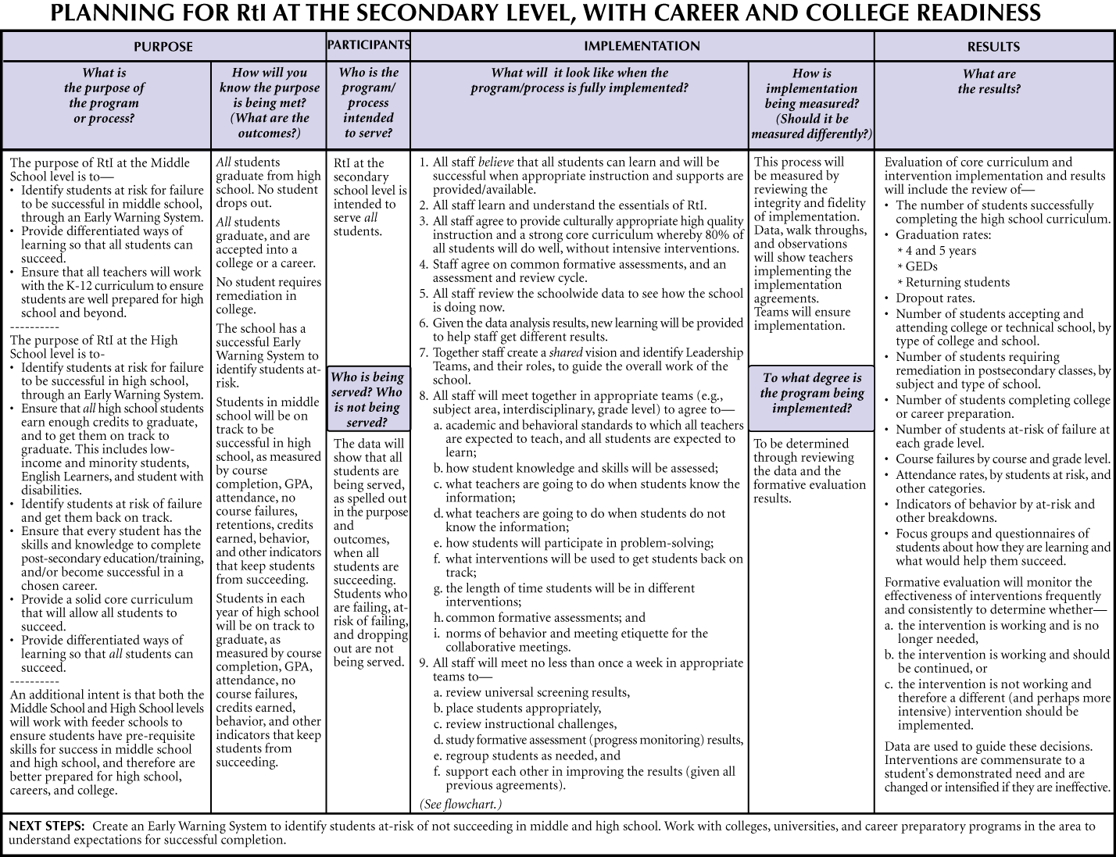
Page 257

Slide 133
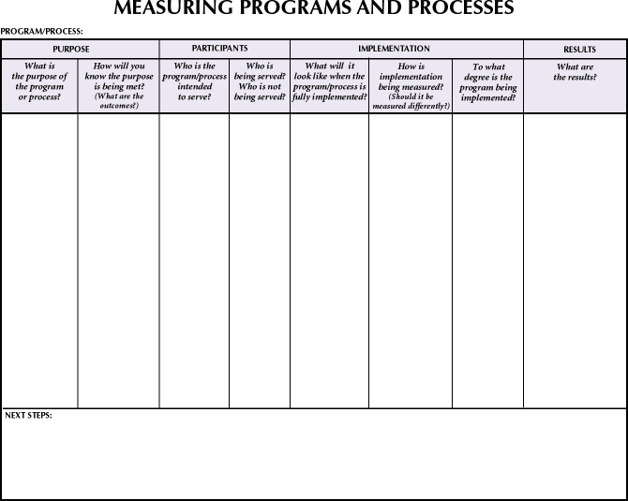
Implementing Common Core –
Pages 84-86
Early Warning System – Page 111
Using Data to Improve Teaching and Learning – Page 151
Vision – Page 160
Elementary RtI – Page 256
Secondary RtI – Page 257

Slide 134
Go through the measuring processes table for a program/process.

Slide 135
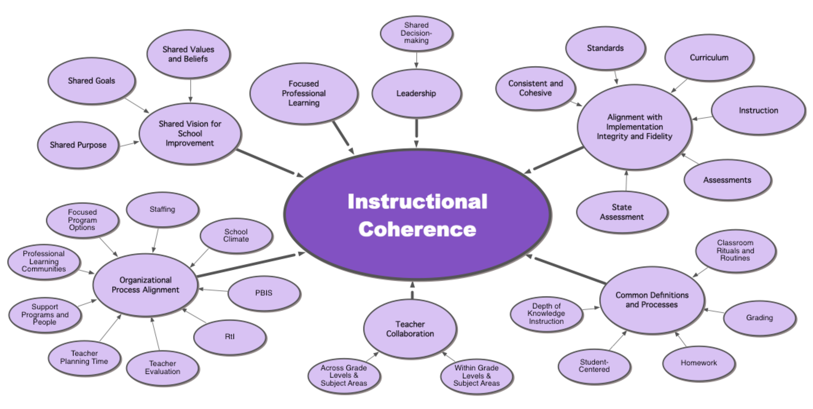

Slide 136
PROGRAMS/PROCESSES TEMPLATE
Compiling the ingredients before moving to implementation.
What do we know? What don’t we know?
What support do we need to fully implement the program/process.
Get visualization and agreement about how the different pieces fit.
Sets up informed implementation.

Slide 137

FACILITATION GUIDE
Pages
253-257

Slide 139
“The illiterate of the 21st century will not be those who cannot read and write,
but those who cannot learn, unlearn, and relearn.”
- Alvin Toffler

Slide 140
Everything
we do is a
PROCESS.

Slide 141
FLOWCHARTING SCHOOL PROCESSES
  Assess what is really being
  implemented.
  Understand how we
  get our results.
  Determine the cause of
  a problem or challenge.

Slide 142
FLOWCHARTING SCHOOL PROCESSES
  Build common understandings of a whole process.
  Communicate process related
  information visually.
  Provide a way to monitor and update processes.

Slide 143

PROCESS FLOWCHARTS
Process maps or flow charts
are composed of a relatively
standardized set of symbols.

Slide 144

DIAMONDS ARE FOR DECISIONS
Individual
student meets benchmark expectations.
Yes
No

Slide 145

RECTANGLES ARE FOR ACTION
Student does need additional assistance—staff identifies skill deficit and matches intervention.

Slide 146

Page 261

Slide 147

Page 371
MARYLIN AVENUE’S SHARED VISION FLOWCHART
Page 63

Slide 148

Pages 88-89

Slide 149

Page 262

Slide 150
FLOWCHART EXAMPLES
Prevention System – Pages 88-89
Common Core State Standards –
Page 90
Shared Vision– Page 260
High School Process– Page 261
Process of Using Data in PLCs–
Page 262

Slide 151

PROCESS FLOWCHARTS
Within your teams, please use the mapping symbols to flowchart a process on chart paper…

Slide 152
FLOWCHARTING SCHOOL PROCESSES
Empowering change.
Creating a focus on fidelity.
Considering best practice and professional
learning.
Practically applying previous learning.
Considering the role of assessment and
student learning data.
Provides foundation for effective
monitoring and measuring.
Process allowing reflection on vision
(values and beliefs).

Slide 153

FACILITATION GUIDE
Pages 258-262

Slide 155
ALL data analysis must be focused on ownership, internalization, and improvement of processes.

Slide 156
“The best way to predict your future is to create it.”
- Abraham Lincoln

Slide 157
THE CHANGE/IMPROVEMENT
PROCESS
Closing the loop on a cycle of inquiry:
Identify the agents of improvement.
Empower with data to identify need(s).
Collaboratively prescribe change.
Support through prof learning,
leadership, partnerships.
Evaluate to make sure it is making the
intended difference.
VISION

Slide 159
FOCUSED ACTS OF IMPROVEMENT
Notes:
The vision of the school which is created from what we expect students to know and be able to do, values and beliefs of the staff, and the purpose and mission of the school, must be at the center of everything that the school does. When the vision is shared and clear, everything that is planned is planned to implement the vision. Everything implemented in the school must be about the vision. Everything is evaluated in terms of how it will get the school to its vision, and everything is improved to better implement the vision.
This will lead to Focused Acts of Improvement.

Slide 160
Page 14
Notes:
160

Slide 161
Notes:
161

Slide 162
“If you don't have a strategy, you're part of someone else's strategy. ”
- Alvin Toffler

Slide 163

Mission
Vision
Continuous Improvement Cycle
Notes:
163

Slide 164
MISSION succinctly defines the fundamental purpose of an organization or an enterprise, describing why they exist.

Slide 165
VISION defines the desired or intended future state of an organization or enterprise in terms of its fundamental objectives relative to key, core areas (curr, inst, assess, environ).

Slide 166
VISION
  Curriculum—
  What we teach.
  Instruction—
  How we teach the curriculum.
  Assessment—
  How we assess learning.
  Environment—
  How each person treats every
  other person.

Slide 167
BUILDING A MISSION AND VISION
• Identify values and beliefs.
• Curr, Instr, Assessment, Environment.
Determine purpose.
Develop mission.
Develop shared vision to accomplish
mission.
Create action plan.

Slide 168

CREATING
A VISION AND MISSION
Comprehensive Data Analysis
Best Practices Learning
Notes:
168

Slide 169
Using Data to Inform Mission and Vision
A Process of Continuous
Improvement

Slide 170
Notes:
170

Slide 171


Using Staff Questionnaire Results
To Inform Mission and Vision
Response to: I work with people who
collaborate effectively.
Notes:
171

Slide 172

Study Questions—Perceptions Data
Notes:
172

Slide 173

Notes:
173

Slide 174
Vision is Putting Action to Our Values and Beliefs

Slide 175
…INTO A SHARED VISION
Value/Belief:
• We must collaborate to provide
quality instruction.
Vision:
• We will collaborate through effective
implementation of Professional
Learning Communities.

Slide 176
What DO YOU BELIEVE impacts learning for Your students?
  Curriculum—
  What we teach.
  Instruction—
  How we teach the curriculum.
  Assessment—
  How we assess learning.
  Environment—
  How each person treats every
  other person.

Slide 177

What DO YOU BELIEVE impacts
learning for Your students?
Please jot down your personal
thoughts about Curriculum, Instruction, Assessment,
and Environment.
Example: Page 364.

Slide 178
What DO YOU BELIEVE impacts
learning for Your students?
Please share your thinking with
your neighbors.

Slide 179
CORE VALUES AND BELIEFS
With staff:
Independent thinking.
Small groups on chart paper.
Merge small groups to whole group.
Result: Core Values and Beliefs.

Slide 180

Pages 364-370
EXAMPLE
SHARED VISION
The Mission of Marylin Avenue Elementary School is to enable ALL students to achieve their personal best, and to be respectful, thoughtful, and independent learners.

Slide 181
Page 215

Slide 183
Page 262

Slide 184
VISION = DESTINATION
Values and beliefs into action
Reflective of your theory of change
Must be informed by data and
research – the evidence of best
practices
• The collaboration around data to inform vision IS getting the agreements in place for change

Slide 185

FACILITATION GUIDE
Pages 359-371

Slide 187
Page 14
Notes:
187

Slide 188
Notes:
188

Slide 189
QUALITY PLANNING
“Vision without action is merely
a dream. Action without vision
just passes the time. Vision with action can change the world.”
- Joel A. Barker

Slide 190
SCHOOL IMPROVEMENT PLANS
What are the components of
an excellent continuous improvement plan?

Slide 191
HOW ARE WE GOING TO GET
TO WHERE WE WANT TO BE?
Items essential to the success of your plan:
  Bringing together implications for
  planning from demographic,
  perception, school process, and student learning data, contributing cause analyses, vision: CCSS and RtI, structures to implement the vision.

Slide 192

Page
381
Notes:
Here’s the big picture of how all of this works together –
The comprehensive data analysis is the foundation of all that follows. I recommend that you look at the kinds of data that was in Marylin Avenues Profiles and compare it to what you’ve been able to gather at this point in time. What data is missing from your current profile that needs to be on your list of next steps? Start a “To Do” list and make sure that you’ve assigned an owner to each of the To Dos!
Given what you currently have, you want to look for implications and commonalities and aggregate those with respect to leadership, curriculum, standards, your vision/plan, professional learning, leadership, partnerships, etc.
This provides a strong foundation for developing your core values, beliefs and purpose, the shared vision, mission. Your school goals – 2 or 3 at the most – should grow out of your vision.
Once you have your shared vision and school goals, you’re ready to develop your plan to implement the vision.

Slide 193

FACILITATION GUIDE
Pages 381-386

Slide 194
LEADERSHIP
“Leadership is the capacity to translate vision into reality.”
Warren G. Bennis

Slide 195
LEADERSHIP
  Assists everyone in the organization in implementing
  the vision.
  Structures in alignment with
  the vision.
  Roles and responsibilities.
  Effective meetings.
Notes:
What helps the plan get implemented?
Leadership structure – is important to the success of your plan!
Everyone needs to know that implementing the vision is key
Uses data
Keeps standards mastery at the forefront
Roles & Responsibilities
Shared leadership - Needs to be able to run without the principal!
Create meeting agendas that are focused on the team responsibilities
Defined roles that keep meetings on track and effective

Slide 196

EXAMPLE: SOMEWHERE ELEMENTARY SCHOOL LEADERSHIP STRUCTURE
Page 138-139

Slide 197

FACILITATION GUIDE
Pages 388-391

Slide 198
PROFESSIONAL LEARNING
“It’s easy to get the players. Getting ‘em to play together, that’s the hard part.”
Casey Stengel

Slide 199
PROFESSIONAL LEARNING
  Includes everyone on the staff.
  How to implement the vision.
  Imbedded into the workweek.

Slide 200

Pages 141-142
EXAMPLE: SOMEWHERE ELEMENTARY SCHOOL
PROFESSIONAL LEARNING CALENDAR

Slide 201

FACILITATION GUIDE
Pages 392-393

Slide 202
PARTNERSHIP DEVELOPMENT
“The key to effective partnerships—Both parties must contribute and both parties must benefit.”
Jere Jacobs

Slide 203
PARTNERSHIP DEVELOPMENT
  Start with what we expect
  students to know and be able
  to do.
  Collaborate with:
    Parent
    Community
    Businesses
Notes:
Look at establishing partnerships on that build what we expect students to know and be able to do and brainstorm who your best partners might be to help accelerate your progress
What resources available among your parents, your community, your local businesses and institutions of higher education?
Lots of opportunities here to enhance the implementation of the vision:
College & Career Readiness – how might you engage your local colleges/universities in these conversations? National Student Clearing house data –
One of our elementary schools has a partnership with a local community agency to support increased parent attendance at workshops on how improve student learning on their interim assessments
Full circle to beginning of this presentation – I was one of those community resources that got tapped for SJUSD to help implement a continuous improvement framework!

Slide 204

What partners does your school have?
How do both contribute?
How do both benefit?

Slide 205

FACILITATION GUIDE
Pages 394-395

Slide 206

Pages 130-132

Slide 208
Bernhardt, V.L. (2013).
Data Analysis for
Continuous School
Improvement. Third Edition.
New York, NY: Routledge.
Page 14. Reproducible.
Notes:
208

Slide 209
Notes:
209

Slide 210
“However beautiful the strategy, you should occasionally
look at the results.”
Winston Churchill
Former British Prime Minister
As quoted at INSEAD Knowledge

Slide 211
CONTINUOUS IMPROVEMENT
AND EVALUATION
“Continuous improvement
causes us to think about
upstream process improvement; not downstream
damage control.”
Teams & Tools

Slide 212
CONTINUOUS IMPROVEMENT
AND EVALUATION
  Evaluate all parts of
  the system.
  Align elements to vision.
  Systems thinking.
  Next steps.

Slide 213
Page 257

Slide 214
Page 262

Slide 215
Evaluating Systems-Level
Processes Using the
Continuous Improvement
Continuums

Slide 216
“You’ve got to think about big things while you’re doing small things, so that all the small things go in the right direction.”
- Alvin Toffler

Slide 217

Page 198

Slide 218

CONTINUOUS IMPROVEMENT CONTINUUM CATEGORIES
Information and Analysis
Student Achievement
Quality Planning
Leadership
Professional Learning
Partnership Development
Continuous Improvement
and Evaluation

Slide 219
CIC’S
Systems-level processes – and if ‘all work is a process’ then also an assessment of implementation of the framework.

Slide 220
Bernhardt, V.L. (2013).
Data Analysis for
Continuous School
Improvement. Third Edition.
New York, NY: Routledge.
Page 14. Reproducible.
Notes:
220

Slide 221



INFORMATION AND ANALYSIS
School Continuums ~ Pages 198-204
Fall
Spring

Slide 222
Page 198

Slide 223

Page 199

Slide 224

Page 200

Slide 225

Page 201

Slide 226

Page 202

Slide 227

Page 203

Slide 228

Page 204

Slide 229
IMPORTANT NOTES
Who facilitates?
Working through all CICs in one session.
Following through to consideration of next steps.
Aggregating implications.

Slide 230
Page 342
What We Saw in the Data: AGGREGATED IMPLICATIONS
Notes:
Big Picture

Slide 231
CICs
Systems level process measurement.
Considering what is possible.
Staff consensus on next steps!
Aligning with sites.
Different types of CICs available.

Slide 232

FACILITATION GUIDE
Pages 193-197

Slide 233



Slide 235
MAKING TIME FOR
SCHOOL IMPROVEMENT

Slide 236
Notes:
236

Slide 237
IMPORTANT NOTES
It describes the work that schools do, linking the essential elements
It is a process of evidence, engagement, and artifacts

Slide 238
A PROCESS OF EVIDENCE, ENGAGEMENT, AND ARTIFACTS
Evidence:
Data to inform and drive a logical progression of next steps.
Engagement:
Bringing staff together to inform improvement through the use of data, moving from personality driven to systemic and systematic.
Artifacts:
The documentation of your improvement efforts.

Slide 239

Pages 170-181
Notes:
239

Slide 240
MAKING TIME FOR
SCHOOL IMPROVEMENT
Knowledge/Information (Why?)
CIPlanning Framework/Process
Data
Organizational Structures
Time

Slide 241
Knowledge/Information: Why?
Notes:
241

Slide 242
Framework/Process
Notes:
242

Slide 243
Data
Notes:
243

Slide 244
Organizational Structures
Notes:
244

Slide 245
Time
Notes:
245

Slide 246

Determine how and when you will
do the work of continuous school improvement with your school.
Read through the sample timeline.
Pages 170-181
How can this be a resource for your work with schools? Discuss with your table group.

Slide 247
BENEFITS OF TIMELINE
Ease ‘what now?’ anxiety, determine appropriate scope and sequence.
Align with available resources, structures – similarly, show need.
Consider compliance/accountability deadlines.
Highlight areas for support!!!!!!

Slide 248

FACILITATION GUIDE
Pages 405-415

Slide 250
Notes:
250

Slide 251
RANDOM ACTS OF IMPROVEMENT
Notes:
Data analysis is only one piece of the puzzle in continuous school improvement.
Without one critical piece of information, a target, our results might resemble “Random Acts of Improvement.”

Slide 252
Notes:
252

Slide 253
FOCUSED ACTS OF IMPROVEMENT
Notes:
The vision of the school which is created from what we expect students to know and be able to do, values and beliefs of the staff, and the purpose and mission of the school, must be at the center of everything that the school does. When the vision is shared and clear, everything that is planned is planned to implement the vision. Everything implemented in the school must be about the vision. Everything is evaluated in terms of how it will get the school to its vision, and everything is improved to better implement the vision.
This will lead to Focused Acts of Improvement.

Slide 254
THE CHANGE/IMPROVEMENT
PROCESS
Identify the change agents.
Empower with data to identify need(s).
Collaboratively prescribe change.
Support through prof learning,
leadership, partnerships.
Evaluate to make sure it is making the
intended difference.
VISION

Slide 256

THANK YOU!
Bradley J. Geise
bgeise@csuchico.edu
http://eff.csuchico.edu

