Slide 1
Fidelity of Strategy Implementation (FSI) Tool
Overview, Scoring, and Reporting
Webinar
02.24.16
Updated: 6.10.17

Slide 2
Purposes
To inform the implementation evaluation of the Nebraska MEP as required by the U.S. Department of Education, Office of Migrant Education.
To measure the level of implementation of each Strategy to determine the extent to which MEP services are delivered with fidelity.
To serve as a self-assessment guide to local MEPs in implementing migrant-funded services in the 3 Goal Areas: 1) School Readiness, 2) Reading/Writing and Mathematics, and 3) High School Graduation and Services to Secondary-Aged Youth.

Slide 3
Directions for Completing the FSI
Convene a group of key MEP staff, discuss each Strategy, and come to consensus on each of the ratings.
Place a checkmark in the box that best reflects your project’s level of implementation of each of the Strategies in the 3 Goal Areas.
If a particular Strategy is not applicable, check the “Not Aware/Applicable” box.

Slide 4
Goal area 1: School Readiness
Strategies

Slide 5
School Readiness Strategies 2016-17
1-1 Provide high-quality supplemental educational services (e.g., preschool programs, in-home preschool services, extended preschool programs) to 3-5 year old migrant children in order to increase their development of school readiness skills.
1-2 Implement a statewide MEP pre/post preschool assessment tool for migrant children participating in short-term or non-school-based, MEP-funded school readiness supplemental instructional services.

Slide 6
School Readiness Strategies, Cont.
1-3 Implement needs-based educational services to migrant parents/families in their home language (e.g., progress monitoring home visits, family literacy programs, parent education, at-home educational programs, video-conferencing/online meetings) to enhance their capacity to support their child’s development of school readiness skills.
1-4 NDE and local projects support all school/MEP staff by providing professional learning opportunities (face-to-face and online) aligned with the State SDP to enhance their knowledge of evidence-based strategies, promising practices, and culturally relevant instruction to improve the school readiness skills of migrant preschool children.

Slide 7
School Readiness Strategies, Cont.
1-5 Coordinate with service providers or provide migrant preschool children with appropriate, needs-based support services (e.g., health and nutrition, educational supplies, translations/interpretations, transportation, mobile hotspots) to eliminate barriers to participation/success in preschool services.

Slide 8
Goal area 2: Reading/writing and mathematics
Strategies

Slide 9
Reading/Writing and Math Strategies 2016-17
2-1 Provide migrant students with high-quality supplemental instructional services (e.g., extended day programs, summer or intersession programs, in-home instruction, online/technology-based programs, individualized learning programs, instructional supports during the school day, intervention support services) to increase their reading/writing and math achievement.
2-2 Implement needs-based educational services to migrant parents/families in their home language (e.g., progress monitoring home visits, family literacy programs, parent education, at-home educational programs, videoconferencing/online meetings) to enhance their capacity to support their child’s success in reading/writing and math.

Slide 10
Reading/Writing and Math Strategies, Cont.
2-3 NDE and local projects support all school/MEP staff by providing professional learning opportunities (face-to-face and online) aligned with the State SDP to enhance their knowledge of evidence-based strategies, promising practices, and culturally relevant instruction to increase migrant student achievement in reading/writing and math.
2-4 Coordinate with service providers or provide migrant children with appropriate needs-based support services (e.g., health and nutrition; educational supplies, interpretation, transportation, access to technology) to eliminate barriers to participation/success in school.

Slide 11
Goal area 3: HS graduation and services to secondary-aged youth
Strategies

Slide 12
HS Graduation and Services to Secondary-Aged Youth Strategies 2016-17
3-1 Provide secondary migrant students and OSY with high-quality supplemental instructional services (e.g., high school credit accrual, ESL instruction, GED classes, extended learning programs, online educational services) to support their achievement of graduation, GED, and/or career readiness goals.
3-2 Implement needs-based educational services to migrant parents/families in their home language (e.g., progress monitoring home visits, family literacy programs, parent education, at-home educational programs, college/career ready programs, videoconferencing/online meetings) to enhance their capacity to support their child in his/her achievement of graduation, GED, life skills, and/or career readiness goals.

Slide 13
HS Graduation and Services to Secondary-Aged Youth Strategies
3-3 : NDE and local projects support all school/MEP staff by providing professional learning opportunities (face-to-face and online) aligned with the State SDP to enhance their knowledge of evidence-based strategies, promising practices, and culturally relevant instruction to increase secondary migrant youth/OSY achievement of graduation, GED, life skills, and/or career readiness goals.
3-4 Coordinate with service providers or provide secondary migrant youth and OSY with appropriate needs-based support services (e.g., health and nutrition; career counseling, life skill lessons, youth leadership programs, interpretation, transportation, regional migrant youth advocates, career interest surveys, industry and college visits, access to technology, learning/graduation plans) to eliminate barriers to accomplishing graduation, GED, life skills, and/or career readiness goals.

Slide 14
Directions for Completing the FSI, Cont.
For each Strategy, rate your migrant education project’s level of implementation during 2016-17.
Gather a group of key staff to discuss each Strategy including ratings and evidence. After reaching consensus, place a checkmark in the rating assigned (or put a checkmark next to “Not Applicable” if the strategy was not selected in your SDP)
Highlight in yellow the evidence that is relevant to your project, and cite additional evidence to support the rating. Please note that projects are only asked to have on file examples of evidence listed under each Strategy. It is not required for projects to have copies of all documentation on all students, parents, events, communication/collaboration, enrollment/participation, etc.
Submit the completed FSI to Sue Henry by August 31, 2017.

Slide 15
FSI Ratings
Ratings are based on a 5-point rubric:
1 = Not Aware or Not Applicable
2 = Aware
3 = Developing
4 = Succeeding (considered “proficient”)
5 = Exceeding

Slide 16
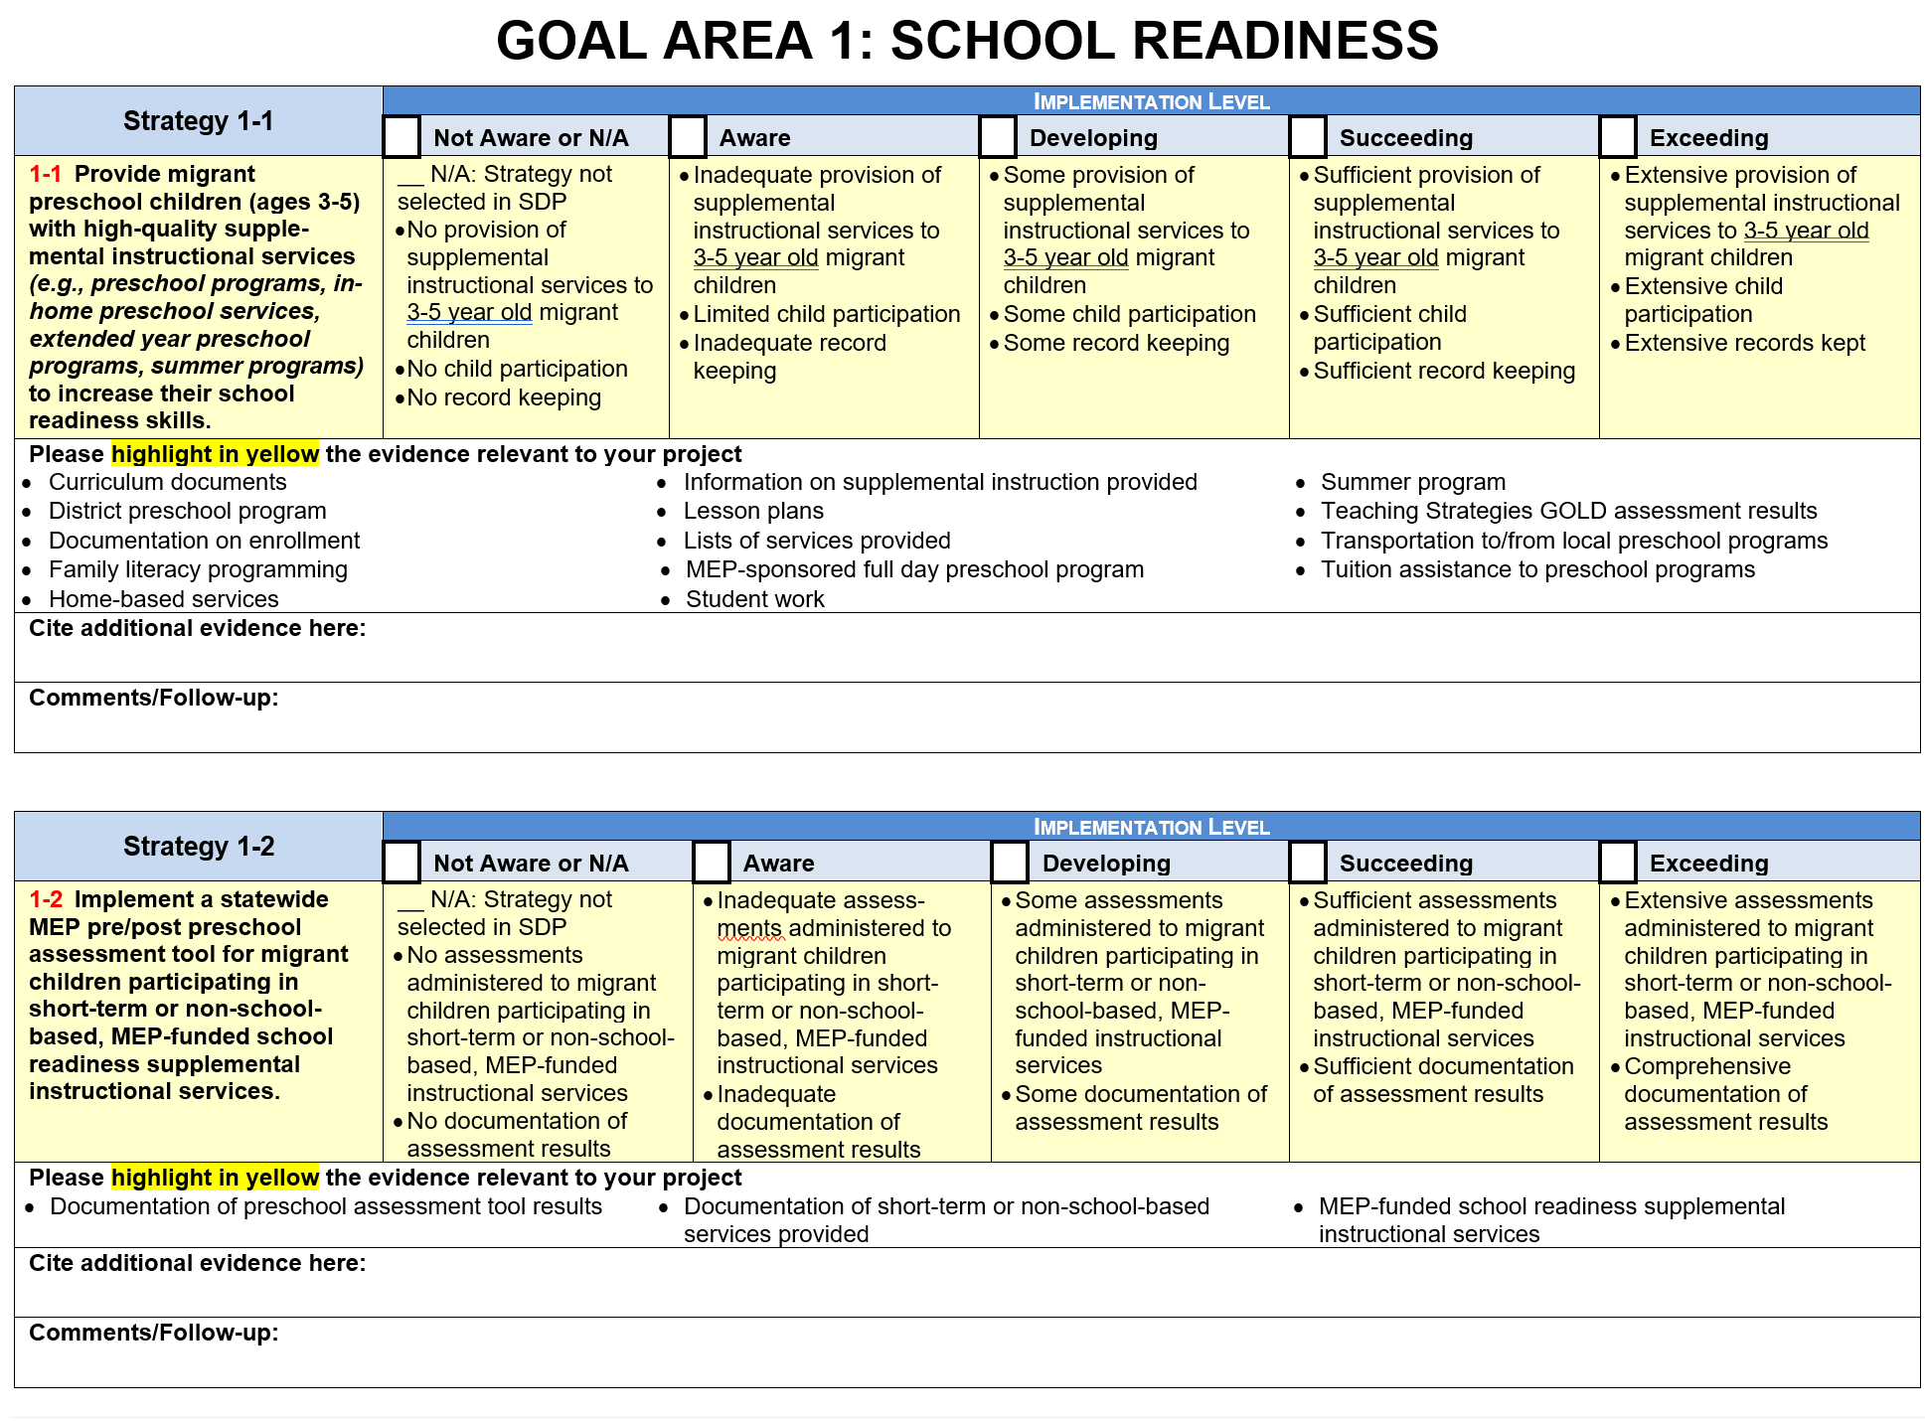

Slide 17
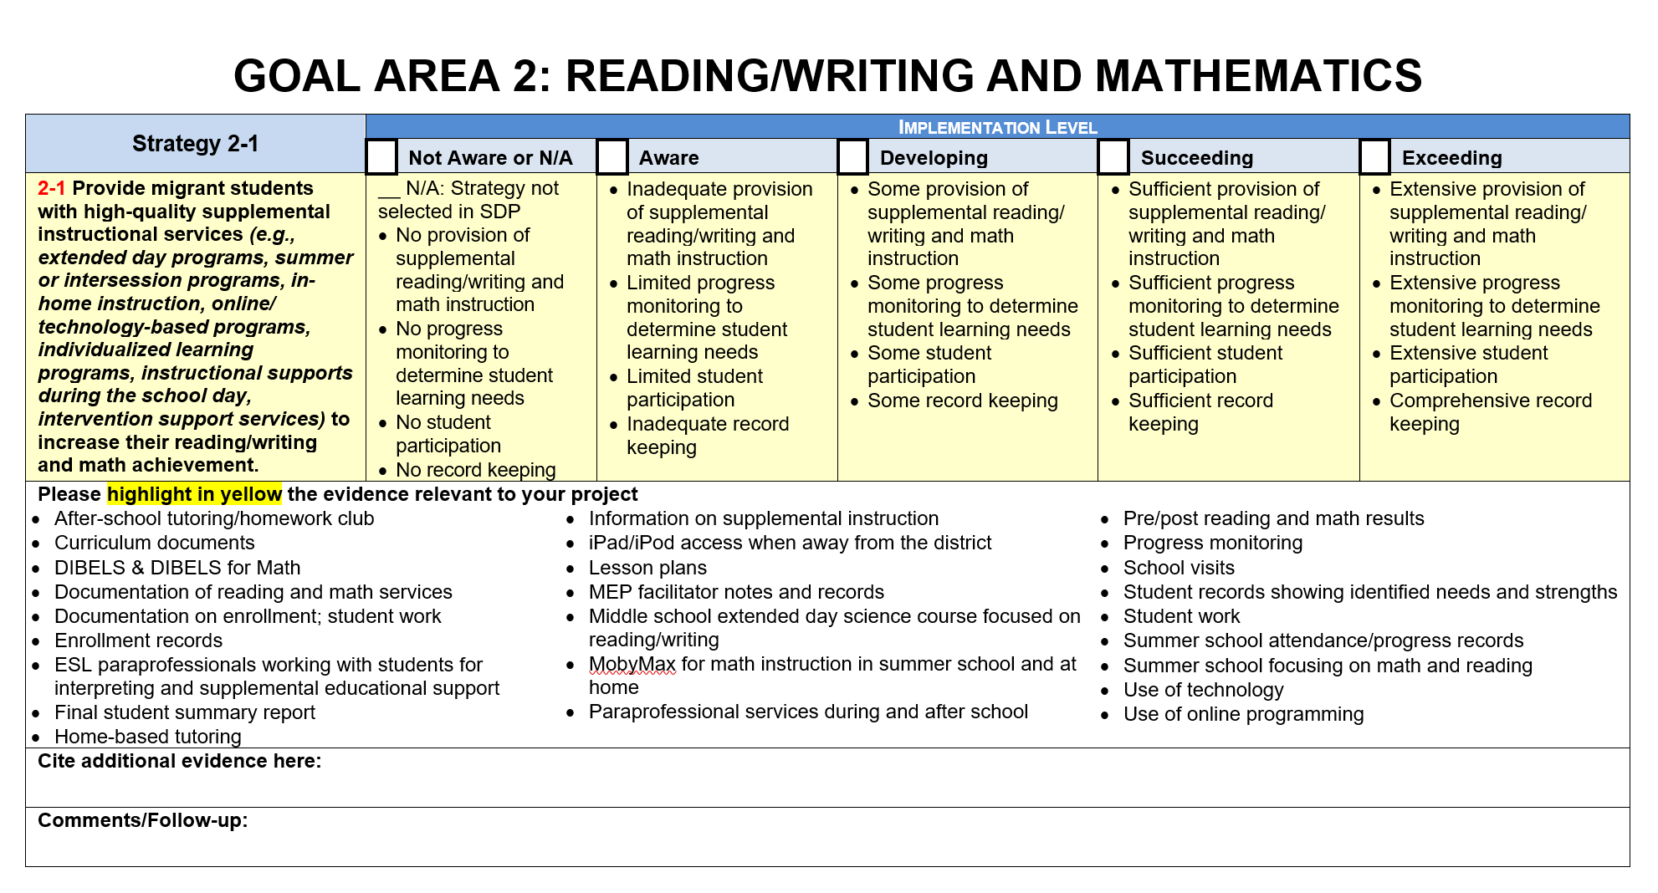
FSI Practice

Slide 18
Questions?
Sue Henry
Sue.henry@nebraska.gov
Cari Semivan
External Evaluator
capan1@aol.com

